Slide 1

Intro
EH&S: Environmental Health & Safety
  Mission Statement: Provide expertise to strengthen the culture of safety and responsibility across the campus community.
  Chemical/Bio/Radiation Safety, fume hood testing,Hazardous Waste Pickups, PPE fittings, etc
  Need help with something safety? Call us!
Patrick Monnig
  Chemical Hygiene Officer/Lab Safety Supervisor
  Charged with helping the campus work safely with chemicals

Slide 2
Today’s Topics
Chemical Storage and Segregation
Spill Response

Slide 3
Stop the Spill before it happens
Best lab practices help stop or mitigate the spill before it occurs
  Keep chemicals segregated by hazard
  Regularly dispose of chemicals that are no longer needed
  Maintain your inventory in UC Chemicals
  Do not order more chemicals than is reasonably needed
  Use secondary containment for hazardous materials
  Minimize the scale of experiments when possible
  General lab awareness of what is stored in the lab for all workers

Slide 4
Safe Chemical Storage Priorities
Flammability
Number one storage priority
Should be in a flammable cabinet
Isolate
If it will contribute to a fire, isolate it
Oxidizers, combustibles
Corrosivity
Acids/Bases
Some acids need separate storage
Toxicity
Prevent Release
Controlled Substances – separate storage
The basic flow of consideration when setting up chemical storage
Not all chemicals will fit neatly into a category
  Use guides such as the Chemical Segregation Chart for general storage setup
  Consult SDS (Sections 7 & 10) for specific storage requirements and incompatibilities
Notes:
Flammability. When establishing a storage scheme, the number one consideration should be the flammability characteristics of the material. If the material is flammable, it should be stored in a flammable cabinet.
Isolate. If the material will contribute significantly to a fire (e.g., oxidizers), it should be isolated from the flammables. If there were a fire in the laboratory and response to the fire with water would exaggerate the situation, isolate the water reactive material away from contact with water.
Corrosivity. Next look at the corrosivity of the material, and store accordingly.
Toxicity. Finally, consider the toxicity of the material, with particular attention paid to regulated materials. In some cases, this may mean that certain chemicals will be isolated within a storage area. For example, a material that is an extreme poison but is also flammable, should be locked away in the flammable storage cabinet to protect it against accidental release.

Slide 5


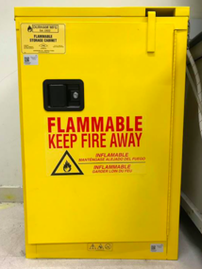

Flammable and Combustible Liquids
      Flammables should be stored in a flammable cabinet
        Flammable Cabinet requirements:
          "FLAMMABLE — KEEP FIRE AWAY" label
          Doors self closing and self latching
      No more than 60 gallons of flammables in a room
        Only amount needed for experiment should be in the work area
        No more than 10 gallons outside of a flammable cabinet
Handle flammable and combustible substances only in areas free of ignition sources
Use the chemical in a fume hood whenever practical
Notes:
Fusible link: melts at 74C to automatically close the door and protect contents

Slide 6

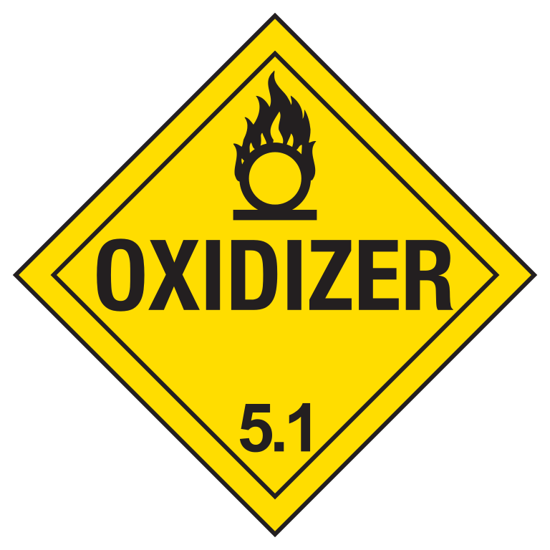
Oxidizers
Store away from flammable and combustible material
Oxidizing gases should be 20 feet away from any flammable gases
How does oxidizer accelerate a fire:
  Supplies oxygen – 1 part of fire tetrahedron
  Intensify combustion
  Widen the flammable range of flammable gases and liquids
  Lower the flashpoints and ignition temperatures of combustible materials so these materials ignite more readily

Slide 7

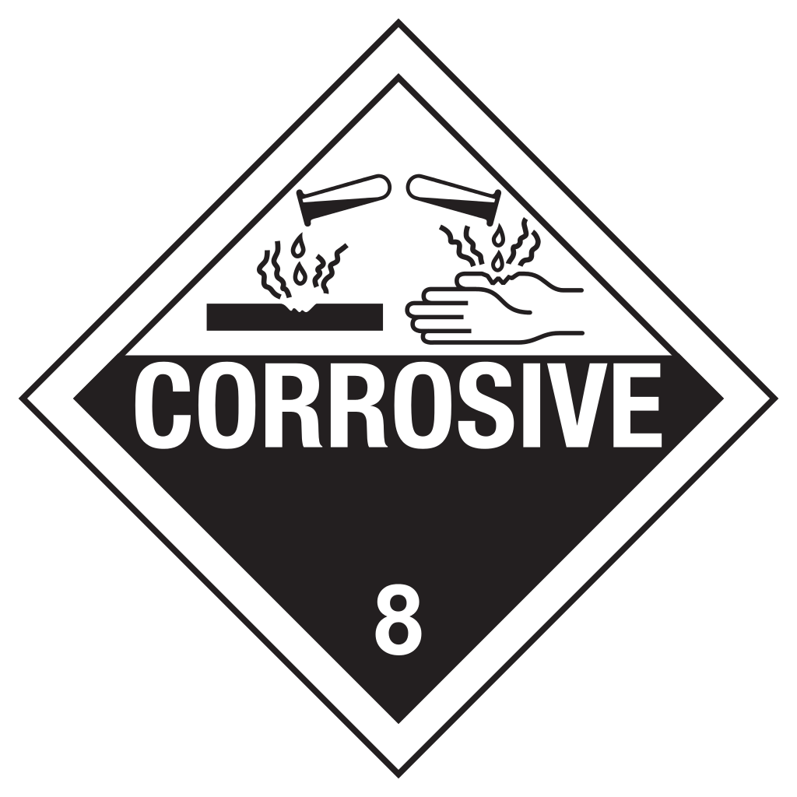
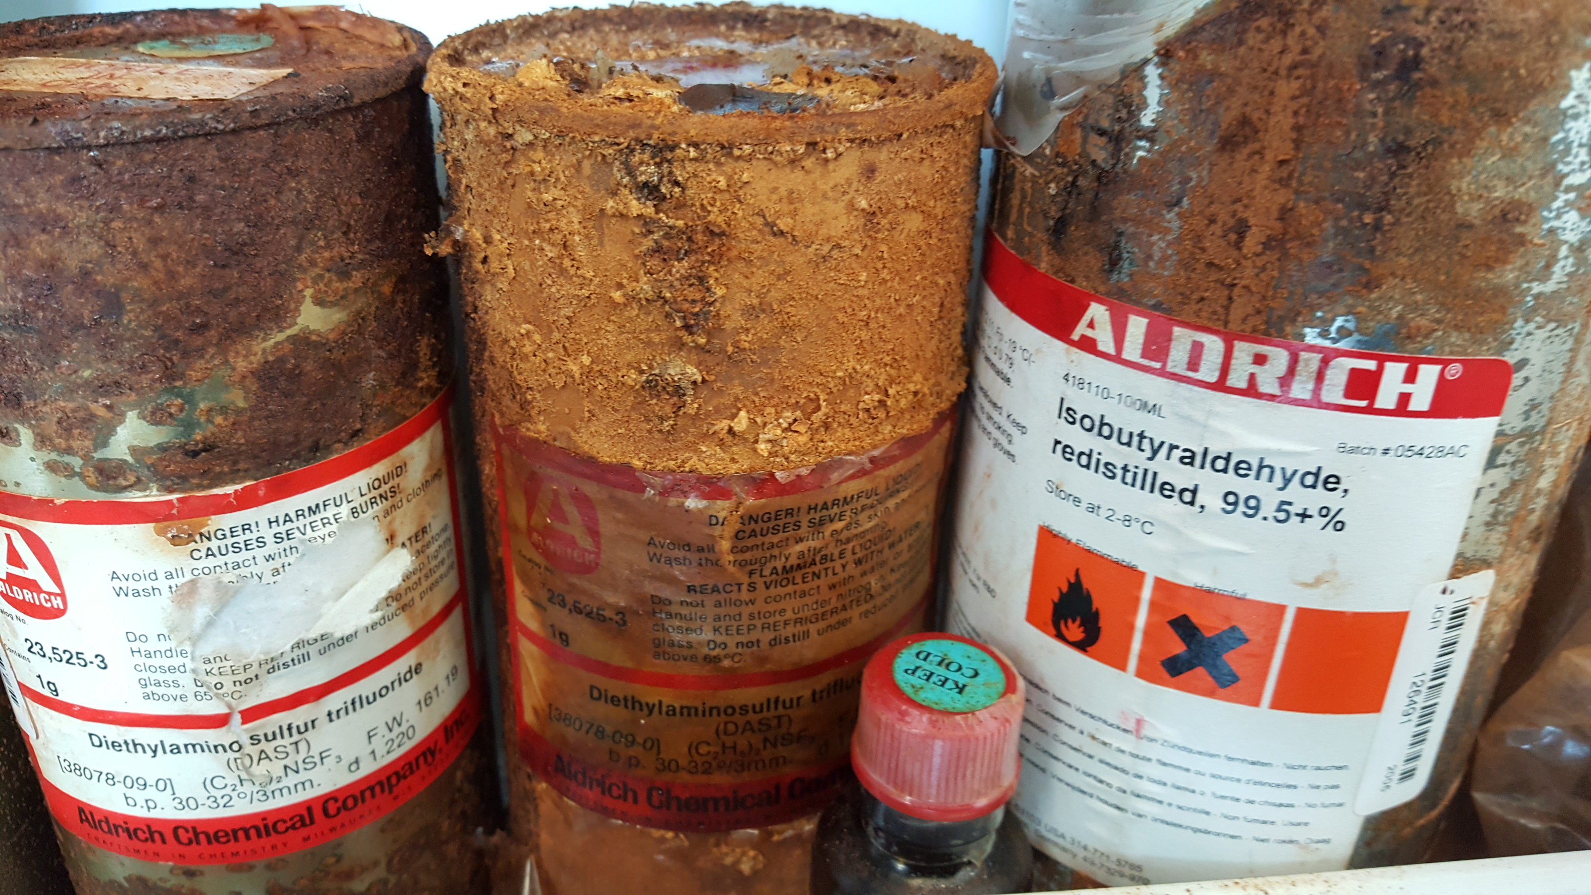
Corrosives
Irreversible damage to skin or metals
  Commonly: pH <2 or >11.5
Storage requirements:
  Store in secondary containment
  Storage should be compatible
    Plastic or powder coated metal
General segregation
  Store bases away from acids
  Store different acid types apart
    Mineral acids
    Organic Acids
    Oxidizing acids
      Nitric Acid and Perchloric acid separated from everything
    Picric acid – explosive when dry, must contain water
Notes:
Several different GHS definitions of corrosivity, not just pH:
-Human experience showing irreversible damage to the skin;
-Structure/activity or structure property relationship to a substance or mixture already classified as corrosive;
-pH extremes of <=2 and >=11.5 including acid/alkali reserve capacity;
-Positive results in a valid and accepted in vitro skin corrosion test; or
-Animal experience or test data that indicate that the substance/mixture causes irreversible damage to the skin following exposure of up to 4 hours.
Why different acid types apart?
-Mineral acids require a corrosive proof cabinet, and react with organic material
-Organic acids can be flammable (glacial acetic) and since they are not fully soluble in water, are often in flammable solvents
-Oxidizing acids would accelerate a fire
-Perchloric acid – strong oxidizer when heated

Slide 8



Toxic Chemicals
Should be stored securely
Storage locations should be clearly labeled to prevent accidental exposure
Store away from flammables and corrosives
  Could damage containers, leading to an exposure
Poisons
Skin/Eye Irritants Acute Toxicity Narcotic Effects Respiratory Tract Irritants
Carcinogens Mutagens Respiratory Sensitizers Target Organ Toxicity Aspiration Toxicity

Slide 9
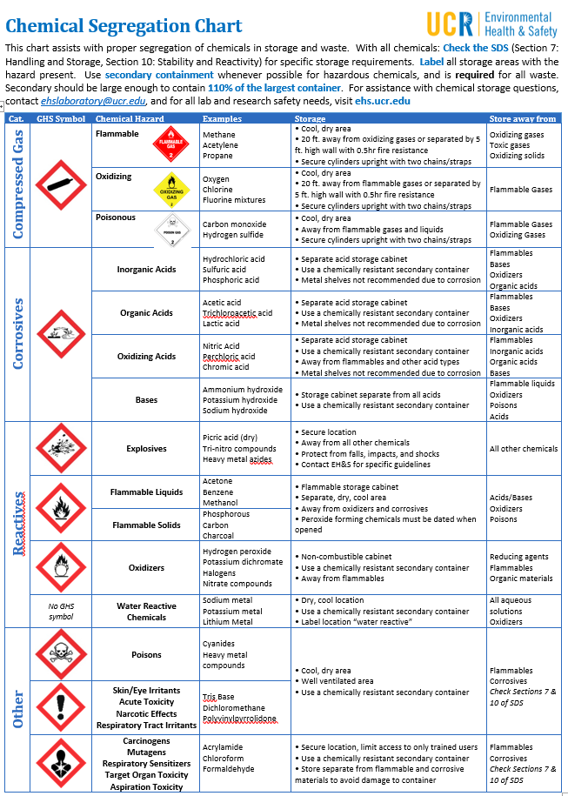
Chemical Segregation guide
Gives the basic storage considerations for most lab chemicals

Slide 10
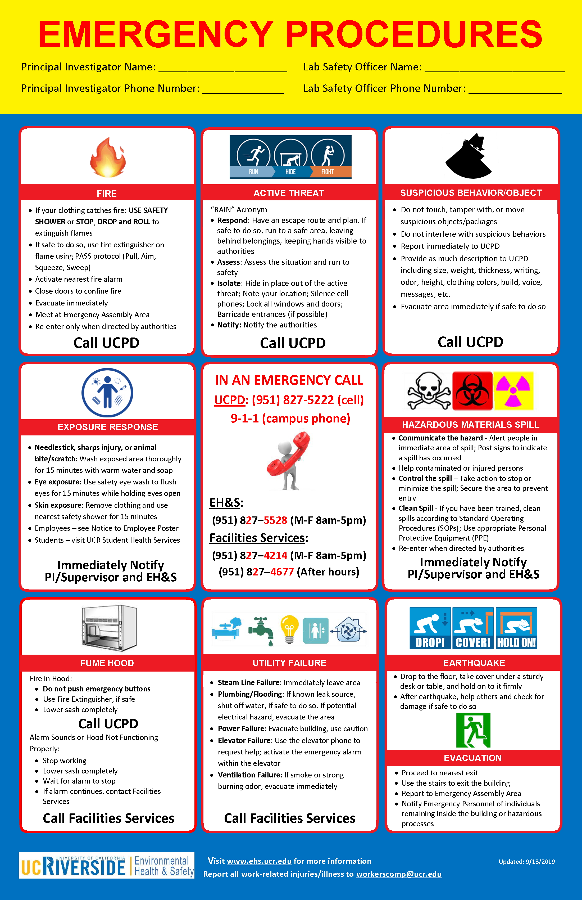
Your Guide to Emergency Response
Emergency Procedures poster should be in every research space
  If not - let us know and we can bring one
Gives the basics of how to handle most emergencies

Slide 11
Hazardous materials Spill
Response will depend on the type of spill, your comfort level, and training on spill clean up
  One gallon of water is less of an emergency than one gallon of hydrofluoric acid
Notify others around you and ensure no one enters the area
Control the spill
  Use spill kit to contain the spilled material
  Goal is to prevent spread and exposure
Clean the spill
  Only if properly trained
  If you can clean safely without exposure
  If you have the right spill clean up materials
If you need assistance with a spill between 8-4:30, call EH&S at 951-827-5528
If after hours, or spill is too large to be contained, call UCPD

Slide 12
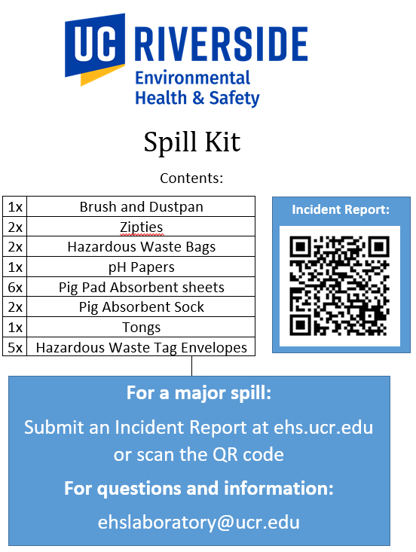
Spill Kit
Includes everything you need to contain a small spill of known contents
  For liquid spills – absorbent sheets, absorbent socks
  For solid spills – brush and dustpan
  Tongs help keep your gloved hands away from contaminated material
After spill is contained, the area needs to be decontaminated
  Will depend on the type of material spilled
  pH paper helps to make sure acid or base spills are neutralized
Bags, zip ties, and waste tag envelopes are to secure and tag out any waste material for pickup

Slide 13
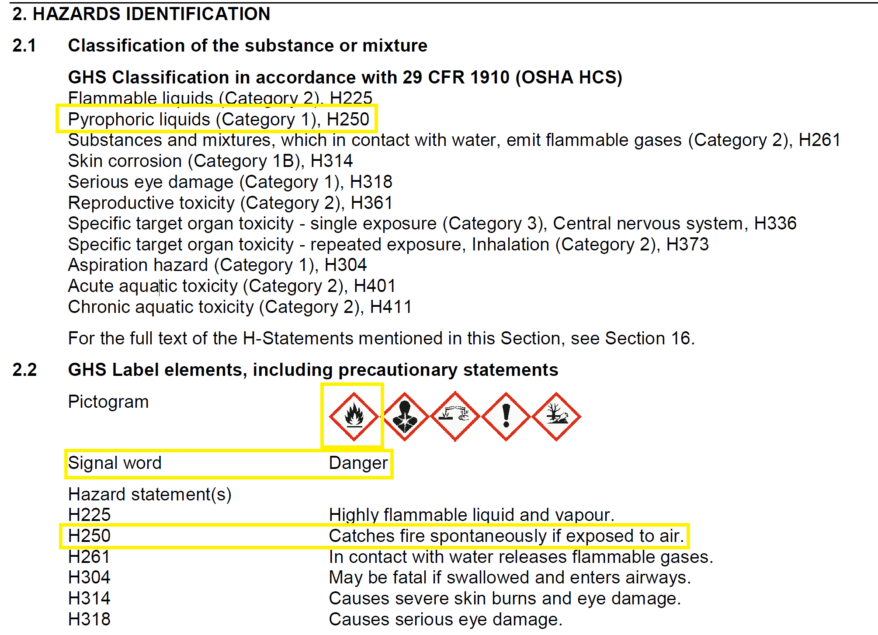
Using an SDS to respond to an emergency
Section 2: Hazards Identification
Includes:
  GHS classifications
  Pictograms
  Signal Words
  Hazard Statements (H-codes)
    H200-H299 – Physical Hazards
    H300-399 – Health Hazards
    H400-499 – Environmental Hazards
  Precautionary Statements (P-statements)
    P100-P199 – General Precautions
    P200-P299 – Prevention Precautions
    P300-P399 – Response Precautions
    P400-P499 – Storage Precautions
    P500-P599 – Disposal Precautions
    Example: “P223 - Keep away from any possible contact with water, because of violent reaction and possible flash fire.”
Notes:
Section 2: butyllithium

Slide 14
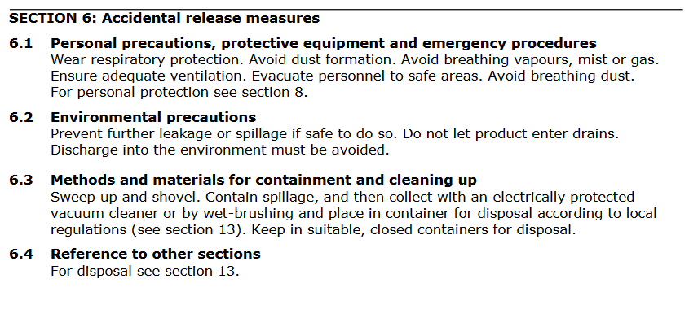
Using an SDS to respond to an emergency
Section 6: Accidental Release Measures
Includes:
  Personal precautions, protective equipment and emergency procedures
  Environmental precautions
  Methods and materials for containment and cleaning up
Notes:
Section 6 – Thallium (I) nitrate

Slide 15
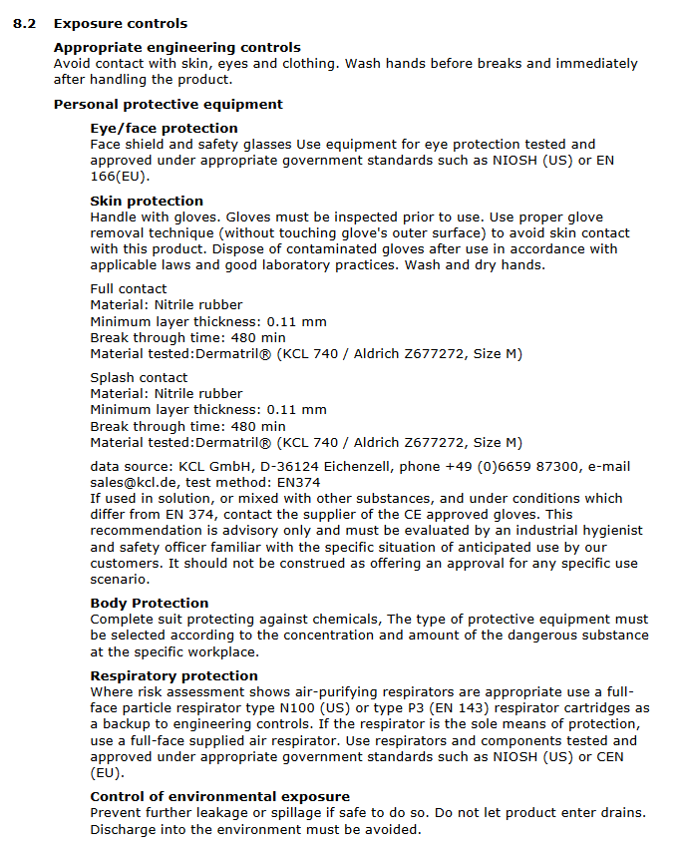
Using an SDS to respond to an emergency
Section 8.2: Exposure Controls
Includes:
  Appropriate engineering controls
  Personal Protective Equipment
    Glove recommendations if available
  Control of Environmental Exposure
Notes:
Section 6 – Thallium (I) nitrate

Slide 16
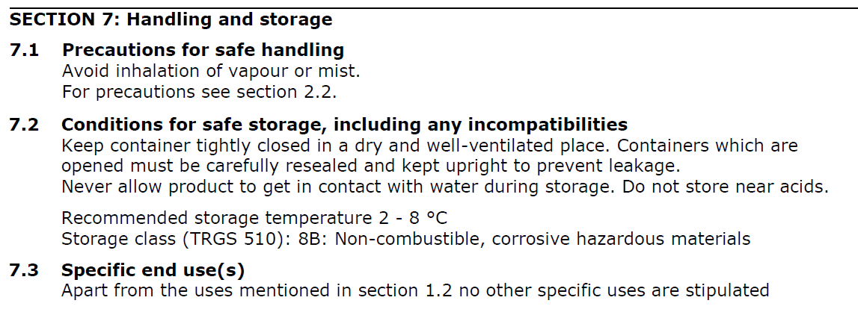
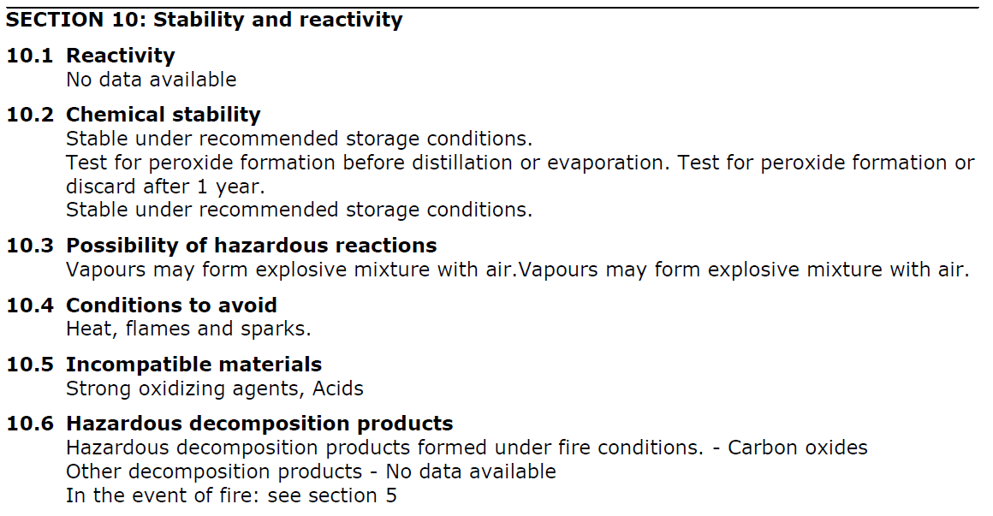
Using an SDS to respond to an emergency
Section 7: Handling and Storage
Includes:
  Precautions for safe handling
  Conditions for safe storage
    Including any incompatibilities
Section 10: Stability and Reactivity
Includes:
  Reactivity
  Chemical stability
  Possibility of hazardous reaction
  Conditions to avoid
  Incompatible materials
  Hazardous decomposition products
Notes:
Section 7 – 10-15% sodium hypochlorite (household bleach is 3-8%)
Note storage temp recommendation 2-8C, not expected based on household bleach usage
Section 10 – THF tetrahydrofuran

Slide 17
Conclusions
Having your chemical hazards appropriately segregated will help to mitigate the dangers of spills or releases
Use the Emergency Procedures poster to guide response
If you need help or are unsure of how to clean up a spill
  Notify those around you and evacuate the area
  Notify your PI and EH&S

Slide 18
UCR RESOURCES
EH&S Website - https://ehs.ucr.edu/
Chemical Hygiene Plan - https://ehs.ucr.edu/laboratory/chemical-hygiene-plan
  Section 6: Chemical Inventory, Labeling, Storage and Transportation
UCR Chemical Segregation Guidance Sheet
UC Lab Safety Design Manual: https://lsdm.ucop.edu/
Any specific or unique questions? ehslaboratory@ucr.edu

Slide 19


