Slide 1
Bias in Student Evaluations of Teaching
Are they measuring what we think they’re measuring?
UCR Women’s Faculty Association
2020

Slide 2
Why aren’t women being promoted at UCR?
38% women (median at UC 42-43%) – we’re the lowest in U.C.
Full: 24%
Distinguished: 14%
One reason is that our evaluations are biased and we believe low or uneven SET are disproportionately used against women faculty and faculty of color in merit review

Slide 3
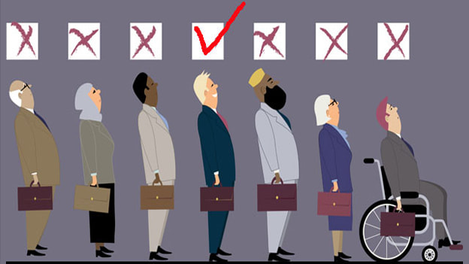
Conclusions from the UC Centers of Teaching and Learning (2019)
“The widely-documented bias in student evaluations of teaching makes them unreliable as the primary form of evidence of teaching efficacy.”
This Photo by Unknown Author is licensed under CC BY-SA-NC

Slide 4
Decades of research have identified bias in SETs:
The widely-documented bias in student evaluations of teaching
Racial bias
Gender bias
This Photo by Unknown Author is licensed under CC BY-SA-NC

Slide 5
Decades of research have Identified bias in SETs:
Adams, C.L. (2012). Online measures of student evaluations of instruction. In M. E. Kite (Ed.), Effective evaluation of teaching: A guide for faculty and administrators. Retrieved from the Society for the Teaching of Psychology web site: http://teachpsych.org/ebooks/evals2012/index.php
Anderson, K. J., & Smith, G. (2005). Students’ preconceptions of professors: Benefits and barriers according to ethnicity and gender. Hispanic Journal of Behavioral Sciences, 27(2), 184-201.
Ballantyne, C. (2003). Online evaluations of teaching: An examination of current practice and considerations for the future. New directions for teaching and learning, 2003(96), 103-112.
Basow, S., Codos, S., & Martin, J. (2013). The effects of professors' race and gender on student evaluations and performance. College Student Journal, 47(2), 352-363.
Bavishi, A., Madera, J. M., & Hebl, M. R. (2010). The effect of professor ethnicity and gender on student evaluations: Judged before met. Journal of Diversity in Higher Education, 3(4), 245.
Benton, S. L., & Ryalls, K. R. (2016). Challenging Misconceptions about Student Ratings of Instruction. IDEA Paper# 58. IDEA Center, Inc.
Becker, W. E., Bosshardt, W., & Watts, M. (2012). How departments of economics evaluate teaching. The Journal of Economic Education, 43(3), 325-333.
Berk, R. A. (2012). Top 20 strategies to increase the online response rates of student rating scales. International Journal of Technology in Teaching and Learning, 8(2), 98-107.
Bernstein, D. J., Jonson, J., & Smith, K. (2000). An examination of the implementation of peer review of teaching. New Directions for Teaching and Learning, 83. 73-86.
Braskamp, L. A., Ory, J. C., & Pieper, D. M. (1981). Student written comments: Dimensions of instructional quality. Journal of Educational Psychology, 73(1), 65-70. doi.org/10.1037/0022-0663.73.1.65
Brookfield, S. (1998), Critically reflective practice. J. Contin. Educ. Health Prof., 18: 197-205. doi:10.1002/chp.1340180402
Boring, A., Ottoboni, K., & Stark, P. (2016). Student evaluations of teaching (mostly) do not measure teaching effectiveness. ScienceOpen Research.
Chism, N. V. N., & Chism, G. W. (2007). Peer review of teaching: A sourcebook. Bolton, MA: Anker Pub. Co.
Crews, T. B. & Dylan F. Curtis, D. F. (2011). Online course evaluations: Faculty perspective and strategies for improved response rates. Assessment & Evaluation in Higher Education, 36:7, 865-878, DOI: 10.1080/02602938.2010.493970
Dommeyer, C. J., Baum, P., Hanna, R. W., & Chapman, K. S. (2004). Gathering faculty teaching evaluations by in-class and online surveys: their effects on response rates and evaluations. Assessment & Evaluation in Higher Education, 29(5), 611-623.
Gillman, R. A., Hensel, N. H., Salomon, D. A., & Wilhite, S. C. (2018). REFINING THE PARADIGM.
Hoel, A., & Dahl, T.I. (2018). Why bother? Student motivation to participate in student evaluations of teaching. Assessment and Evaluation in Higher Education, DOI: 10.1080/02602938.2018.1511969.
Hornstein, H. A. (2017). Student evaluations of teaching are an inadequate assessment tool for evaluating faculty performance. Cogent Education, 4(1), 1304016.
MacNell, L., Driscoll, A., & Hunt, A. N. (2015). What’s in a name: Exposing gender bias in student ratings of teaching. Innovative Higher Education, 40(4), 291-303.
Nutly, D. D. (2008). The adequacy of response rates to online and paper surveys: What can be done? Assessment and Evaluation in Higher Education, 33(3, June), 301–314.
Peterson, D. A., Biederman, L. A., Andersen, D., Ditonto, T. M., & Roe, K. (2019). Mitigating gender bias in student evaluations of teaching. PloS one, 14(5), e0216241.
Seldin, P. (2006). Evaluating faculty performance: A practical guide to assessing teaching, research, and service. Bolton, MA: Anker Pub. Co.
Smith, B. P., & Hawkins, B. (2011). Examining student evaluations of Black college faculty: Does race matter?. Journal of Negro Education, 80(2).
Spooren, P., Brockx, B., & Mortelmans, D. (2013). On the validity of student evaluation of teaching: The state of the art. Review of Educational Research, 83(4), 598-642.
Stark, P. B., & Freishtat, R. (2014). An evaluation of course evaluations. doi:10.14293/S2199-1006.1.SQR-EDU.AOFRQA.v1Stark. Retrieved from Science Open:
https://www.scienceopen.com/document/vid/42e6aae5-246b-4900-8015-dc99b467b6e 4?0
Svinici, M. D. (2001). Encouraging your students to give feedback. New Directions for Teaching and Learning, 87, 17-24.
"Statement on Student Evaluations of Teaching," American Sociological Association, August 2019
Uttl, B., White, C. A., & Gonzalez, D. W. (2017). Meta-analysis of faculty's teaching effectiveness: Student evaluation of teaching ratings and student learning are not related. Studies in Educational Evaluation, 54, 22-42.
Worthington, A.C. (2002). The impact of student perceptions and characteristics on teaching evaluations: A case study in finance education, Assessment and Evaluation in Higher Education, 27(1), 49–64.
This Photo by Unknown Author is licensed under CC BY-SA-NC

Slide 6
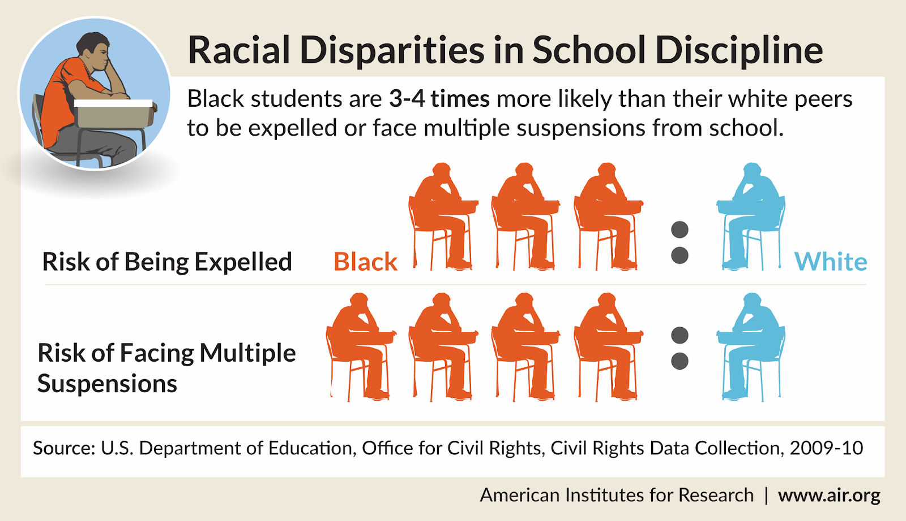
What is “Implicit Bias?”
Given identical case vignettes, pediatricians were more likely to prescribe painkillers for patients who were White as opposed to Black.
Physicians are not aware
that they are prescribing disproportionately
This Photo by Unknown Author is licensed under CC BY-NC-ND

Slide 7
What is “Implicit Bias?”
Teachers are not aware that they are applying discipline disproportionately
This Photo by Unknown Author is licensed under CC BY-ND
This Photo by Unknown Author is licensed under CC BY-NC-ND

Slide 8
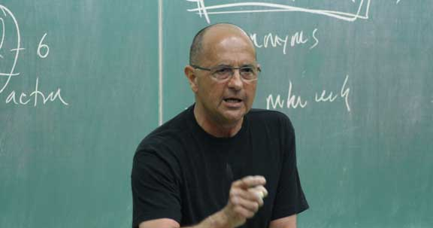
What is “Implicit Bias?”
It exists in everyone, including students, academics,
and in our tools
Bias that is implied, not overt
Unconscious and automatic
Involuntary – do not necessarily align with our declared values
A function of fast processing systems
This Photo by Unknown Author is licensed under CC BY-NC-ND

Slide 9
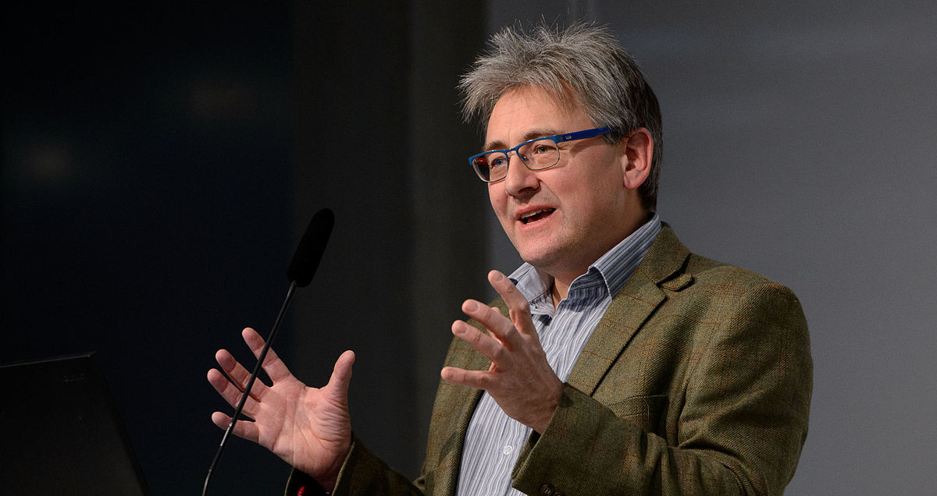
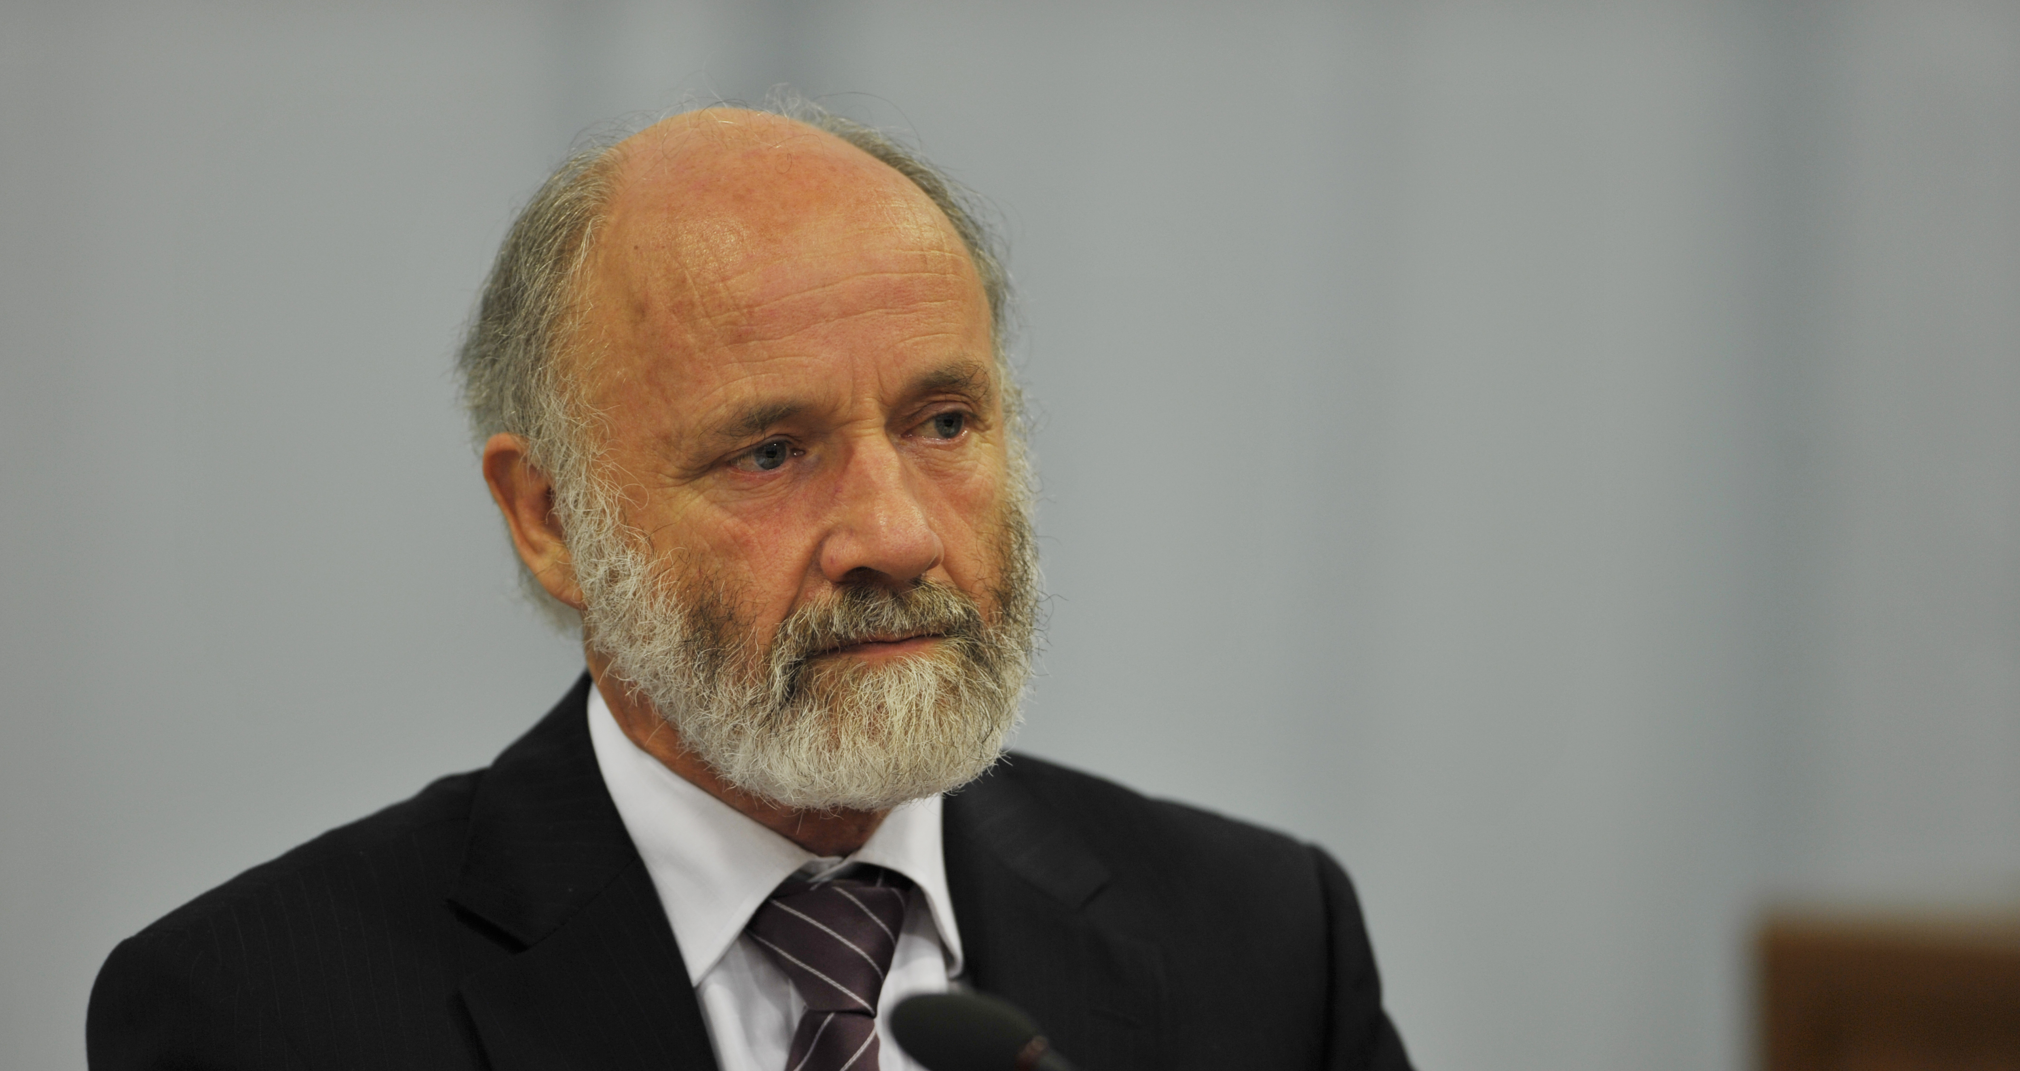
A search for images of “Professor” produced these results

Slide 10
A search for images of “woman professor huge lecture,” produced this as the first result
Implicit bias
in search engine

Slide 11
Statistical problems in SETs
Averaging qualitative data is nonsensical
(A good professor) + (a bad professor) ≠ (an average professor)
Therefore, comparing averages is nonsensical:
Between different class sizes
Between different disciplines
Between different colleges

Slide 12
Layers of Bias
Questions should be designed better
Bias in the readers of SETs results
How they interpret the evals
Varies by gender and race of person evaluated
How they weight the evals
Varies by gender and race of person evaluated
Bias in the evaluation questions and design
Bias in the students
Implicit bias about gender
Implicit bias about race
Bias via grade or difficulty of course
Implicit bias in gendered questions
Implicit bias in personality-based questions
Implicit racial bias in questions
Students should be debiased before SETs are administered
CAP & departments should be debiased before interpreting results

Slide 13
UC Centers of Teaching and Learning (2019) Recommendations:
Change the questions
Eliminate global questions (i.e. “evaluate the structure overall”) which are more prone to bias.
Change how teaching is evaluated
Use more holistic evaluation of teaching, including teaching portfolios and peer evaluations
Change how SETs are interpreted
Emphasize student EXPERIENCE of learning
Adopt a developmental approach to teaching… [which] creates opportunities to experiment and innovate in their courses without fear of “failing.”
Enforce the requirement for other measures of teaching effectiveness in addition to SETs.
Educate review committees (like CAP) about the widely documented bias in SET evaluations particularly toward women and faculty of color.
Do not average SET ratings to produce a quantitative mean score.
Do not compare instructor’s scores to another instructor or to departmental averages.

Slide 14
Women’s Faculty Association supports these solutions:
Alternative questions or alternative SETS
Debiasing of faculty and students
Support faculty in other modes of evaluation
Suspension of use of current questions until a more appropriate instrument can’t be developed

