Slide 1










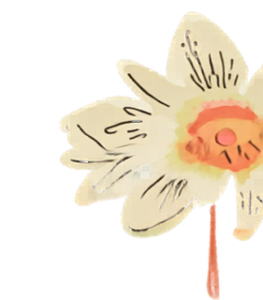


Society, Environment, and Health Equity
SEHE Department
Spring Open House
May 6,
4-6pm
INTS 1111
Look ahead to the future! Learn how to prepare to apply to graduate and professional schools in health and sustainability. Discover SEHE course options in Summer and Fall.
Food and drinks provided.
sehe.ucr.edu
@SEHE_UCR

