Slide 1


Welcome to the COPE Programs Presentation!
Or Click Link:
https://forms.gle/NXXFoQZcDVoc8E7z5

Slide 2



Health Scholar Program
WHO
Committed students interested in health professions pathways, enrolled in an experiential program through UCLA Executive Programs in Health Policy & Management through the Fielding School of Public Health All students are pre-screened via application, interview, health screening and 30-hour training
WHAT
A 280-hour commitment requiring a minimum of one, 4-hour shift/week Nine (9) and three (3) month options are offered to complete the program sooner Provides first-hand health care experience in a variety of departments Engages students in organizational key initiatives Provides professional development and mentoring Connects students with entry-level hospital and health system jobs Develops health care leadership from the community
WHERE
Inpatient clinical units, ambulatory settings and administrative areas

Slide 3




Program Prerequisites
18 years or older
18
Have a High School Degree
Health screening*
Background clearance
Active health care insurance through out program participation

Slide 4
COPE Tuition
Health Scholar
Higher education students and graduates assist with basic patient care and support health care administrators.
Tuition fee: $325- $595
Care Navigator Scholar
Expose and train current Care Navigators for roles in care management and care coordination
Tuition fee: $325
Health Scholar w/Care Navigator Minor
Current scholars can shift both on the clinical floors as well as assisting in care management and care coordination
Notes:
ED

Slide 5
Health Scholar Role
Role Objectives:
Learn how to provide basic patient care from clinical team
Join the patient care team and support with providing customized one-on-one patient care
Learn about different career paths within health care
Support patient care team with enhancing patient experience and patient satisfaction
Staff Presence Not Required
Staff Approval Presence NOT Required
Staff Presence Required
Restrictions
Greet and assist members and/or visitors
Round on Patients
Answer call lights
Promote floor initiatives
Discharge patients
Ambulate non-fall risk patients/members
Patient Vitals
Feed Patients
Run Labs
Assist staff with daily patient care activities
Examples: bathing, toileting, repositioning
Observe procedures and office visits
Translate/interpret clinical information
Handle medications
Act as a sitter
Ambulate fall-risk patients/members

Slide 6
Program Experience and Benefits

Slide 7
Alumni Current Schools and Career Paths
Alumni Current Profession
Alumni Current School Program

Slide 8
Emergency Department
Internal Medicine
Cardiology
OB/GYN
MRI
Tier 4
144+ Floor Hours
Tier 3
96 Floor Hours
Maternity Care [Postpartum, L&D, and NICU]
Physical Medicine / Polk Gym
Laboratory
Radiology
Tier 2
48 Floor Hours
Moreno Valley MOB
Employee Health
Mammography
Corona MOB
Urgent Care
Pediatrics
Tier 1
0 Floor Hours
4 East + Hemodialysis
4 West
5 East
5 West
KPR Department Tier System
Training
Notes:
Maternity Care [Postpartum, L&D, and NICU]=
Physical Medicine / Polk Gym
Laboratory
Radiology

Slide 9




The Benefits
Eligibility for a Letter of Recommendation
A completion certificate from
Keck Graduate Institute (KGI)
Access to educational events, workshops and priority benefits when applying to KGI graduate programs
Access to over 34,000 alumni through COPE Connect network

Slide 10

The Benefits
Eligibility for a Letter of Recommendation
A completion certificate from
UCLA’s Executive Programs in Health Policy & Management
Access to educational events, workshops and benefits when applying to graduate programs
Access to over 34,000 alumni through COPE Connect network

Slide 11



The Benefits
 | Quarterly educational lectures and workshops focused on enhancing basic health care knowledge. Examples include: Health Care vs. Health: What is the Difference? Aging and Health Care Managed Care 101 Changing Health Care Landscape Understanding Social Determinants of Health in the US
 | Quarterly workshops designed to provide professional development opportunities. Examples include: Excel Training Personal Branding Nailing your Interview Mock Interviews Resume Building
 | Quarterly workshops in partnership with The Princeton Review including: Mastering the Medical School Admissions Timeline MCAT/GRE Overview Info Session Interview Tips/Multiple Mini Interview Introduction

Slide 12


The Benefits
 | Diverse career panels exposing Scholars to different professions with the purpose of: Understand all available roles in health care First hand exposure to unique journeys to career success Connect Scholars to prospective mentors to support their career path Opportunity for Scholar to ask specific questions regarding specific health care role
 | Access to COPE Connect network Join a growing network of 34,000 Health Scholar alumni across the nation Access to networking opportunities with seasoned health care professionals Receive discount with preferred vendors including The Princeton Review Gain letter of recommendation privilege even after graduating from COPE Health Scholar program

Slide 13
Enrollment and Training

Slide 14
Overview
Enrollment
Training
Online Application
Virtual Interview
Health Screening, Clearance and One-Time Tuition
30-hour Training and Examinations
Quarterly Department-Specific Orientation and Training
Quarterly Rotations (minimum one 4-hour shift per week)
Minimum 280-hours experience as Health Scholar
Completion certificate in
Patient Experience and Pre-Licensed Clinical Care
Ongoing Program Experience
Graduation

Slide 15
Current COVID-19 Guidelines & Precautions
Scholars will follow the standard screening process for Kaiser sites each time they report to the hospital, which includes completion of a temperature check.
Scholars will not enter Covid-19 rooms
Scholars will wear a mask and eye precautions at all times.

Slide 16
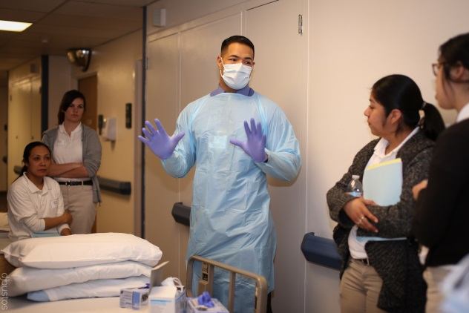
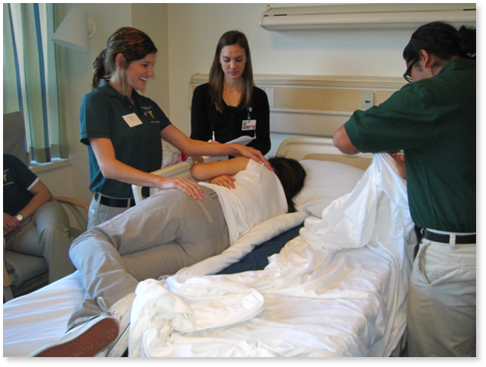
Program Training
Training
Didactic
Online modules completed remotely on topics including:
Program structure and policies, infection control, customer service, patient safety and confidentiality
Patient Care Training
Weekend (2) training include:
Patient comfort care skills and competencies
Practical scenarios in a patient care setting
Evaluation
Competency Evaluation
Written and practical scenario-based examinations
Department Specific Training and Rotations
DST will be given following successful admission on Training Day 2​
Shifting will begin on the 1st of the next month

Slide 17
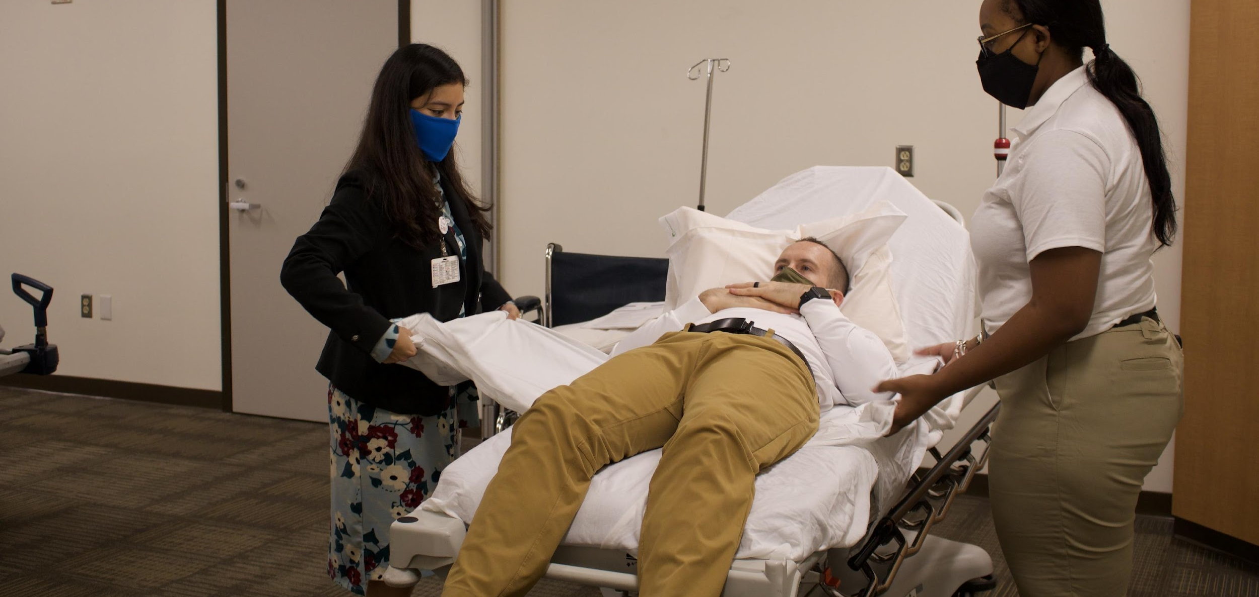
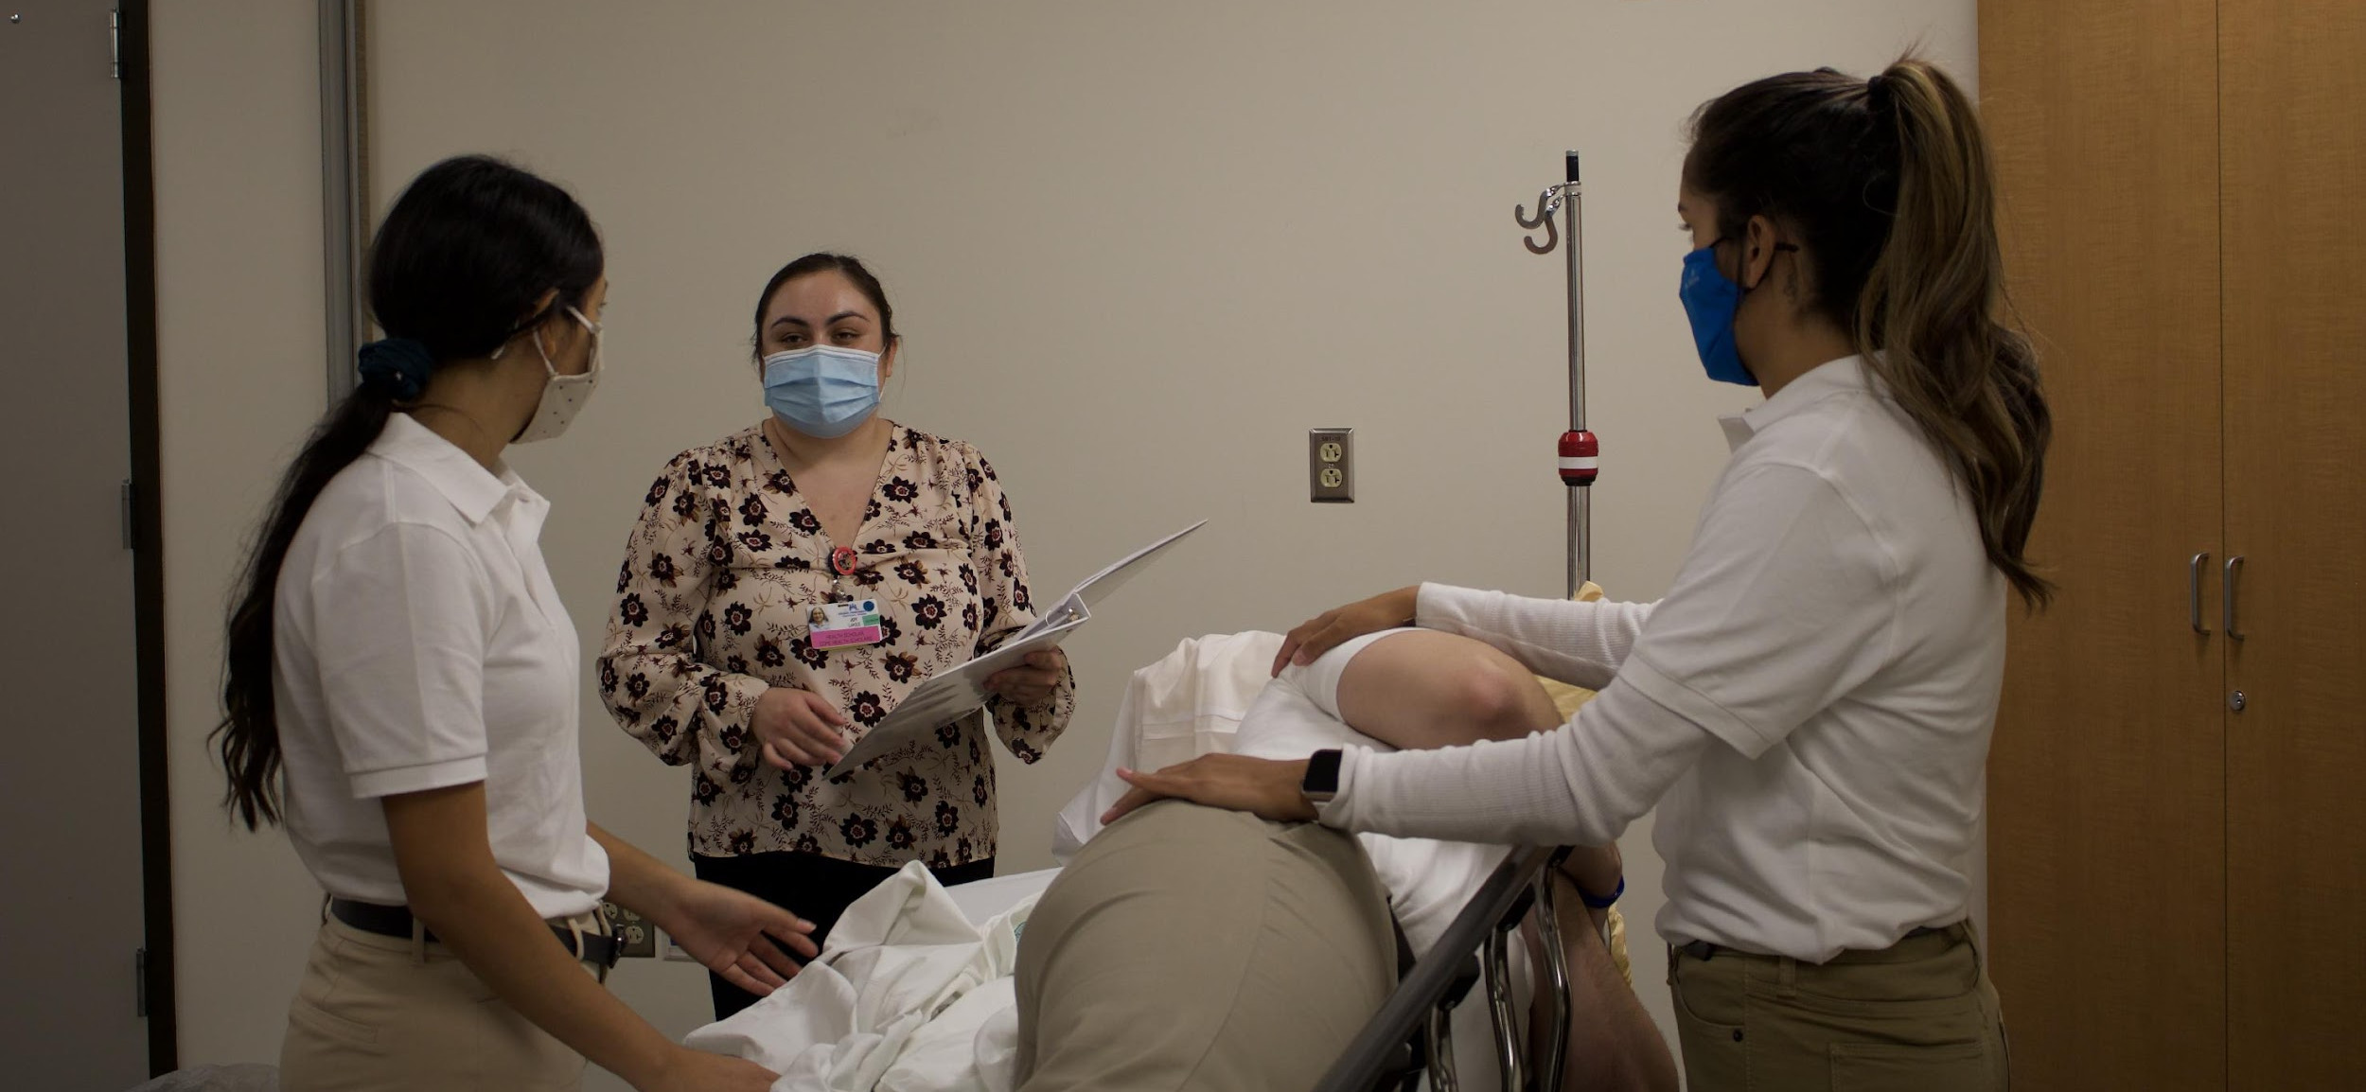
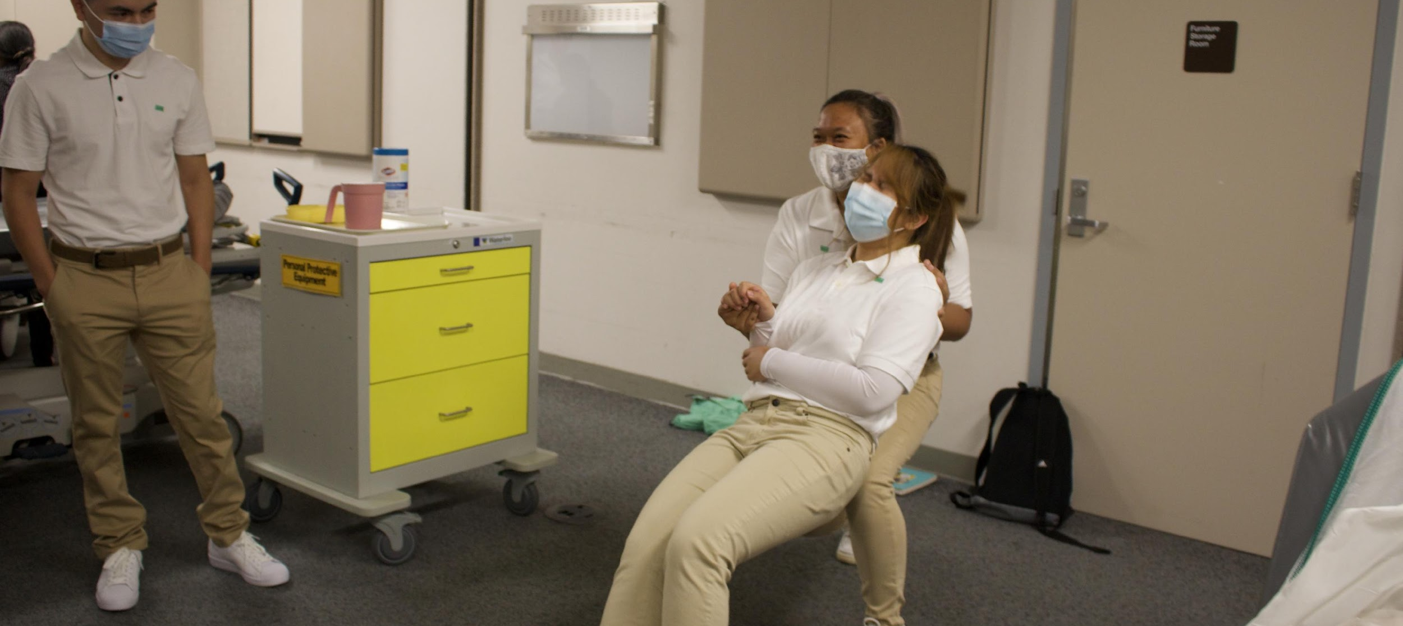
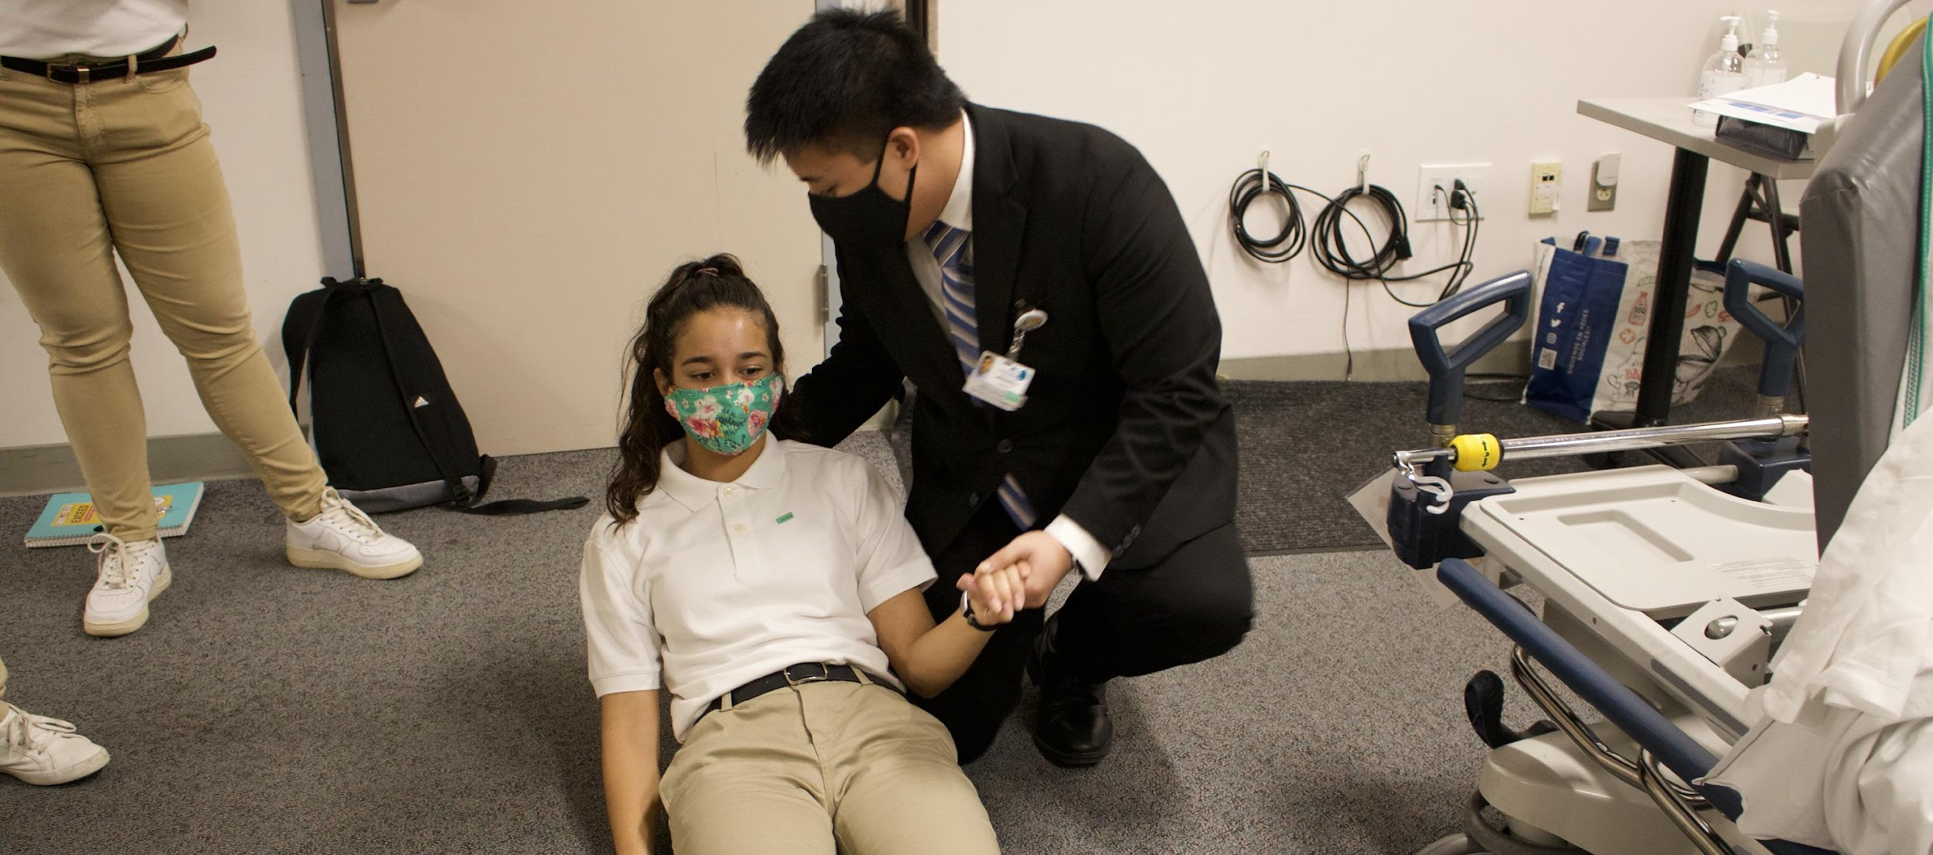
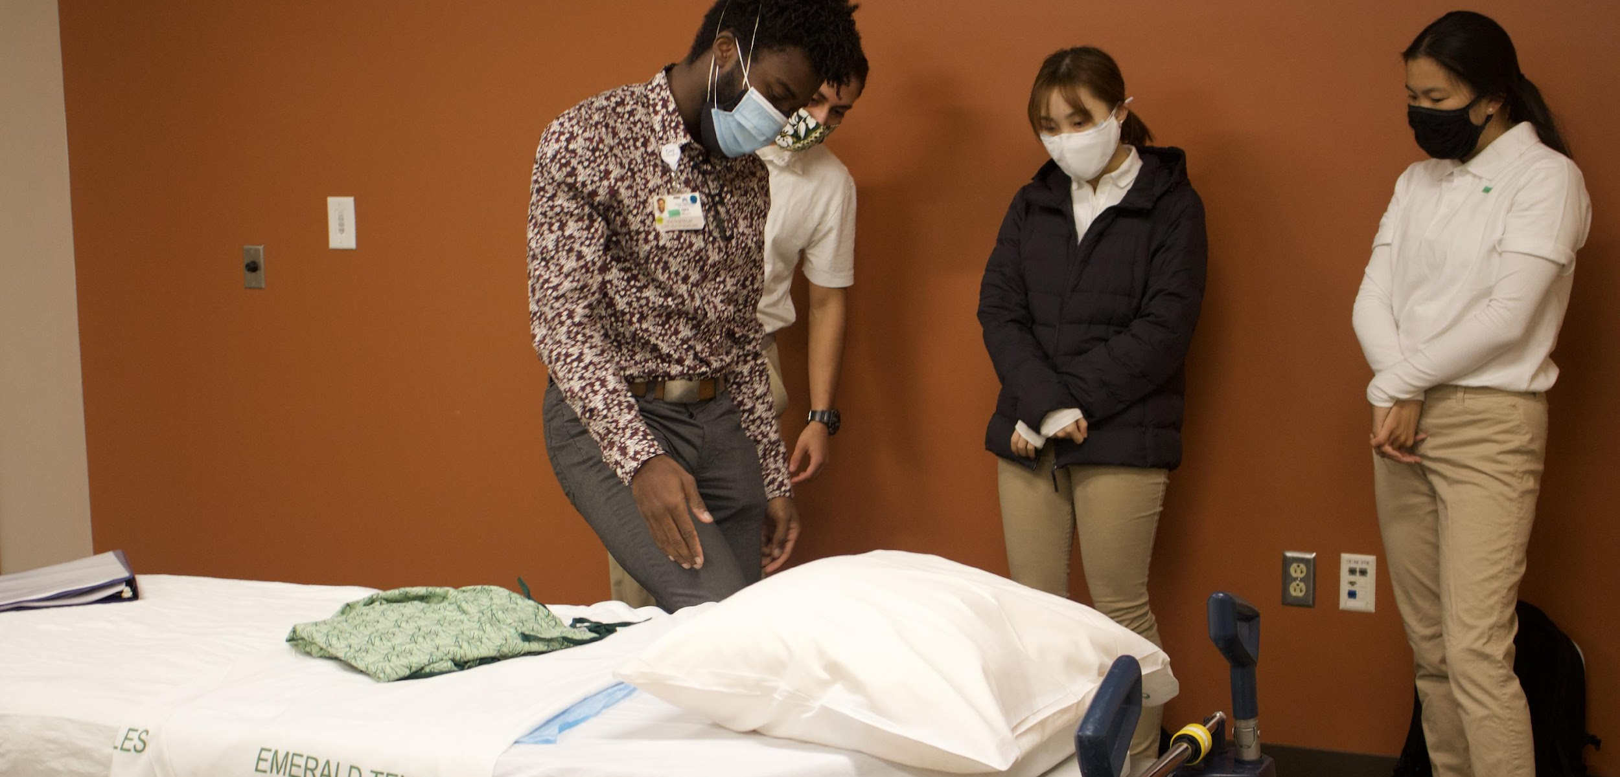
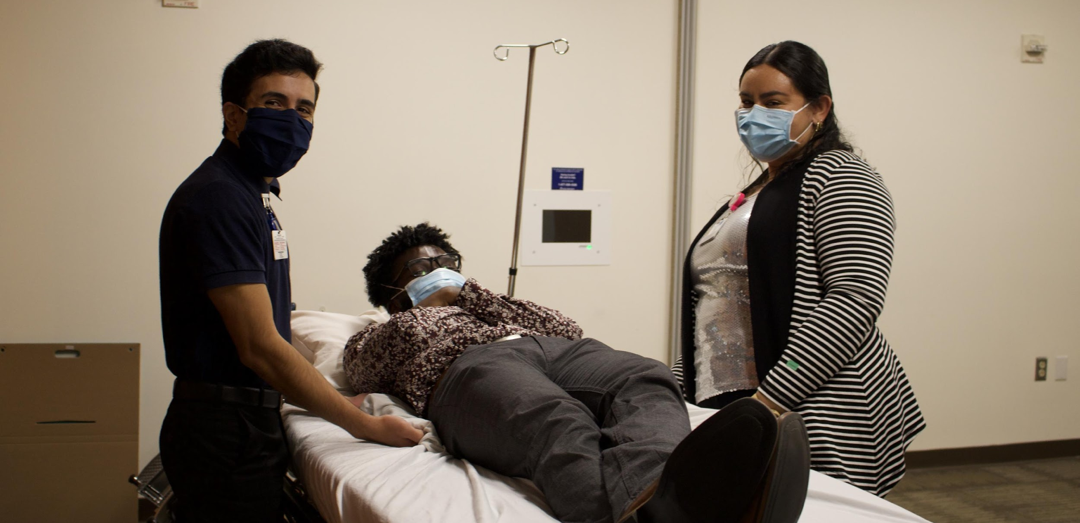
What does Training look like?

Slide 18
Training Curriculum
Patient comfort care techniques
Evidence-based practices
Critical thinking skills
Standard precautions
National patient safety goals
Covid-19 Precautions
HCAHPS Improvement
HEDIS Improvement
Age-appropriate care
Diversity and cultural competency
Hourly rounding
Key organizational initiatives
Patient Care Competency
Service Excellence
Rules and Regulations
Leadership and Management
HIPAA
Accrediting agencies (The Joint Commission, DNV, CMS, DHS, CDC)
Mandatory reporting
Health reform
Health care system policies
Leadership team
Project management
Professional development
Public speaking
Program operations
Employment readiness

Slide 19




Health Scholar with Care Navigator Minor
- Students can shift either as both as Health Scholar and Care Navigator
- Students can pause as a Health Scholar and complete Care Navigator
96 Hours to complete the Minor
No additional Tuition

Slide 20
Care Navigators Overview
The Care Navigator Scholar program offers individuals the opportunity to gain firsthand experience in working with underserved communities to improve health outcomes
As a Care Navigator Scholar, you will receive training to prepare you to connect patients to educational resources, community-based opportunities, and more
You will work closely with care coordinators, social workers, health care administrators and case managers to be uniquely positioned to support interventions targeted towards special populations including homeless individuals and those diagnosed with chronic conditions.

Slide 21





Primary Care Navigation Activities
Care navigation includes a broad range of tasks that can be categorized into the following six primary areas
Care Coordination Organizing health care activities between recipient, family and providers to facilitate care delivery and navigation of the healthcare system to carry out necessary activities |  | Health Promotion Enabling recipients to increase control in health care decisions and improve health through proactive interventions and strategies and preventative care |  | Supporting access to care, follow- up with health care providers, necessary tests and labs to ensure engagement in health care and increased adherence with treatment
Leveraging community resources and social supports to effectively support recipients in navigating the health care delivery system |  | Care Transitions Supporting and facilitating care transitions from one setting of care to another |  | Engagement
Comprehensive Traditional Care & Follow-Up
Community Referrals & Social Support Services
Engaging in meaningful activities or strategies that provide recipients with a sense of ownership in health care increasing the likelihood of adherence and improved outcomes
Comprehensive traditional Care and Follow-Up

Slide 22
Why the COPE Care Navigator Program?
Learn about population health management across the care continuum
Increase knowledge of the impact of social determinants on health outcomes
Increase knowledge of the changing health care landscape
Assist in educating patients about their conditions and care options
Improve care by leveraging both health system and community-based resources
Learn important administration skills necessary for documentation in a health care setting
Enhance health care industry knowledge by engaging in outpatient and inpatient settings
Develop communication and customer service skills
Prepare yourself for a healthcare administration career path

Slide 23
Core Care Navigator Curriculum
Navigators’ role is a strategy designed to facilitate care access and through advocacy and coordination, building trust and demonstrating cultural competence
Health Care Landscape
Social Determinants of Health
Chronic Disease Management
Effective Communication & Motivational Interviewing
Cultural Humility & Inclusivity
Documentation Basics
Resources & Referrals

Slide 24
Care Navigators at KP Medical Group Riverside
 | Strategic Goals
 | Increase in member screening and attendance to appointments through member education Develop customized training to train Care Navigators on the “why” behind importance of screenings, making Care Navigators ambassadors to KP members Training Care Navigators to identify and help address social determinants of health barriers by providing key KP resources Outcome Metrics: Increase in members scheduled for appointment Increase in members who attend appointment Increase in members with a barrier to care successfully resolved
Care Navigators work collaboratively with KP team to support organizational goals towards meeting HEDIS scores
Targets include:
Hypertension – Blood Pressure Management
Diabetes – A1C Testing
Pediatrics – Immunization Screening
Breast Cancer Mammography Screening

Slide 25


Care Navigator Program Commitment
One to Two, 4-hour shifts/week (9-month)
Two, 4-hour shifts/week (6-month)
Quarterly program meetings
250 hours to complete the program
Tuition Fee
8

Slide 26
The Benefits
Eligibility for a Letter of Recommendation
A completion certificate from
UCLA’s Executive Programs in Health Policy & Management
Access to educational events, workshops and priority benefits when applying to KGI graduate programs
Access to over 34,000 alumni through COPE Connect network

Slide 27
Locations and
Next Steps

Slide 28
Deadlines & Tuition
Application Deadlines | Training Days | Program Start
Fall Rotation: August 8 | Interviews/Clearance: ​ Training: September 6, 7, & 13 | October 1
Application Fee* | One Time Program Tuition*
$21 | $325 - $595
Tuition assistance is available for eligible applicants
Visit our website at www.copehealthscholars.org

Slide 29
KPR Program Contact Information
Kaiser Permanente Riverside Program Manager: Sam Tien
stien@copehealthsolutions.com
Kaiser Permanente Riverside Director of Recruitment: Leah Serrano
kprdr@copehealthscholars.org
Kaiser Permanente Riverside Director of Enrollment: Sherry Saad
kprde@copehealthscholar.org

Slide 30

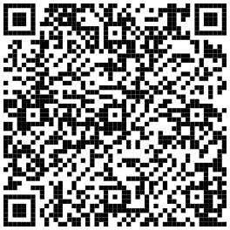
Interest Form
@Copehealthscholars
@Iehealthscholars
Notes:
https://forms.gle/jbyrMvkjTPw5Tnpq8

Slide 31

Interest Form
@Copehealthscholars
@Iehealthscholars
Notes:
https://forms.gle/jbyrMvkjTPw5Tnpq8

