Slide 1





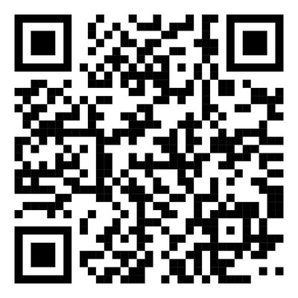

Join us for Spring Quarter
SOCIETY, ENVIRONMENT AND HEALTH EQUITY (SEHE 190).
2025!
UCR Latinx & the Environment Seminar
Description: This seminar will showcase research and advocacy work by UCR researchers and local community leaders on environmental issues that impact Latinx communities.
Themes include environmental law, climate anxiety, methane emission, and more!
Students may choose to enroll for 1-2 units course credit in SEHE190.
Website
Follow Instagram for updates:
@sehe_ucr @latinxenvironmentucr
WHERE:
INTN 3023
WHEN:
WEDNESDAYS 11AM-12:20PM STARTING APRIL 2, 2025
Food and drinks provided!
All Are Welcome!

