Slide 1




Join us for the Inaugural
UCR Latinxs & The Environment Seminar
This seminar will showcase research and advocacy work by UCR researchers and local community leaders on environmental issues that impact Latinx communities.
Themes include air pollution, climate anxiety, environmental law, and more!
Students may choose to enroll for 1-2 units course credit in Society, Environment and Health Equity (SEHE 190).
WHERE:
INTN 3023
WHEN:
WEDNESDAYS 4-5:30 PM STARTING OCT 2, 2024
Food and drinks provided!
All Are
Welcome!

Slide 2

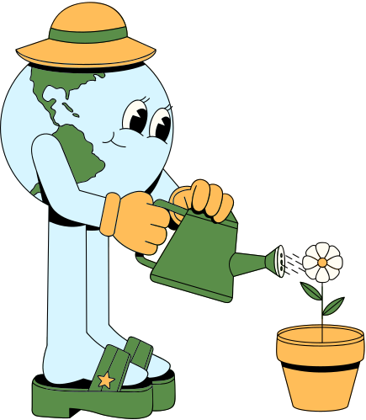
How does it work?
Step 2:
Learn about the seminar objectives and themes.
Step 3:
Fill out enrollment form at the seminar and attend following seminars.
Step 1:
Come to the first seminar on Oct 2.
CONTACT : DANA.SIMMONS@UCR.EDU
HTTPS://SEHE.UCR.EDU HTTPS://LATINXSENV.UCR.EDU

