Slide 1
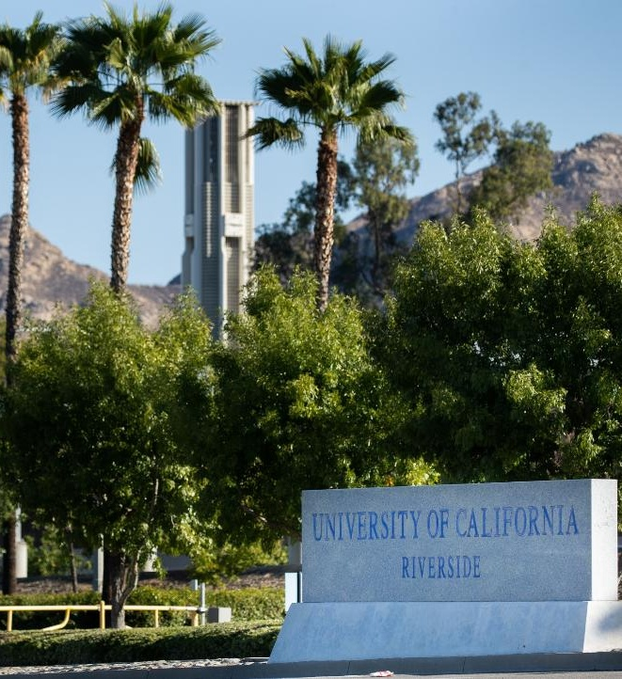

Strategic Plan Update 2026
UCR Town Hall
strategicplan.ucr.edu
June 30, 2026

Slide 2
Pillars of our Mission
1
Distinctive, transformative research and scholarship
2
A rigorous, engaging, and empowering learning environment
3
A welcoming, inclusive, and collaborative community
4
Advancement of the public good
5
Sustainability for climate action and environmental justice

Slide 3
Strategic Goals
1
Build financial stability, resiliency, and sustainability
2
Invest in the success of the people who teach, research, work, learn, and live at UCR
3
Expand the visibility and scope of influence of UCR locally, nationally, and globally

Slide 4
Objective:
Increase net revenue

Slide 5

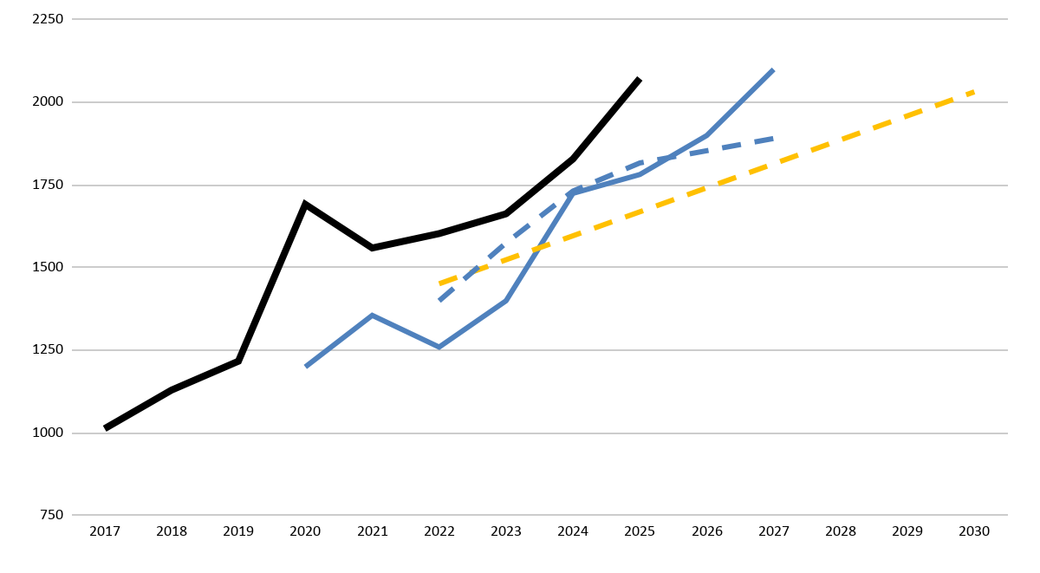

Summer Sessions Enrollment
Summer Undergraduate FTE Projections and Goals

Slide 6
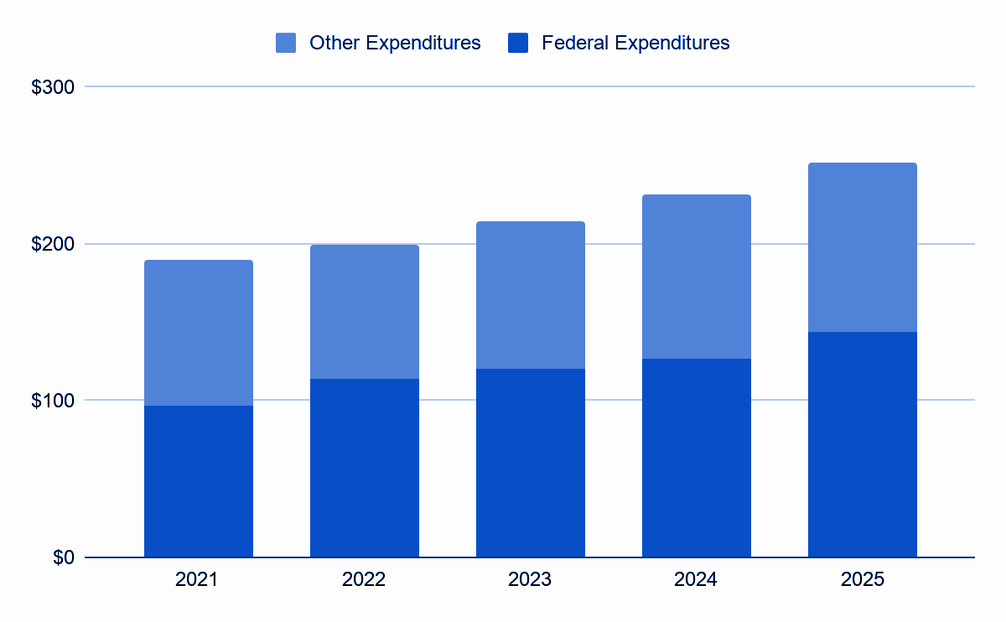
Annual Research Expenditures
Data from Higher Education Research & Development (HERD) - in Millions

Slide 7
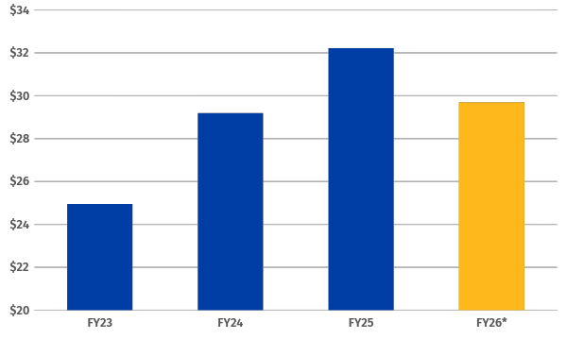
Fundraising
Total Raised FY23-FY26 - in Millions
*FY26 reflects year-to-date fundraising as of May 11, 2026

Slide 8
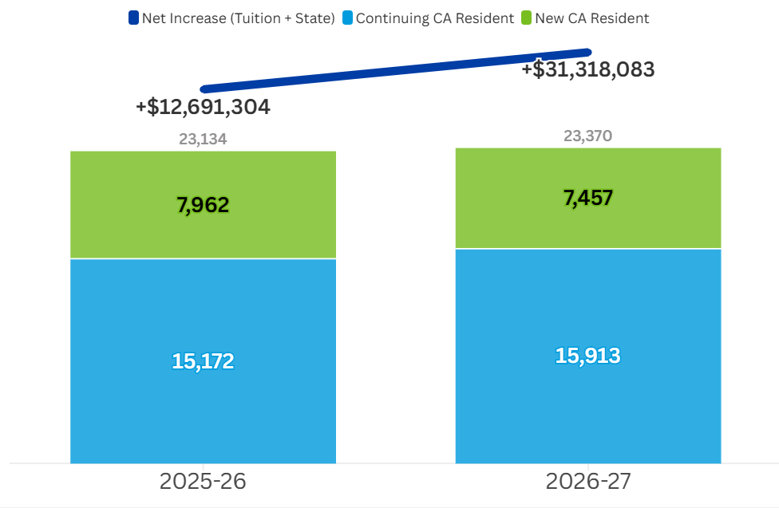
Effect of Enrollment Growth on Revenue
 | FY 26 | FY 27 PROJECTED
IF NO GROWTH:
STATE FUNDS | ($2.1M) | $9.2M
TUITION | $3.8M | $4.2M
TOTAL | $1.7M | $13.4M
ACTUAL GROWTH:
STATE FUNDS | $1.3M | $27.5M
TUITION | $13M | $17.2M
TOTAL | $14.3M | $44.7M
INCREASE TO UCR: | $12.6M | $31.3M
Notes on state budget: | Cut to UC | Increase to UC

Slide 9
Objective:
Address faculty diversity, equity, and professional growth
1. Reduce Equity Gaps
2. Enhance Leadership Development
3. Increase the number of Senate faculty from historically underrepresented backgrounds

Slide 10
Objective:
Graduate student success

Slide 11
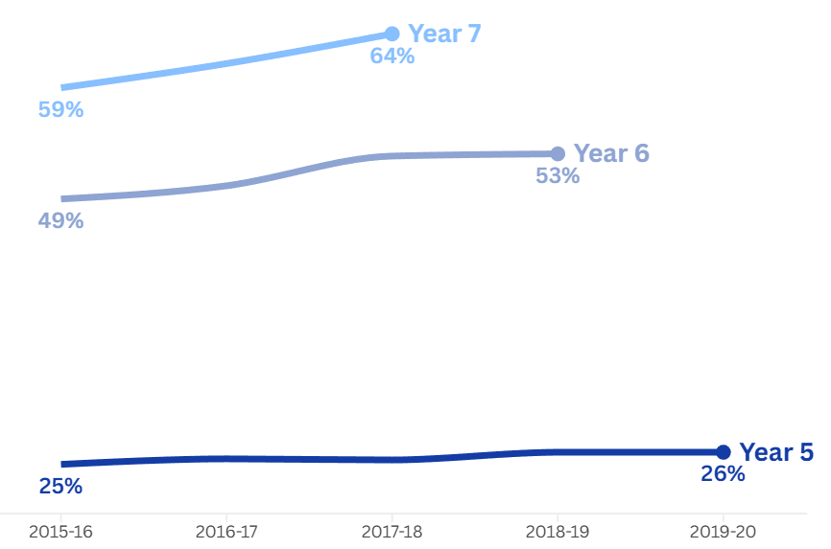
PhD Graduation Rates

Slide 12
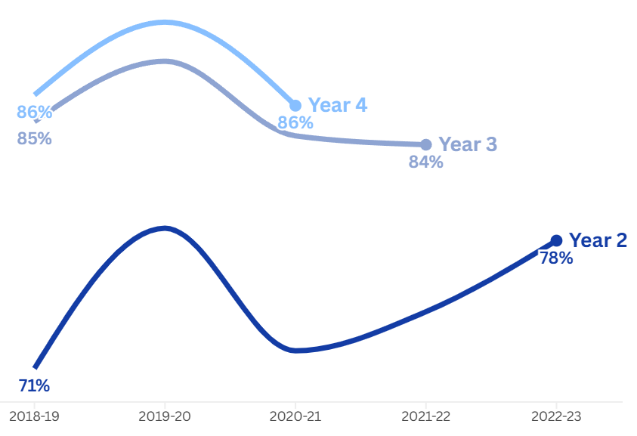
Master’s Graduation Rates

Slide 13
Objective:
Undergraduate student success

Slide 14
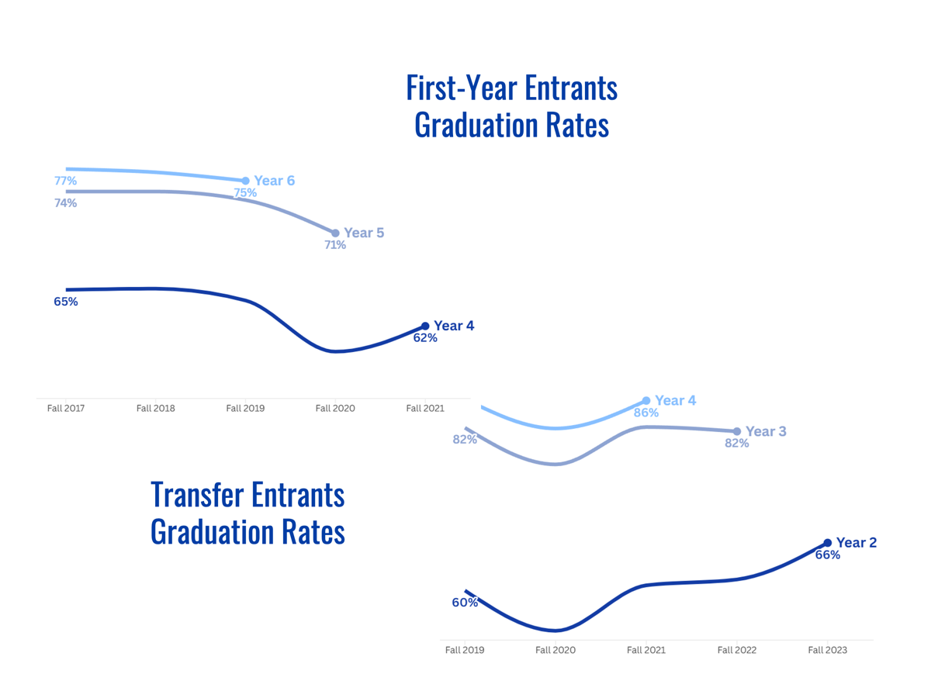
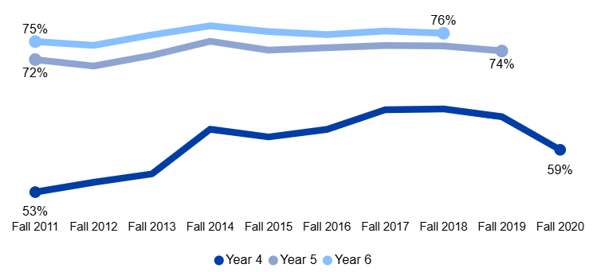
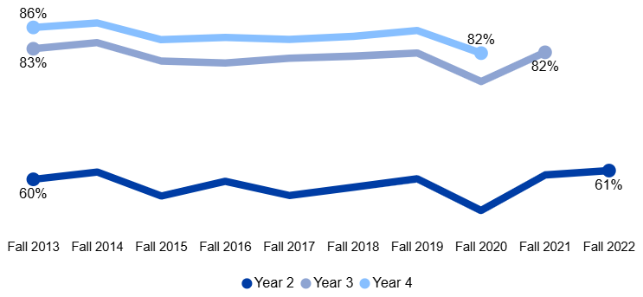
UPDATE STARTING WITH 2017 Frosh Entrants Graduation Rates
UPDATE STARTING WITH 2019 Transfer Entrants Graduation Rates
86%

Slide 15
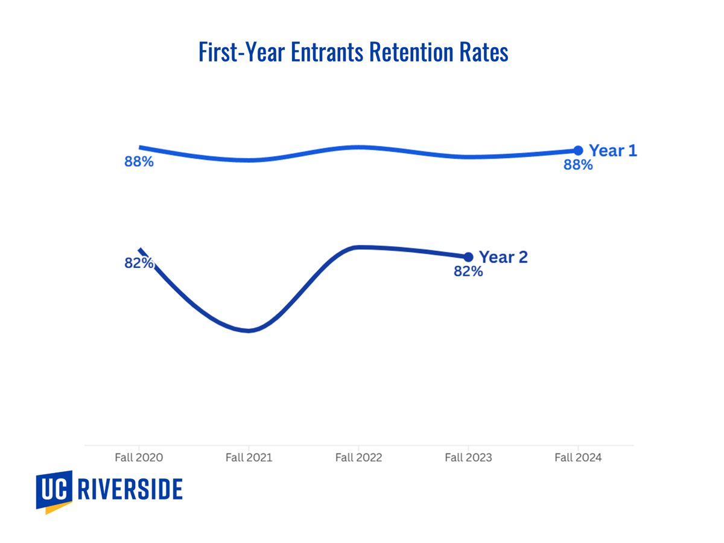
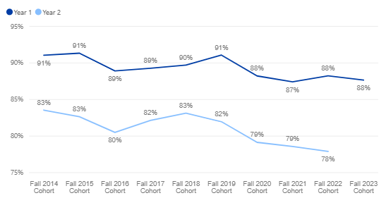

First-Time Full-Time Frosh Retention Rates UPDATE STARTING WITH 2020

Slide 16
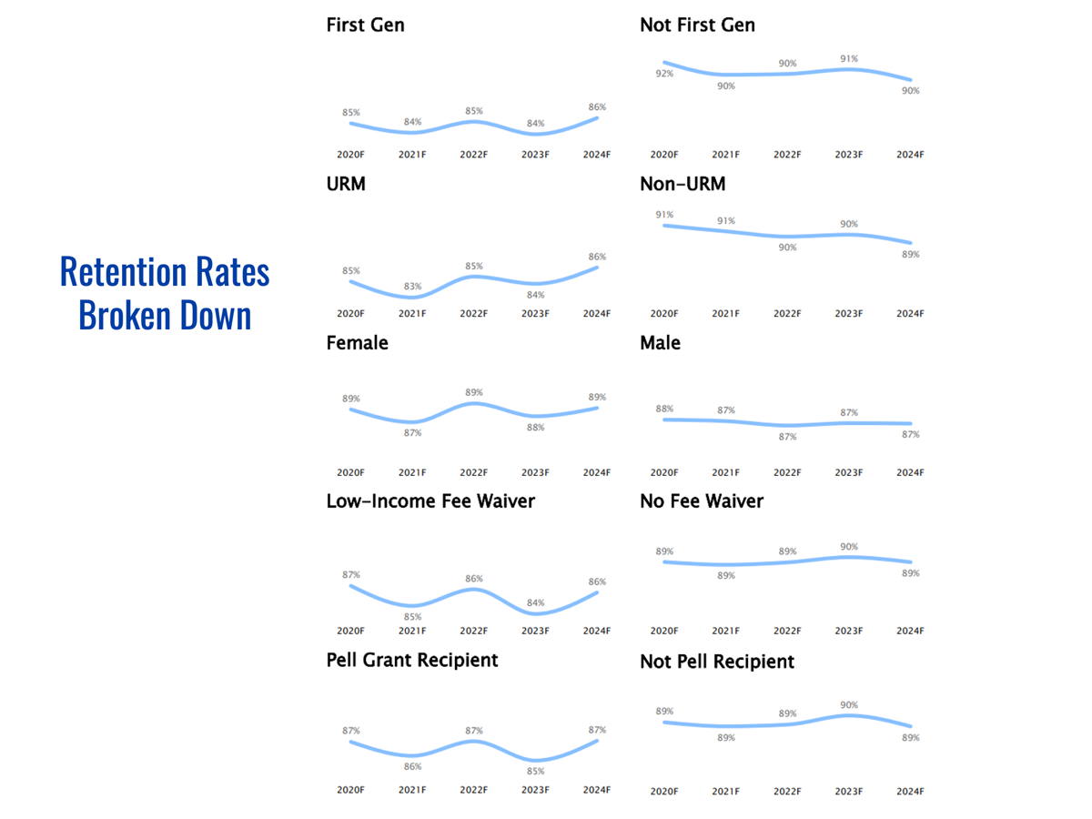
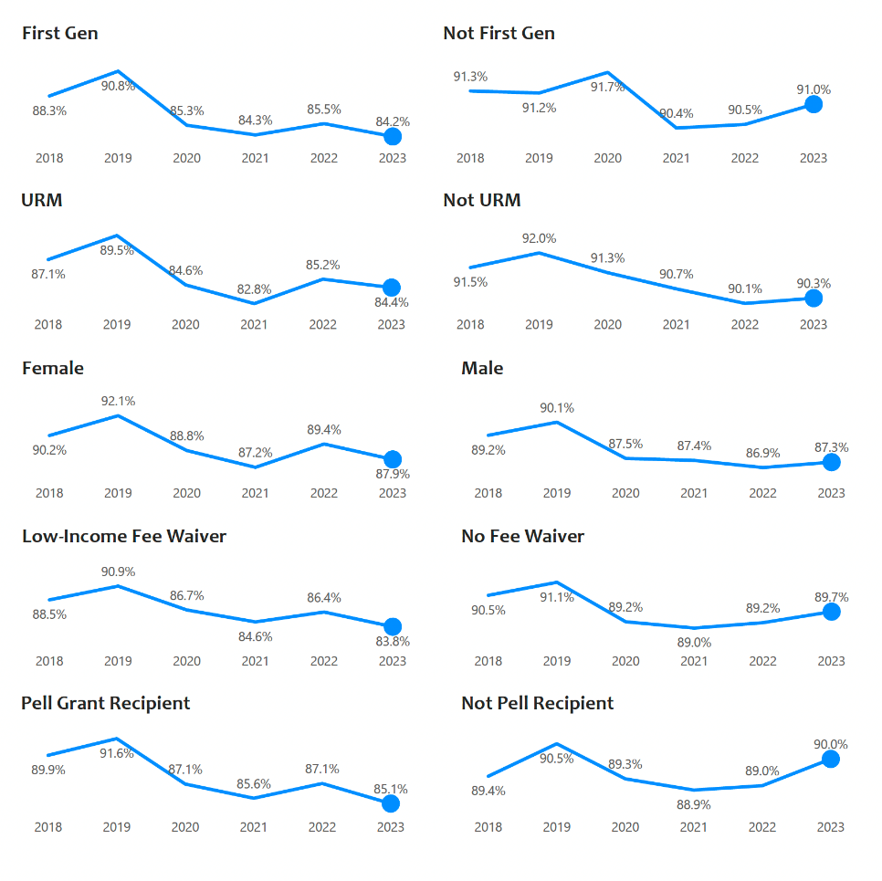

Slide 17
Objective:
Enhance staff professional development

Slide 18
Staff Professional Development
Comprehensive Employee Development Programs: Launched three cohort-based programs: Spark Your Potential, Foundations of Supervisory Success, and Mastering Management.
Employee Coaching Cohort Program: "New Level Management" employee coaching program began May 2026, and exceed target participation numbers from academic & administrative units.
Inaugural Career Development Month: Inaugural program in November 2025 with 223 total participants.

Slide 19
Objective:
Enhance campus space

Slide 20

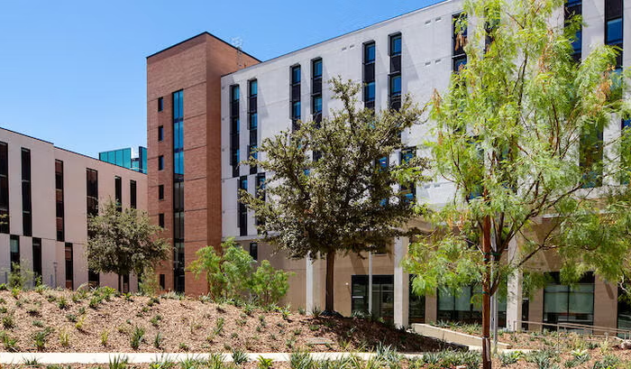
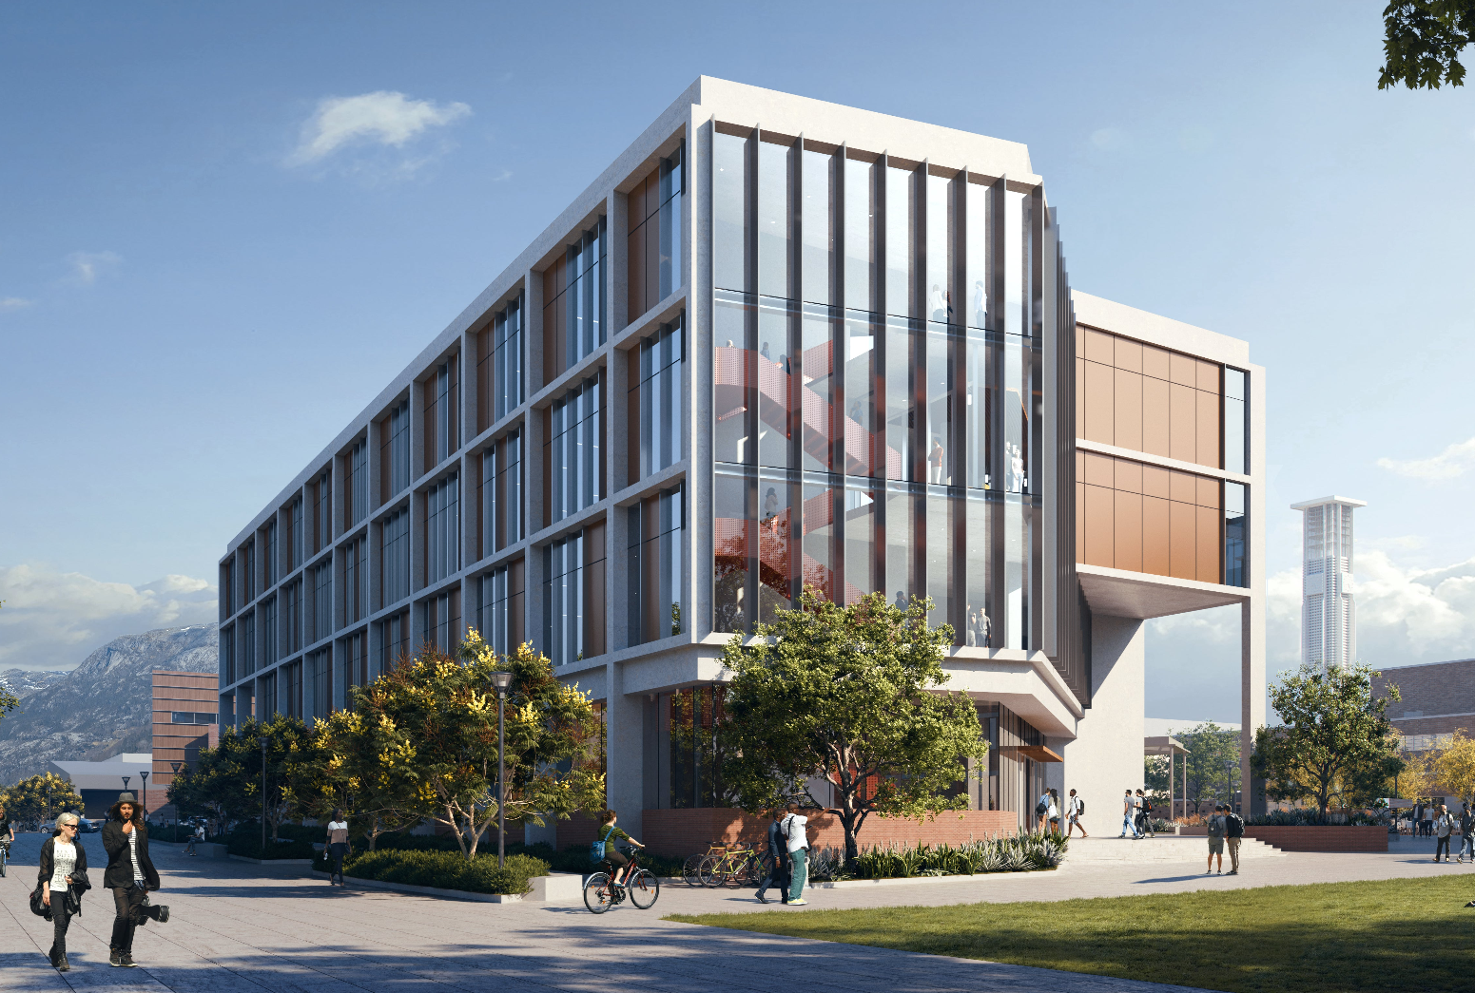
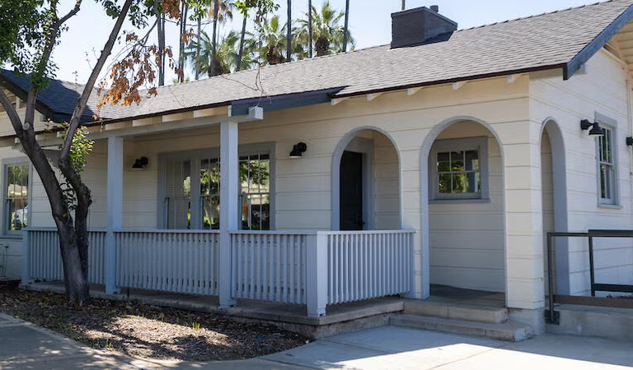
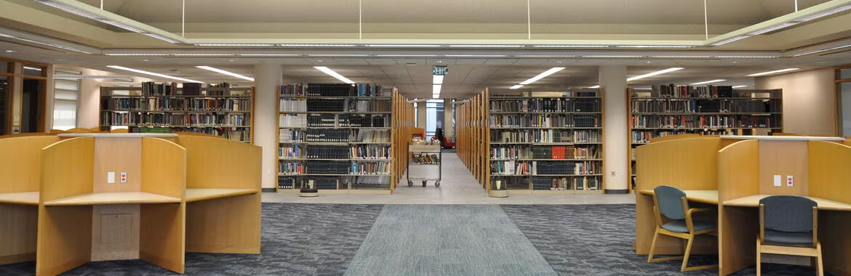
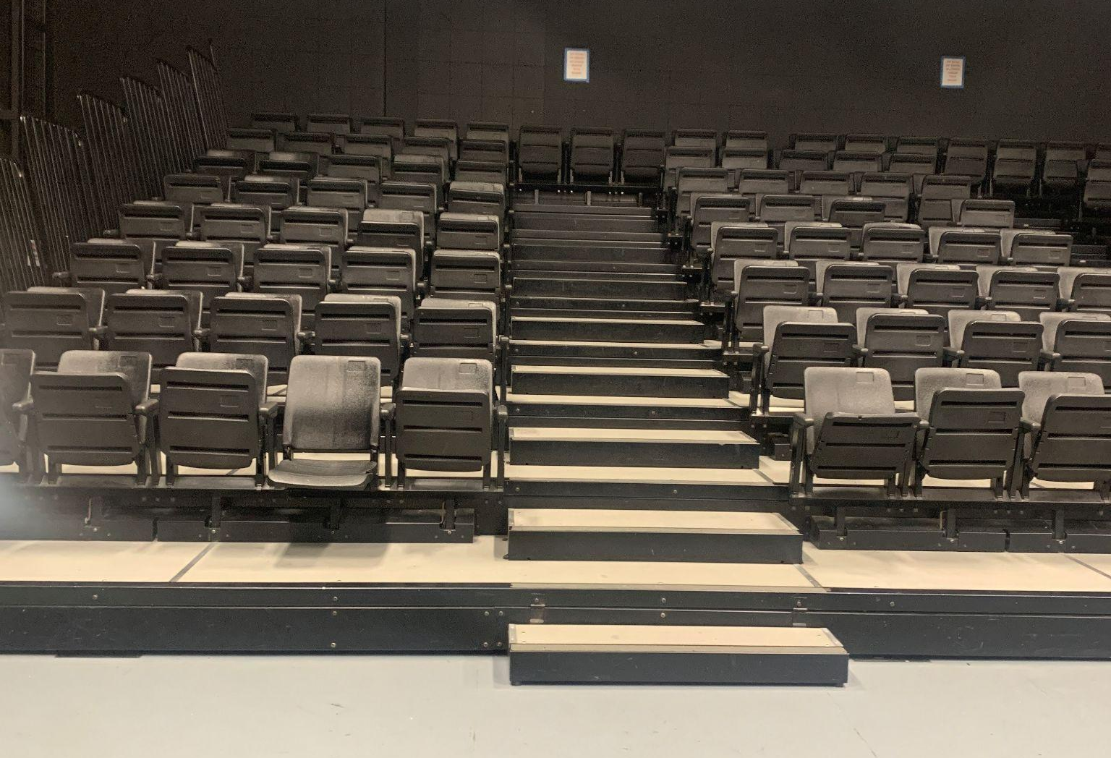
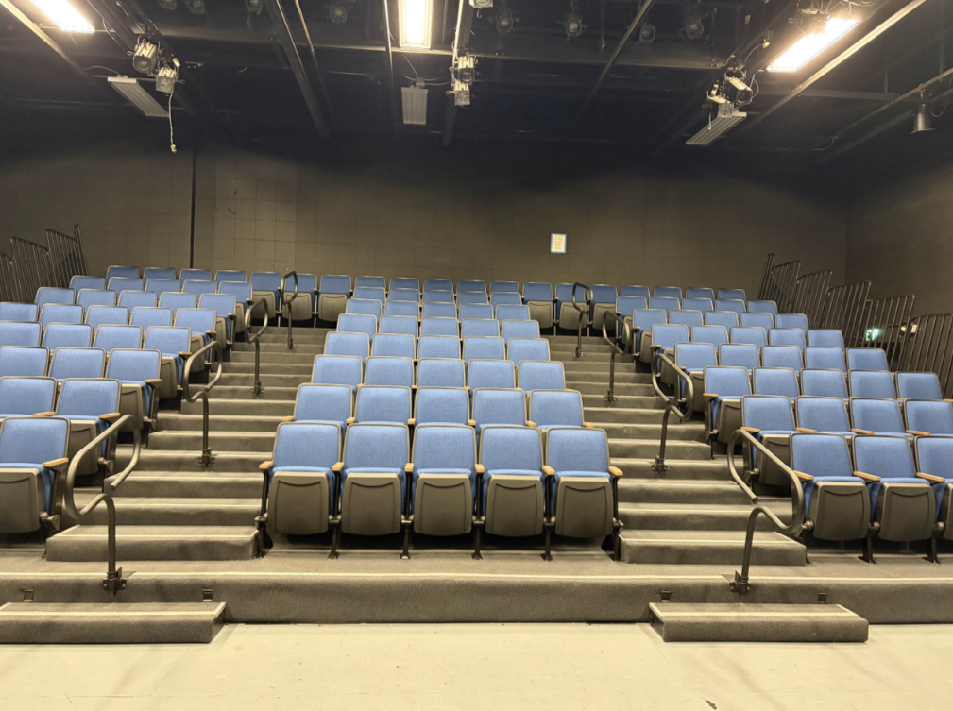
Construction and Upgrades
ND2 - opened Fall 2025
UTLF - opening Fall 2026
Emeritus & Retiree Cottage
Orbach science library renovation
HUM 411 (before and after)

Slide 21
Objective:
Serve as an anchor institution for research and economic development

Slide 22
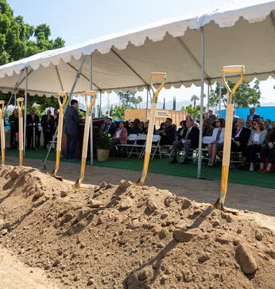
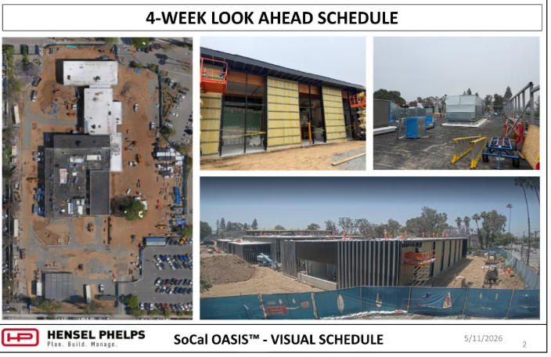
SoCal OASIS Clean Tech Park
PROGRESS AS OF MAY 11
JUNE 23 GROUNDBREAKING

Slide 23
Objective:
Achieve additional national recognition

Slide 24
Sustainability Recognition
#1 IN THE NATION
Investment in Sustainability
Ranked in the Top Three Nationally in the 2025 Sustainable Campus Index (SCI):
Procurement & Waste
Representation & Access
Public Engagement
Curriculum

Slide 25
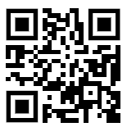
strategicplan.ucr.edu

