Slide 1

NRP for the next 10 years Frank Würthwein Director, San Diego Supercomputer Center September 27th 2022

Slide 2
Vision

Slide 3

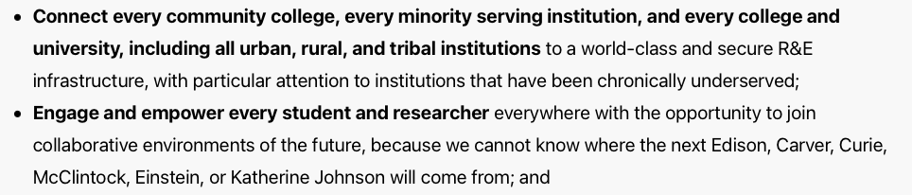
Democratize Access
https://mindsweneed.org

Slide 4
Long Term Vision
Create an Open National Cyberinfrastructure that allows the federation of CI at all ~4,000 accredited, degree granting higher education institutions, non-profit research institutions, and national laboratories.
Open Science
Open Data
Open Source
Open Infrastructure
Open Compute
Open Storage & CDN
Open devices/instruments/IoT, …?
Openness for an Open Society

Slide 5
Community vs Funded Projects
Lot’s of funded projects that
contribute to this shared
vision in different ways.
Community with
Shared Vision
We want you to …
… grow NRP.
… build on NRP.
NRP is “owned” and “built” by the community for the community

Slide 6
Supporting Nautilus for the next decade

Slide 7
The NSF Cat-II Program
NSF supports via the Cat-II program novel systems ideas.
3 year “testbed” phase
The PI owns the resource, and has freedom with regard to who uses it.
No requirements for making it available via any specific allocation mechanism.
It is expected that not all features work on day 1.
3 years of experimentation & development of features
2 year “allocation” phase
The resource is made available via an NSF supported allocation mechanism.
The solicitation mentions the possibility of an additional 5 year renewal without re-competition if system is successful.
We decided that this is an ideal program to try and secure NRP core operations funding for the next 10 years
And thus provide the stability necessary for growth of NRP.

Slide 8
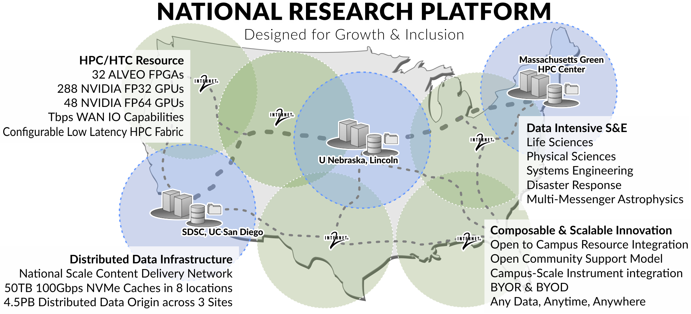
Cat-II: Prototype National Research Platform
A10
288
80GB A100
64
5 year project with $4.8M hardware & $6.45M people
Supports Nautilus, and thus the core NRP infrastructure
Promises to go beyond “PRP” functionality
PI = Wuerthwein; Co-PIs: DeFanti, Rosing, Tatineni, Weitzel
Funded as NSF 2112167

Slide 9
Innovations
I1: Innovative network fabric that allows “rack” of hardware to behave like a single “node” connected via PCIe.
I2: Innovative application libraries to expose FPGAs hardware to science apps at language constructs scientists understand (C, C++ rather than firmware)
I3: A “Bring Your Own Resource” model that allows campuses nationwide to join their resources to the system.
I4: Innovative scheduling to support urgent computing, including interactive via Jupyter.
I5: Innovative Data Infrastructure, including national scale Content Delivery System like YouTube for science.
I3 & I4 & I5 turn ”PRP” into “NRP” and sustains it into the future.
I1 & I2 are totally new.

Slide 10
Data Infrastructure Model of NRP
Support regional Ceph storage systems across the USA.
Campuses can join individual storage hosts to the Ceph system in their region.
All regional storage systems are Origins in OSG Data Federation (OSDF)
Deploy replication system such that researchers can decide what part of their namespace should be in which regional storage.
Deploy caches in Internet2 backbone such that no campus nationwide is more than 500 miles from a cache.
NRP data infrastructure model combines best of PRP & OSG
From PRP we take the regional Ceph storage concept
From OSG we take the data origin & caching concepts
And then we add as a totally new feature:
User controlled replication of partial namespaces across regions.
(We will develop this during 3 year “testbed” phase)
Want Others to build higher level data services on top

Slide 11
Science Drivers
Lot’s of AI …
but so much more …
NSF MREFCs
Incl. 4 campus scale
instrument facilities
Incl. a very diverse
set of sciences and
engineering

Slide 12
Goals for the Future
Growth of NRP infrastructure
1,000++ GPUs end of 2022
50 PB storage end of 2023
Growth in diversity of community
# and types of campuses and their researchers
Introduce new capabilities into NRP
Machine learning at 100TB scale
Experiment with new types of “nodes” on NRP
Expand NRP into Wireless, Edge, IoT
New Directions initiated by the Community
See you at 4th NRP Workshop, San Diego, Feb. 8-10th 2023

Slide 13
Comments & Questions ?

Slide 14
Backup Slides

Slide 15
3 Ways to build Open Infrastructure Federation(s)
At the container orchestration layer, e.g. K8S as implemented in Pacific Research Platform.
Federating independent container orchestration frameworks, e.g. via SLATE or via Admiralty on K8S.
Federating storage and compute clusters at the storage and batch system layer., e.g. via OSG.
More (cybersecurity) control
implies more effort to join & operate.
Some Institutions will never be able to join because of a mismatch
between the effort they have and the control they desire.

Slide 16
Complementarity in Implementation of “Bring Your Own Resource” model
OSG focused on campus cluster integration.
NRP focused on individual node integration instead of clusters.

