Slide 1
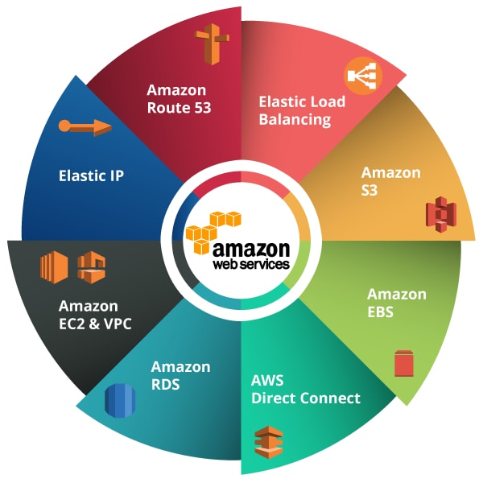


AWS Enterprise Discount Program
A University of California, Office of President negotiated contract with AWS.
Available to all UCR
Single Payer Account per campus
FAU Recharge
15% Discount on all AWS Services for EDP members
31% Additional discount on all AWS S3 & Glacier storage (excluding deep archive) (uswest1 and uswest2)
46% Total discount on storage
Administrative Costs
UCR One-time account setup fee of $135
UCR Annual fee of $407/year for administrative support

Slide 2
AWS, GCP, Azure
 | AWS | AZURE | GCP
UC Agreement | Yes | Yes | Yes (~nov. 2021)
Discounts | 15% + 31% storage | 11% | 12%
Waived Egress Fee | 15% | 100% | 15%
BAA for HIPAA | Yes | Yes | Yes

Slide 3
RDB RFP Project on hold
We received notice from the Chair of the Research Data Backup RFP Committee and UC Procurement lead Tom Trappler that the RDB RFP Project has just been put on hold pending a re-Charter/re-Scope.
This action came from the New RDB RFP Executive Sponsor and UC CIO Van Williams.
The re-Charter/re-Scope meeting set for Dec.13th.

Slide 4
RDB RFP Survey Short Summary
(Lisa Snyder, UCLA)
That most researchers and units have been left to fend for themselves in terms of backup so there is a wide range of solutions in place,
Many are using cloud services for back-up instead of purpose-built backup solutions (which might be OK, certainly better than nothing),
The risk is neigh on impossible to quantify without digging into explore individual researchers’ situations (some have it together, others do not, but it’s spotty at best),
Researchers are eager for a solution and also think the UC should be better supporting their data needs,
There is concern that the UC system will be unable to handle the task (many cited problems with UCPath),
There is hesitation about adopting a system-wide solution because of administrative challenges and cost considerations.

