Slide 1

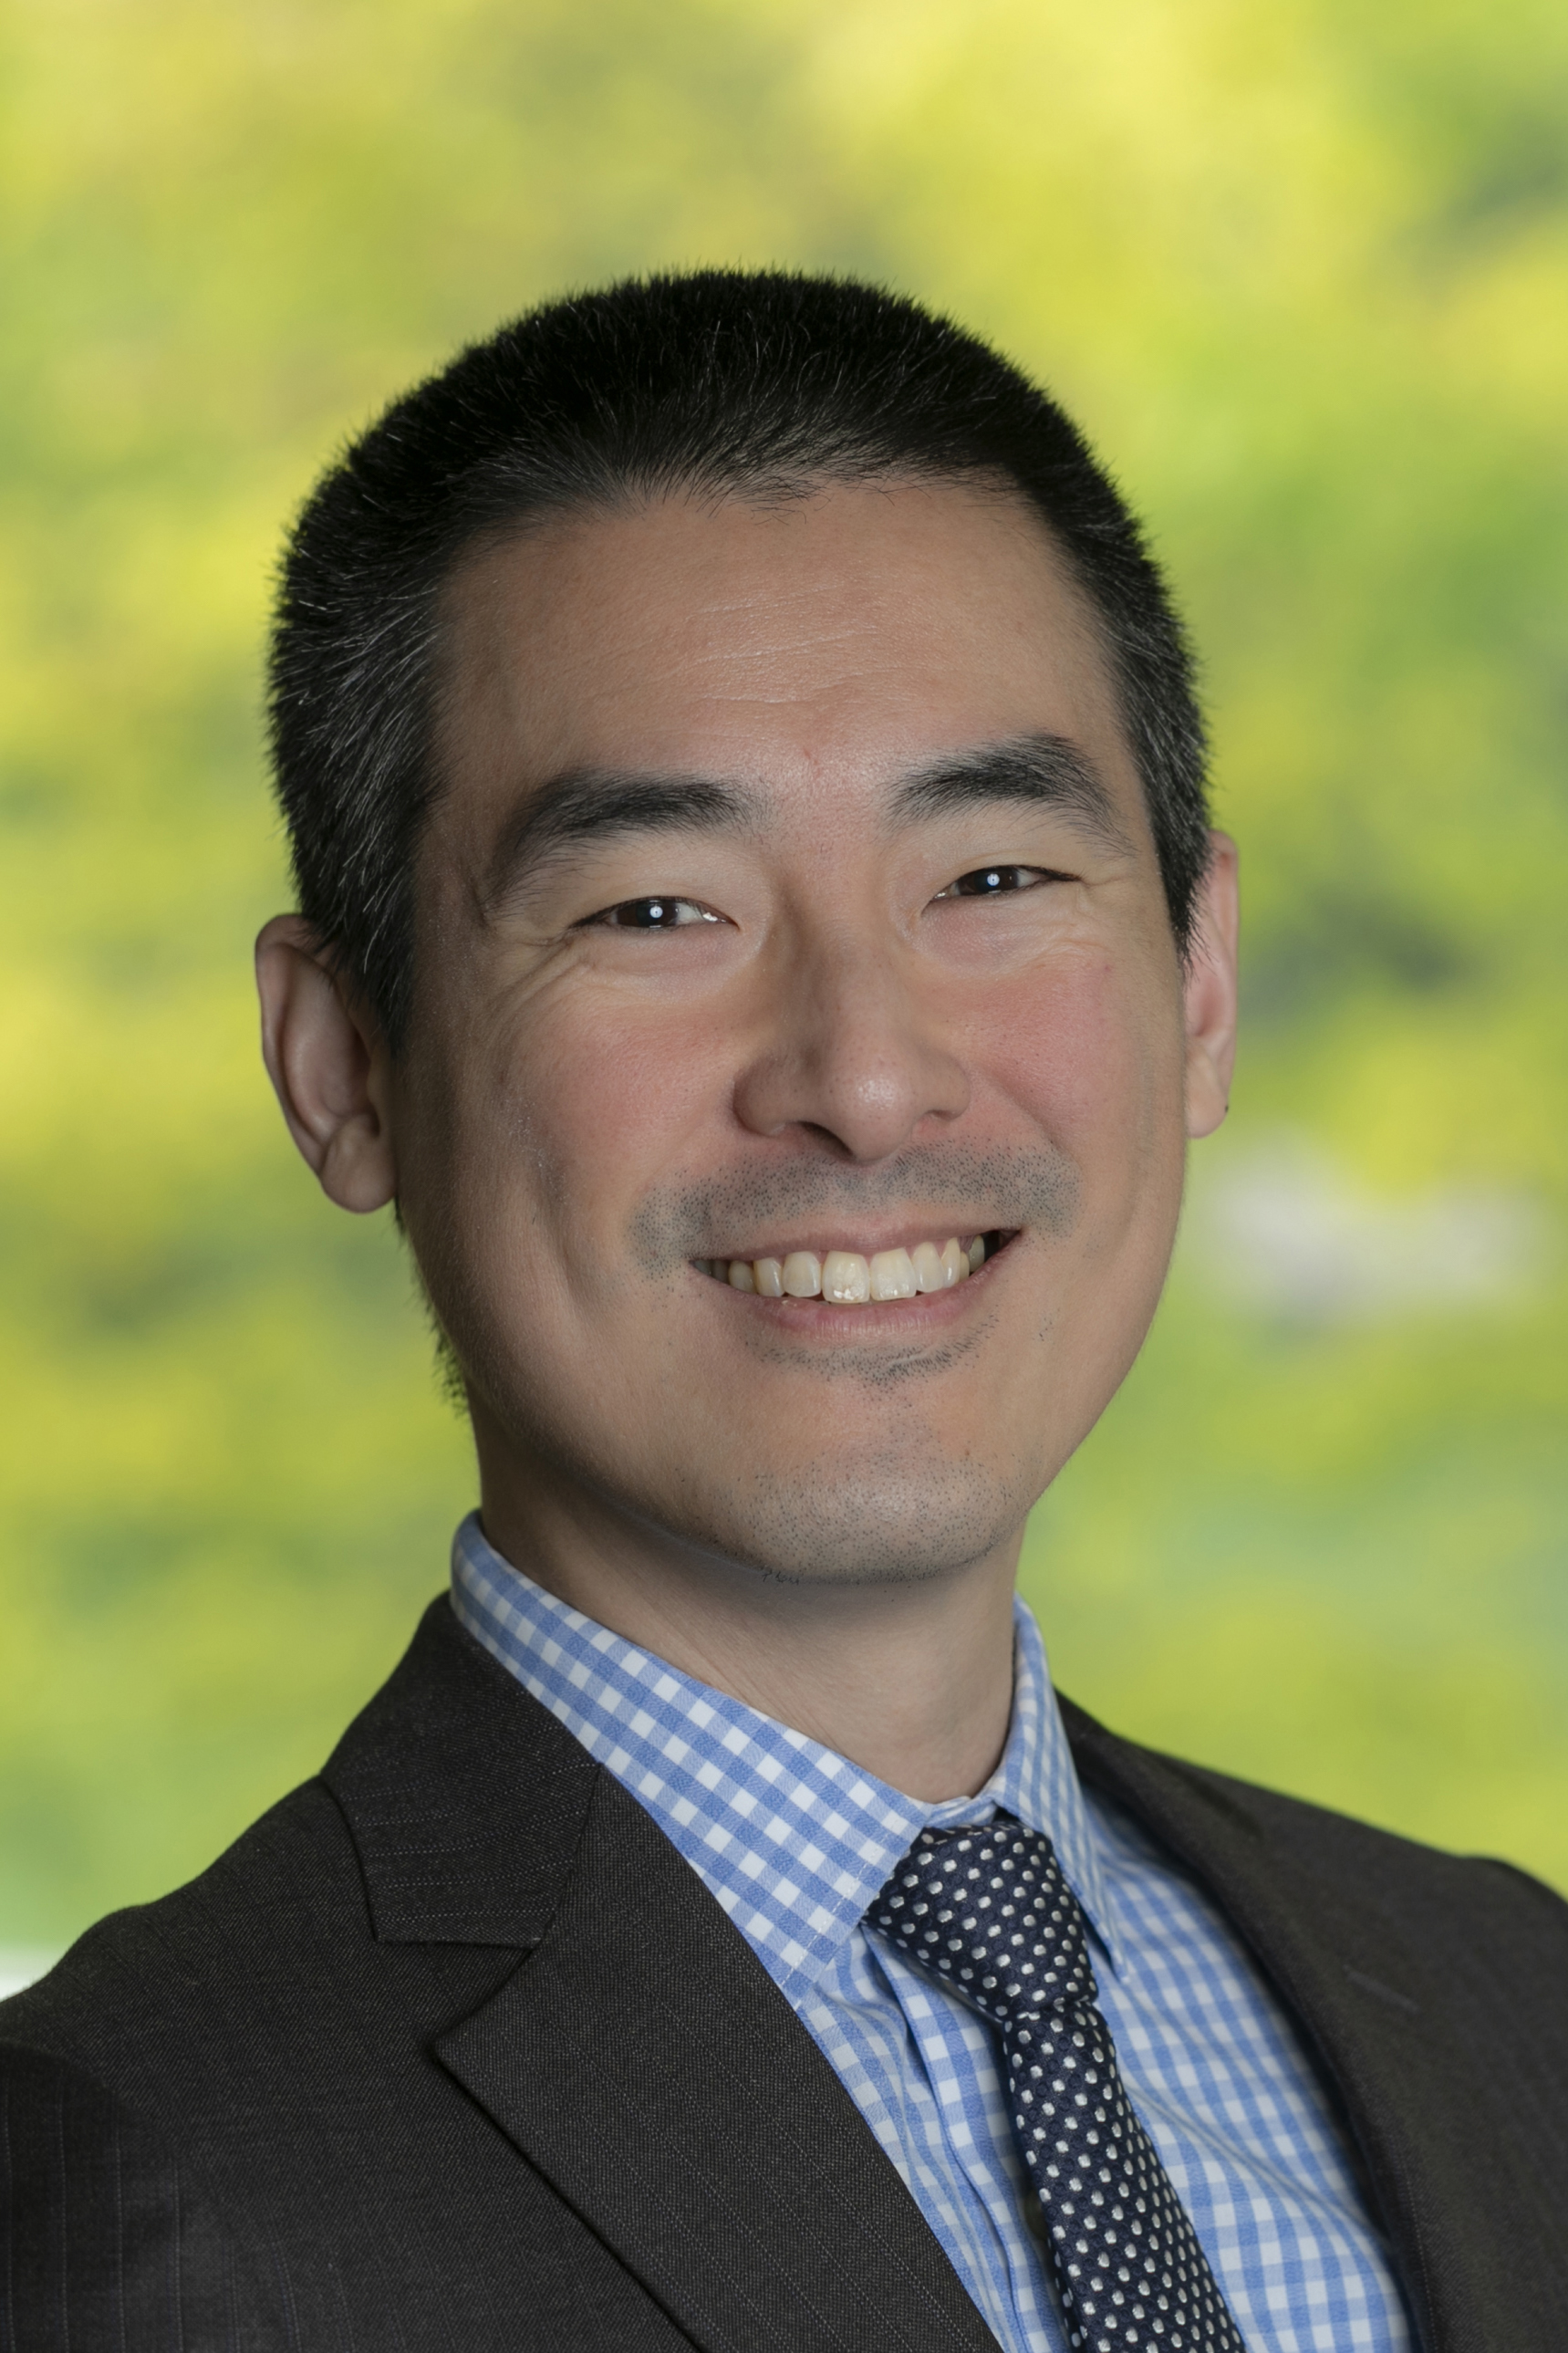
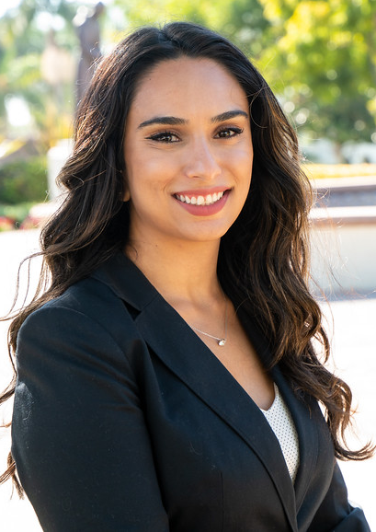
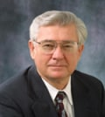
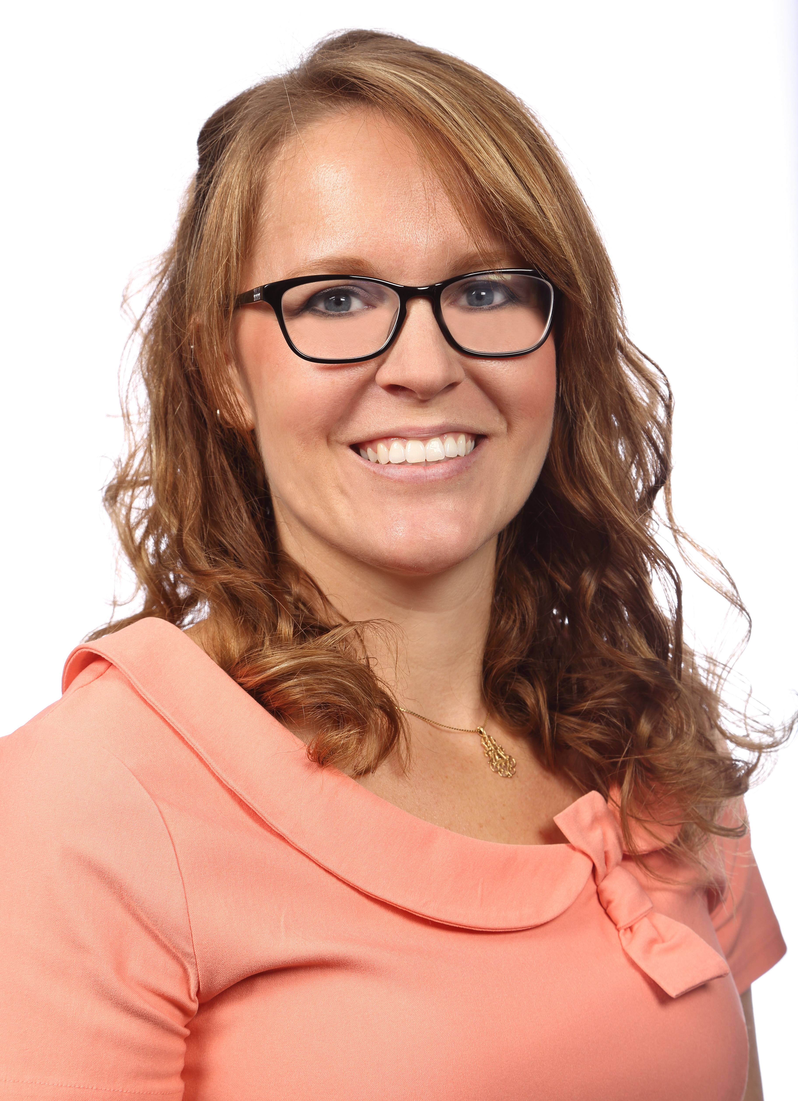
Department of Political Science
CAREER WORKSHOPS
Law School and Legal Careers for Political Science Majors
A degree in political science prepares students for many potential career paths. This session is designed to inform students about the pursuit of law school and legal careers.
The speakers for this week – many of whom are UCR alums – attended law school school and work in the legal field.
Desmund Wu, Teaching Faculty, University of Wisconsin Law School
Peter Mort, Lecturer and Former Attorney, UC Riverside
Meena Kaypour, Graduate Law Clerk, San Diego Office of County Counsel
Rebecca McKee, Assistant City Attorney, Riverside City Attorney’s Office
This workshop will be held in-person and via Zoom. Snacks will be available for those who choose to attend in-person. If you have questions, please email us: medearis@ucr.edu.
TIME:
ZOOM DETAILS:
Friday, May 12th, 2023
12:00 – 1:00 pm
Meeting ID: 940 3251 7937 Passcode: 771086 https://ucr.zoom.us/j/94032517937?pwd=ekNXMG5KanYrdDdwVDVuZm9TbEZMdz09
LOCATION
INTS – Room 1128

