Slide 1
Administrative Services and Strategic Executive Team (ASSET)
Meet and Greet
April 14, 2025

Slide 2

Who is ASSET?
ASSET is a partner-focused, action-oriented shared service team dedicated to delivering collaborative, innovative, and strategic support across various organizational functions, including administrative, human resources, and budget/financial services, along with policy interpretation and compliance.
ASSET serves as a key gateway for supporting and advancing critical strategic goals and initiatives on behalf of campus leadership.
By leveraging the team's collective expertise, ASSET provides organizational units with a tailored portfolio of services designed to meet their specific needs.
ASSET is committed to providing a first-class experience that consistently exceeds expectations in service, quality, value, and excellence.

Slide 3
Core HR Functions Performed by ASSET
General HR Consultation
Recruitment Management
Position Management
Appointment Management
Total Compensation
Executive Searches Management
Employee Onboarding & Separations
Payroll Administration
Background Checks- Live Scan
Benefits & Leave Administration
Labor and Employee Relations
Performance Management
Incentive Award Programs Management (STAR, SPOT etc.)
Employment Contract Administration
HR Policy Review, Interpretation & Compliance
Timesheet Management
Personnel File Management
Employee Compliance Training Management
HR Audits & Data Requests

Slide 4
Core Finance/Business Ops Functions Performed by ASSET
Full Scope Financial Management
Financial Reporting, Reconciliation, & Expense Tracking
Financial Consultations
Budget Development & Submissions
Funding Commitments
Contract and Grant Management
Salary Cost Transfers
Space Management
Procurement Management
Business Operations Support
Procurement/T&E Card Administration
Travel Management
Employee Reimbursements
Contract Administration
Administrative Services
Policy Review, Interpretation & Compliance
Financial Audits & Data Requests

Slide 5

Other Functions Performed by ASSET
Short & Long Term Planning
Strategic Planning & KPI Development
Process Management & Improvement
Project & Portfolio Management
Event Management
Change Management
Communications Management

Slide 6
ASSET Partner Service Delivery Model
ASSET follows a portfolio management service delivery model.
This approach to work is based on dedicated team members serving as centers of expertise for their partner groups.
It leverages a hybrid model that blends the specialized expertise of subject-matter specialists with the flexibility and adaptability of cross-functional generalists.
This approach allows the team to respond nimbly to changing needs and priorities, while leveraging specialized knowledge where necessary.
The combination of both specialized and generalist roles fosters a collaborative environment, enhancing overall efficiency, responsiveness, and strategic alignment across operations.

Slide 7
Effective Portfolio Management
Visibility and ownership of work & constraints
Purpose& Partner driven prioritization
Strategic & adaptive Resource Management
Continuous monitoring of value, execution, and, impact
Changed-enabled culture
Leadership Engagement – Meeting Cadence
Weekly – Leadership Engagement – Org Unit
Monthly – Department Head Meeting with
HR, Budget & Business Operations
Monthly – Cabinet/Leadership Meeting
Adhock – topic specific or need based
Escalations – as needed
Dedicated Team Members for Partner Engagement

Slide 8
ASSET Advisory Board

Slide 9
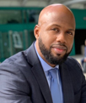
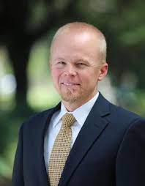



Advisory Board Members
Michael Richards
Associate Chancellor
Standing for Chancellor’s Org
Ken Baerenklau
Associate Provost
Standing for Provost Org
Sheila Hedayati
Executive Director,
EH&S Division
Rotating for PB&A
Denise Woods
Vice Chancellor, Health, Wellbeing, and Safety
Standing for HW&S
Gerry Bomotti
Vice Chancellor and CFO
Ex-officio (non-voting)

Slide 10
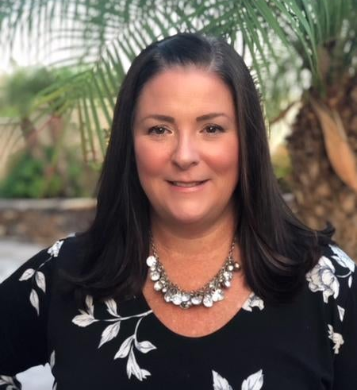
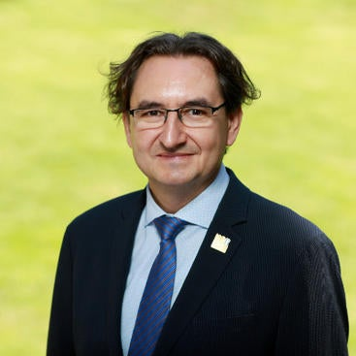
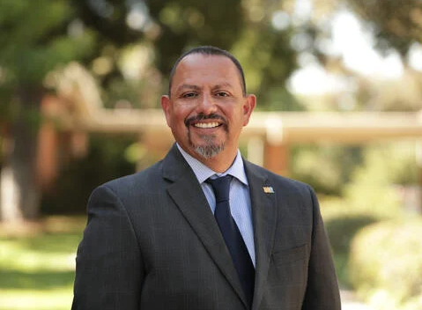
New Advisory Board Members
Emily Engelschall
Associate Vice Chancellor Enrollment Services
Standing for Enrollment Services
Marko Princevac
Vice Provost for International Affairs
Standing for International Affairs
Louie Rodriguez
Vice Provost and Dean of Undergraduate Education
Standing for Undergraduate Education

Slide 11
Advisory Board Structure
Gerry Bomotti
Vice Chancellor, Planning, Budget & Administration
Advisory Board
Board Composition
1 representative – Chancellor’s Org (Org 20)
1 representative – Health, Wellbeing, and
Safety (ORG 42)
1 representative – Provost’s Org (Org 31)
1 representative – Planning, Budget, and Administration (Org 39), Facilities Services/PD&C (Org 28 and Org 30), and Auxiliary Services (Org 19)
1 representative – Enrollment Services (Org33)
1 representative – International Affairs (Org 32)
1 representative –Undergraduate Education (Org 36)
Administrative Services and Strategic Executive Team (ASSET)
Meeting Cadence:
Board - Quarterly Meetings with ASSET Leadership.
Individually – Weekly Meetings with ASSET Leadership.

Slide 12
Advisory Board Collective Charge
Oversight
Guidance
Expertise
Represent
Provide input and recommendations on ASSET operations, overall strategic direction, budget/resource deployment and priorities.
Provide input and recommendations on ASSET service delivery, performance ratings/metrics, ongoing support, and process improvement initiatives.
Support a culture of continuous improvement, professional development, and implementation of leading best practices.
Represent the interests of units supported by the ASSET team and engage in regular feedback with stakeholders.

Slide 13
General Administration
FAST Integration

Slide 14
Business Case for Team Integration
By integrating the ASSET and FAST teams, UCR will create a more agile, cost-effective, and collaborative structure, better positioned to meet evolving needs and drive improved outcomes in business and HR operations and service delivery.
The integration is a strategic move toward a unified, efficient administrative support system.
It will allow UCR to leverage the strengths of both teams, creating efficiencies in operations and enhancing the overall effectiveness of business and HR functions.
With a unified approach, the newly integrated team will have the flexibility to adapt quickly to changes, streamline workflows, and eliminate redundancies, ultimately resulting in a more responsive and resource-efficient system.
The integration will also foster greater collaboration across departments, encouraging a more cohesive working environment where cross-functional teams can innovate and problem-solve together.
Additionally, the strategic alignment of ASSET and FAST will be a forward-thinking move toward building a more resilient and future-ready administrative support system for UCR.

Slide 15
Integration Approach – Lift and Shift
Initial stage: Lift and Shift
When contemplating the integration of FAST to ASSET, the most effective strategy is to begin with a “lift and shift” approach to existing operations.
This method allows for the careful development of a comprehensive integration plan.
Under a "lift and shift" model, the two teams would initiate the integration process under unified leadership who will collaborate to develop a full implementation plan, leveraging the collective expertise of both teams.
This process will also provide an opportunity to identify gaps and critical pain points that need to be addressed.
General Timeline : FAST Leadership Integration – April 2025
FAST Team Integration into ASSET –July 2025

Slide 16
Team Integration and Implementation Plan
Establishment of a core leadership team responsible for developing a plan for team integration and implementation to be approved by the Advisory Board Meeting.
The leadership team will prioritize the creation of a comprehensive integration and implementation strategy designed to forge a unified team, seamlessly combining the distinct cultures of ASSET and FAST.
This effort will focus on nurturing a new, cohesive organizational culture that balances the unique strengths of both teams.
Key strategies will include team-building exercises, the establishment of shared core values, and providing ample support for change through tailored training programs, leadership coaching, and cultivating a culture of open feedback and communication.
This will involve mapping out critical timelines, identifying key stakeholders, and ensuring alignment between both teams.

Slide 17
Transition Timeline
Phase 1: Pre-Integration Planning (2 months: March - April 2025)
Phase 2: Integration Strategy Development (2 months: May –June 2025)
Phase 3: Team Building and Culture Integration (ongoing)
Phase 4: Implementation of Integration Plan (3-6 months: July –December 2025)
Phase 5: Evaluation and Continuous Improvement (Ongoing)

Slide 18
Questions

