Slide 1
Return to Campus Survey
Dr. Jennifer Brown
Vice Provost and Dean of Undergraduate Education

Slide 2
UE Survey

Slide 3
Do you currently serve in a student facing capacity?

Slide 4
How comfortable are you returning to campus on September 1st, 2021?
N=28

Slide 5
Which of the following are concerns you have about returning to work in the office?

Slide 6
Other concerns about returning to work in the office:
Sharing an office space
Indoor mask mandate
Lack of executive communication about COVID mitigation efforts

Slide 7
Which of the following would make you feel more comfortable returning to work?

Slide 8
What would make you feel more comfortable
returning to work?
Requiring everyone to wear masks | Daily Wellness Check
Nothing would make me feel more comfortable returning to the office | Frequent cleaning (wiping down doorknobs, etc)
Staggering hour/shifts | Installing partitions in between desks
Limiting the number of individuals in the building | Air purifiers- no confidence in HVAC
Closing communal spaces | Secured care/support for children or other family members
Having secured care/support for children or other family members | Low density

Slide 9
Which of the following you prefer not to be implemented when returning to work in the office?

Slide 10
Other things you would prefer not to be implemented:
Wearing masks indoors when fully vaccinated
Unvaccinated people should not be allowed on campus
More safety precautions need to be implemented
Proposed plans for masks, partitions, closing spaces, or limiting access just reinforces staff concerns about the safety of returning
Daily Wellness Check is not effective. Seems like a legal effort to prevent liability. Offers no protection.

Slide 11
What should be considered regarding COVID variants?
Rising infection rates in Riverside and San Bernardino Counties
Continued flexibility from the campus, orgs, and departments
Parents are at risk of being exposed and passing it on to their children who are unable to get vaccinated
The vaccine does not protect us against new variants
Long term effects are unknown
High touch areas are continuously sanitized
Staff access to disinfectant sprays and hand sanitizers
Air ducts are working properly and filtering the air

Slide 12
What other factors should UE consider?
Importance of leadership
Self-test kits for staff
Enforcing social distancing
Common Area Use (Microwave Use, Sink, Refrigerator Cleaning)
Various Levels of Risks

Slide 13
Consistent Monitoring

Slide 14
UCR Vaccination Mandate
74% employees and 64% of students have complied with vaccine mandate
Students will get a series of notices including a progressive discipline process
Every week they will get a reminder
Communicating to non-compliant students – text and email
ABC of vaccine compliance
Possible holds start August 30th
Employees will get notices and ultimately progressive discipline

Slide 15
COVID-19 Update 08.17.21

Slide 16
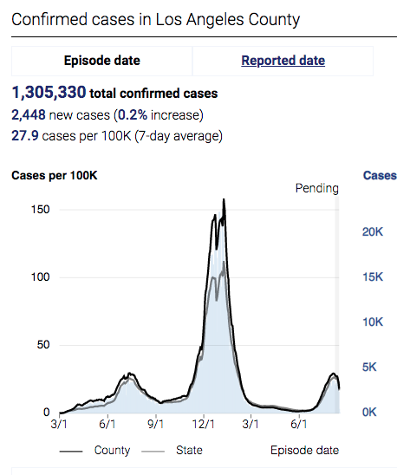
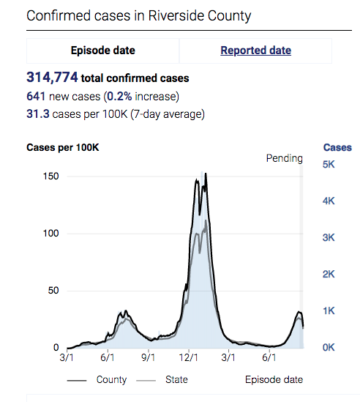
Number of COVID-19 Cases

Slide 17
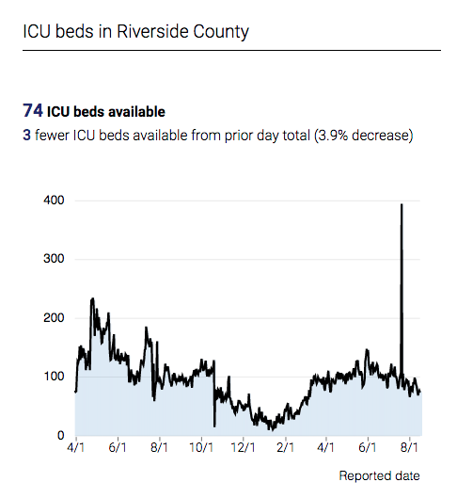
Riverside County ICU Beds

Slide 18
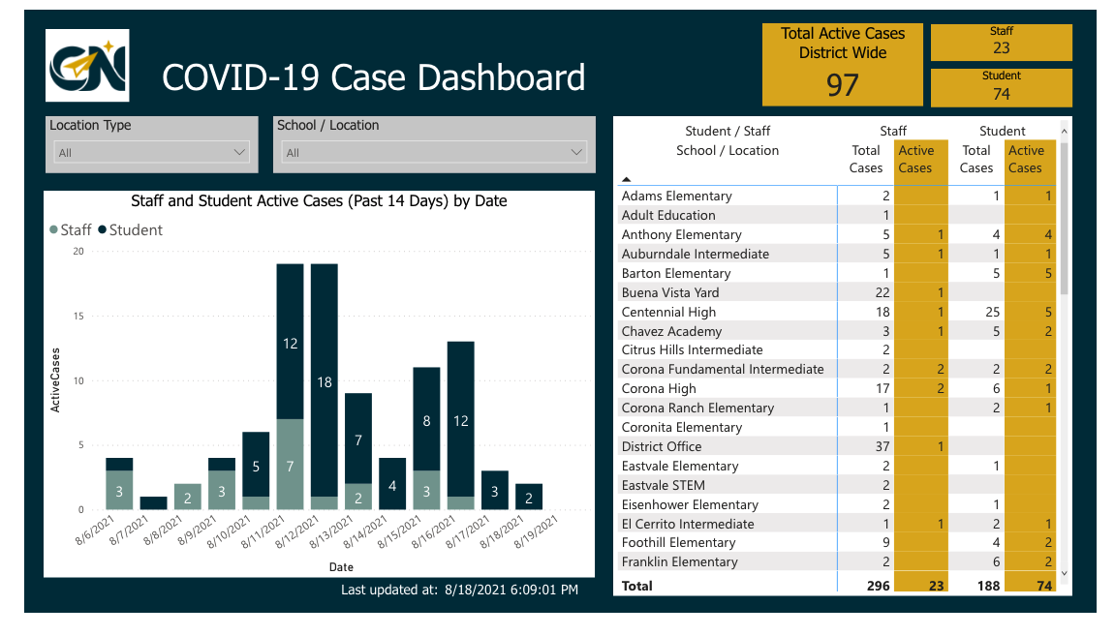

Slide 19
What will UE do based on survey results?
Getting Exposed at Work
Staggered Schedules
Working to have low density in shared offices
Flexible Parking Passes
TAPS Website
Decreased Productivity
Need more Information
Transporting Office Equipment
Staff Assembly HEERf Funding – Hybrid Office Equipment
Anonymous Qualtrics Link for ongoing feedback

Slide 20
What are we missing?

Slide 21
Campus Resources
Website | Resource
COVID-19 training https://insideucr.ucr.edu/announcements/2021/02/02/updated-covid-19-prevention-training | Training required for staff/faculty in order to return to campus; can be accessed through the UC Learning Center (LMS)
Daily Wellness Check https://ucriverside.az1.qualtrics.com/jfe/form/SV_cCNbV5EYqSIvXaC | Form must be completed prior to arriving on campus.
University of California, Riverside COVID-19 Prevention Plan (UCR C19 PP) | Prevention measures the campus has put in place and what specific responsibilities are placed on faculty, staff, and students returning to campus, and essential personnel remaining on campus, in order to ensure the safety of the entire campus community.
https://campusreturn.ucr.edu/ | Current information for returning to campus
http://covidverify.ucr.edu/ | Supervisor access to verify vaccination registration
https://flexport.ucr.edu/ebusiness/Account/Portal | Parking permit information
https://provost.ucr.edu/blog/2021/07/13/use-federal-higher-education-emergency-relief-funds-heerf-ucr | Staff assembly information on HEERF – hybrid and remote

Slide 22
Questions?

