Slide 1
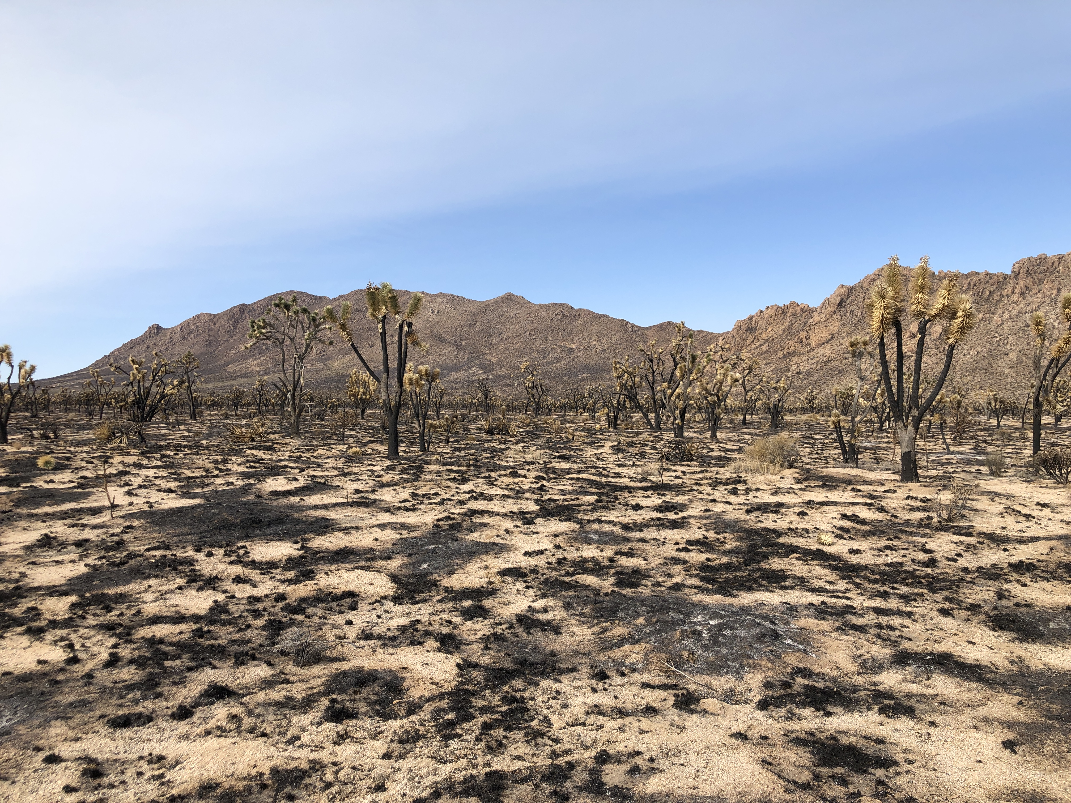
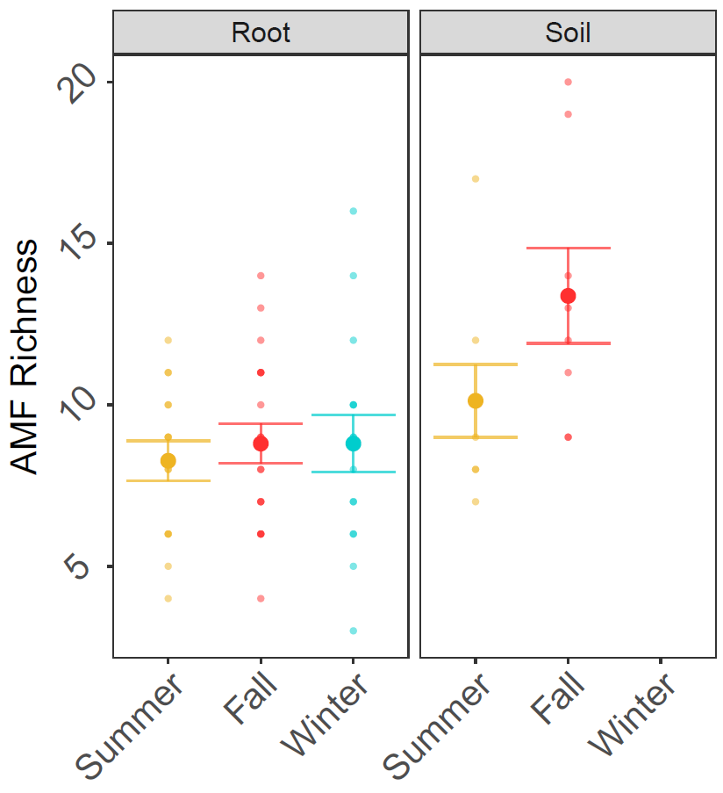
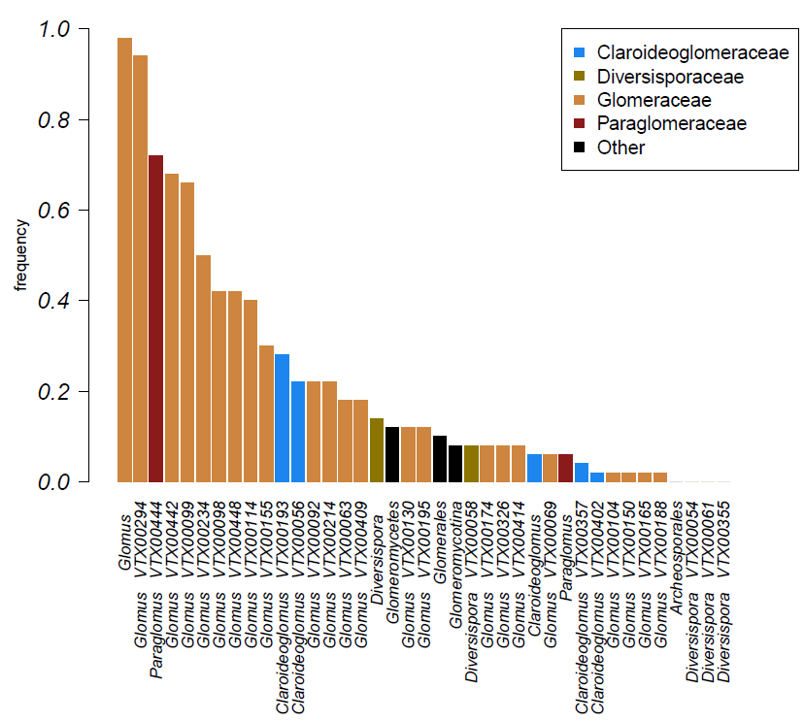
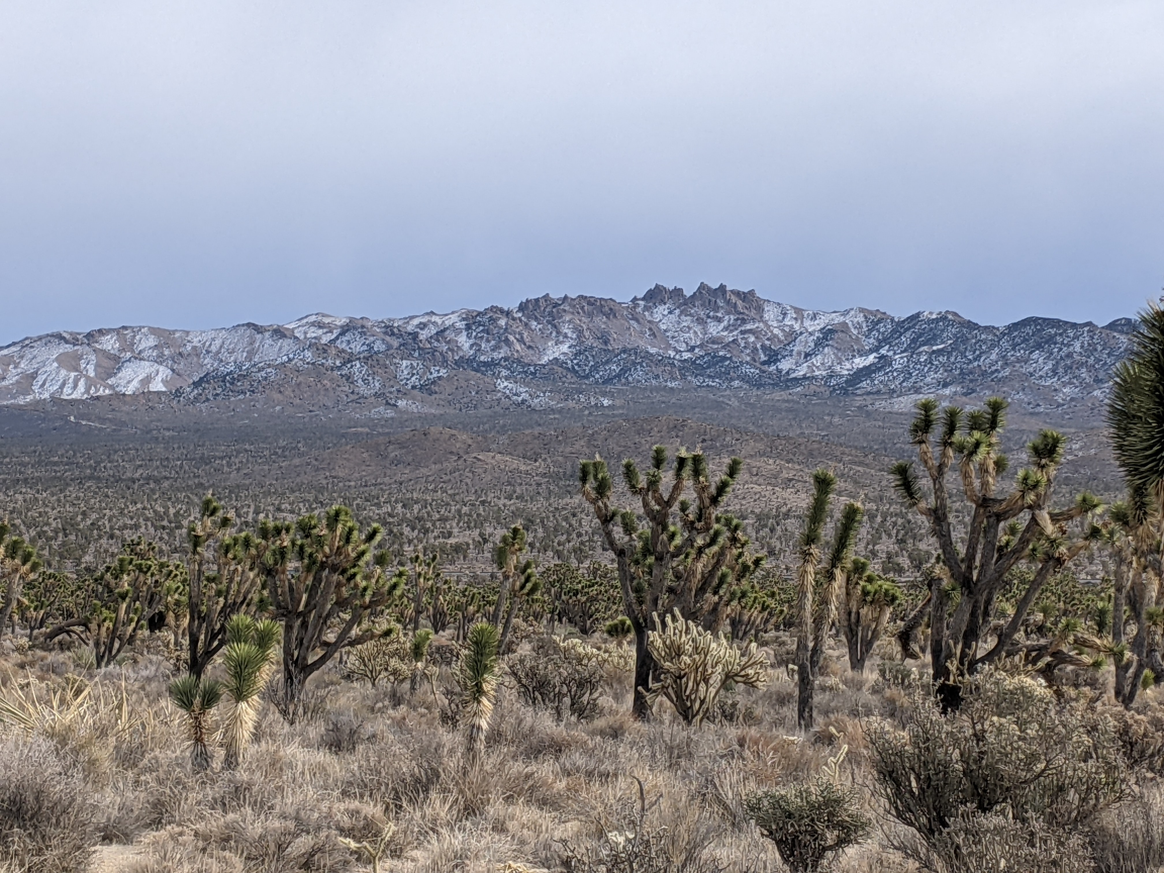
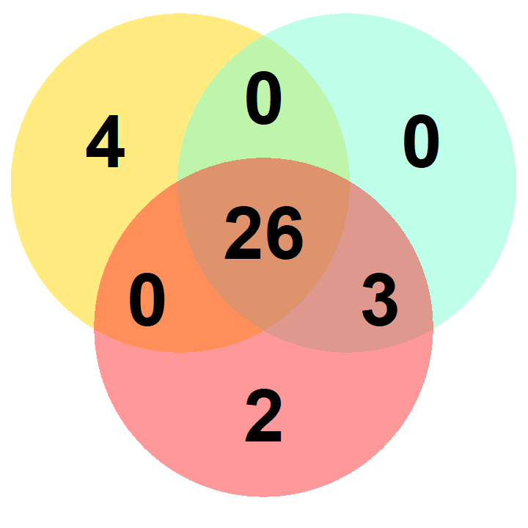
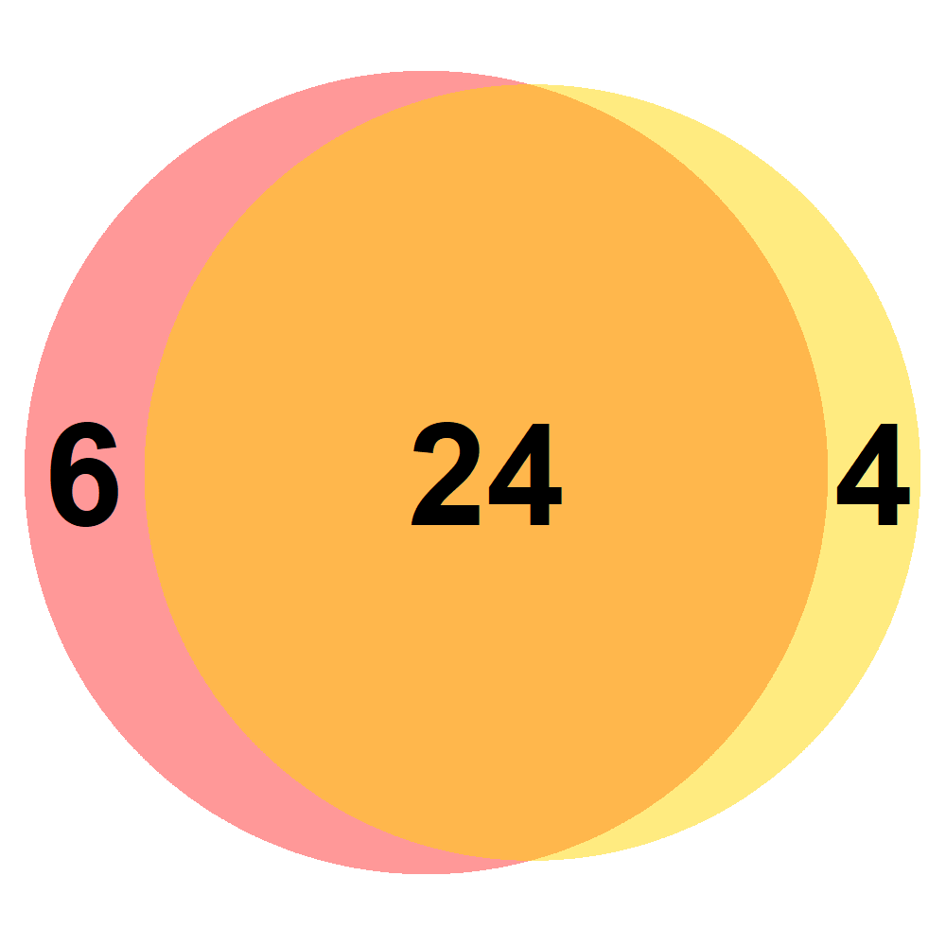
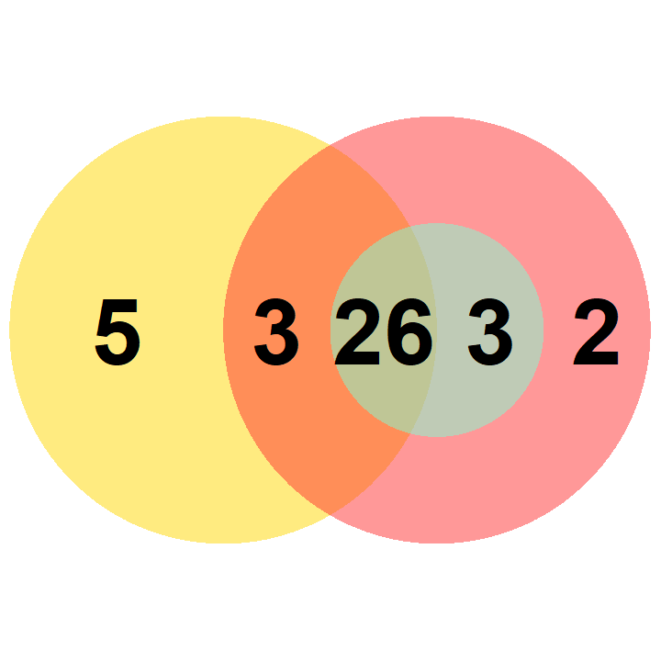
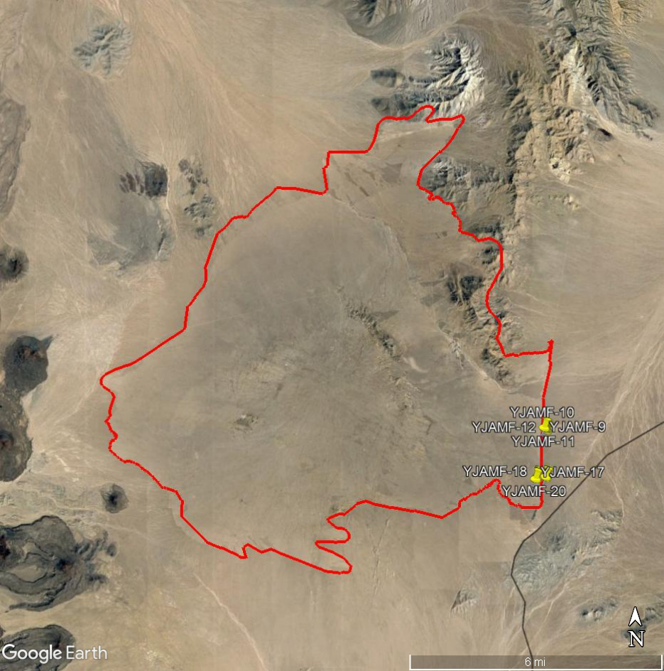
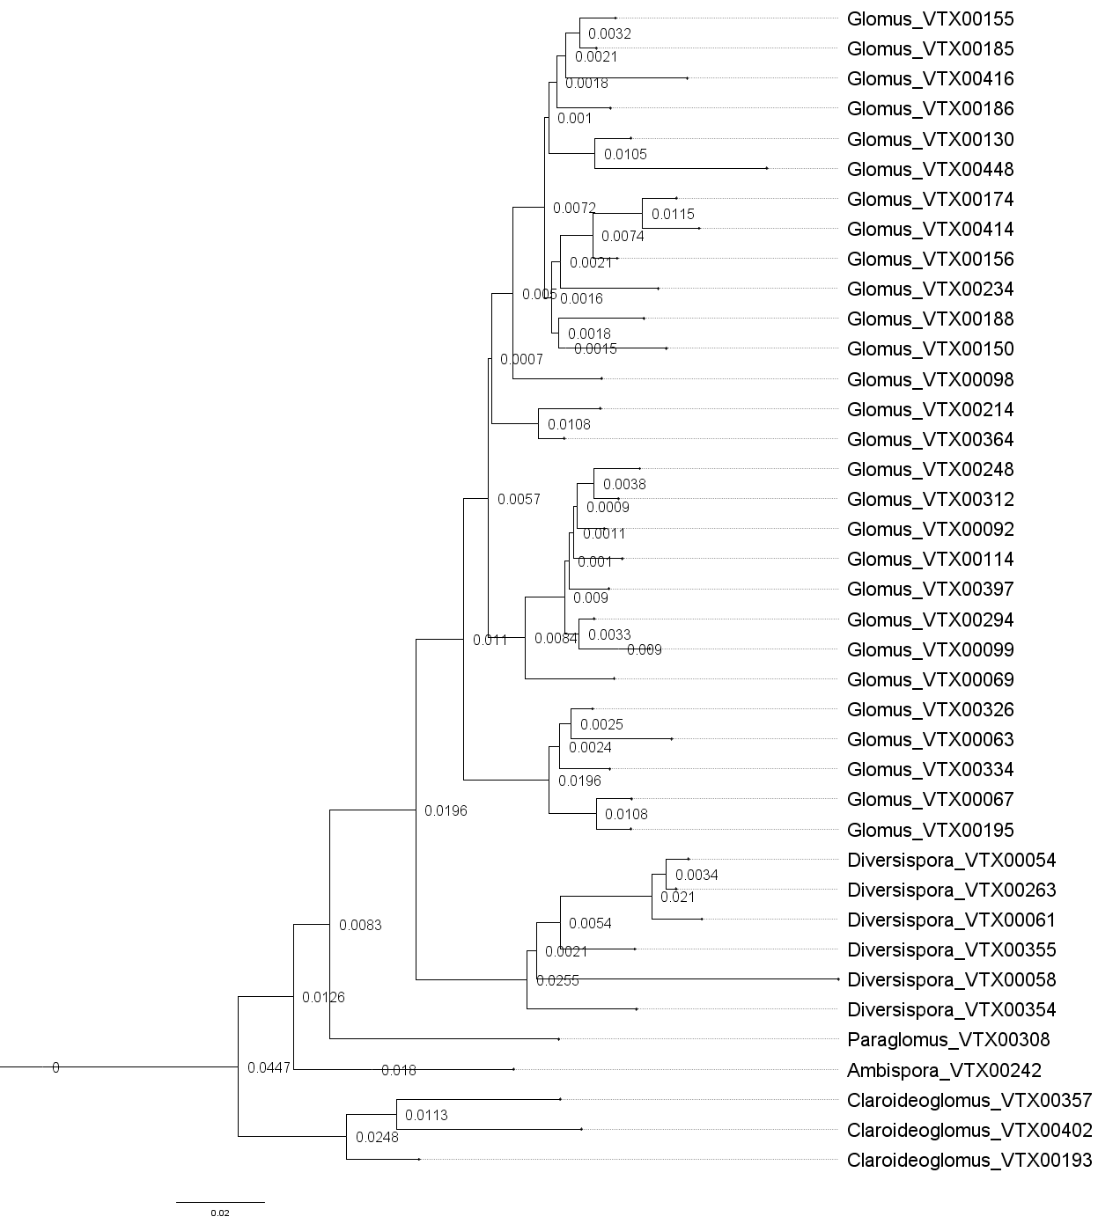
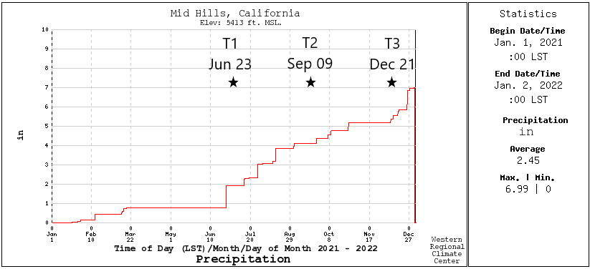
Eastern Joshua tree associated AM fungi maintain composition across seasons
A. Joukhajian*, S. I. Glassman*
*Department of Microbiology and Plant Pathology, University of California, Riverside, CA, USA
Contact: Arik.Joukhajian@email.ucr.edu
4,032 × 3,024
4,032 × 3,024
,024
AMF Richness does not vary seasonally
Glomeraceae appear most frequently in roots
Introduction
The 2020 Dome Fire burned 43,273 acres of the California Mojave National Preserve, accounting for ¼ of the Eastern Joshua tree (Yucca jaegeriana) forest and killing ~ 1 million trees¹
Joshua trees like Y. jaegeriana and its closely related sister species Y. brevifolia (Western Joshua Tree), have slow growth and are not adapted to high severity fires. They are unlikely to recover without intervention.
Arbuscular mycorrhizal fungi (AMF) are critical to desert plant survival³ and AMF amendments will likely improve Joshua tree restoration, yet the AMF of Y. jaegeriana remain completed uncharacterized.
Fig. 5. Mean taxa richness across each timepoint in root and soil samples.
Across 72 samples collected from 20 trees from 3 seasons for roots and 2 seasons for soils, we identified 39 AMF virtual taxa from 4 families.
The mean per tree AMF richness did not vary across seasons but mean richness was significantly greater in soils (11.75 ± 0.99) than roots (8.64 ± 0.39; K-W: Χ² = 7.6, p = 0.005)
Fig. 1. The aftermath of the Dome Fire.
4,032 × 3,024
Fig 2. The unburned shrublands which make up the Eastern Joshua tree forest surrounding Cima Dome.
Most species co-occur across seasons
Fig. 8. Rank abundance curve of AMF taxa detected in 50 root samples from all three timepoints. The y axis represents the relative frequency of each taxa per total number of root samples.
Here, we sought to characterize Y. jaegeriana AMF richness, abundance, and community composition with both molecular and traditional morphological methods to identify how AMF vary in 1) richness, 2) composition, and 3) abundance across seasons in roots versus soils.
Root
Soil
Root and Soil
Conclusions and Future Directions
4,032 × 3,024
We characterized for the first time the AMF associated with Y. jaegeriana, finding a diverse community of 39 taxa from 4 families that is fairly consistent in richness and composition across seasons
Several taxa found had previously been detected inhabiting Y. brevifolia in Joshua Tree National Park including the virtual taxa Claroideoglomus VTX00193 and VTX00056, and Glomus VTX00069, VTX00092, and VTX0114
The genus Glomus is dominant across soil and root samples across all seasons, with VTX 00294 appearing most frequently
We will next test if AMF and soil amendments improve existing aboveground based Eastern Joshua tree restoration efforts in the Mojave National Preserve
Cima Dome burn scar perimeter and pins marking sampled Eastern Joshua trees.
4,032 × 3,024
Methods
Soil and roots were sampled at 10-15 cm depth from 20 healthy Y. jaegeriana trees located near the Dome Fire perimeter in Summer, Fall, and Winter 2021
DNA was extracted from roots and soils and AMF were PCR amplified with WANDA-AML2 primers and sequenced with Illumina MiSeq
Sequences were analyzed in QIIME2 and taxonomy was assigned using the MaarjAM database⁴
Fig 6. Venn diagrams of taxa overlap between timepoints.
We detected 35 taxa in roots and 34 taxa in soil
In our root samples, 4 taxa only appeared in the Summer, with 2 more appearing in the Fall, and no more new taxa appearing in the Winter
In our soil samples, 4 samples were only detected in Summer while 6 new taxa appeared in the Fall
Fig. 3. Relative location of the Dome Fire burn scar.
Pinned points indicate sampling locations.
We thank the National Park Service for their cooperation and acknowledge the native Nuwuvi people who were stewards of this land. We thank Aishwarya Veerabahu, Marcos Vinicius Caiafa Sepulveda, Dylan Enright, Anna Nyugen, and Basubi Binti Zhilik for their assistance with field sampling.
References: (1) NPS. Dome Fire - Mojave National Preserve. (2020). (2) Smith SE, Read DJ. 2008. Mycorrhizal symbiosis. Cambridge, UK. (3) Titus, J H., et al. Western North American Naturalist (2002): 327-334. (4) Öpik, M. et al. 2010. New Phytologist 188: 223-241.
Fig. 4. Total annual precipitation and sampling dates. Sampling of root and soil from 20 trees occurred in the Summer (Jun 23), Fall (Sep 9), and Winter (Dec 21)
Fig. 7. A phylogenetic tree of the taxa detected across all our samples.

