Slide 1
Time & Attendance Reporting System (TARS) for Graduate Students

Slide 2
Agenda
Context
GSR-Specific PTO Policies
Types of Leaves
Job Aid: Step-by-Step Walkthrough
FAQs
Monthly TARS Schedule
TARS E-mail Examples
Q&A

Slide 3
Goal
Goal:
Understand the TARS timesheet process
Fill out and submit a timesheet through TARS
(Supervisors) Approve a TARS timesheet

Slide 4
Context
New contracts for ASEs and GSRs
Slight difference between contracts
New Process for Timesheets
Increase in questions from graduate students and supervisors on timesheet process

Slide 5
GSR-Specific PTO Policies
Who is eligible for PTO?
GSRs with appointment of 25% or more are now eligible for paid time off
How much PTO do they earn?
1 day PTO for every full month of service
Does their PTO carry over?
Unused PTO not carried over, according to their contract.
Contract:
https://ucnet.universityofcalifornia.edu/labor/bargaining-units/br/docs/br_23_personal-time-off_2022-2025.pdf

Slide 6
GSR and ASE – Types of Leaves
Both GSRs and ASEs are now expected to enter their leaves into TARS
Most common types of leaves:
Full details in contract:
GSR contract: https://ucnet.universityofcalifornia.edu/labor/bargaining-units/br/docs/br_17_leaves_2022-2025.pdf
ASE contract: https://ucnet.universityofcalifornia.edu/labor/bargaining-units/bx/docs/bx_18-leaves_2022-2025.pdf
Military Leave | Pregnancy Leave | Short Term Leave
Long Term Leave | Bereavement | Jury Duty
Family Leave*
Family member: GSR’s/ASE’s parent, child, spouse, domestic partner, grandparent, grandchild, or sibling.

Slide 7
TARS Training Job Aids
ASE/GSR Leave Reporting Entry – for Graduate Students
https://live-ucr-graduate.pantheonsite.io/document/asegsrjobaidpdf
GSR/ASE Timesheet Approval – for Supervisors
https://live-ucr-graduate.pantheonsite.io/document/supervisorjobaidpdf

Slide 8
FAQs
How do I generate a timesheet?
Log into TARS to generate a timesheet each month.
Do I need to fill out a timesheet if I haven’t taken leave that month?
Yes, a timesheet must be submitted even if leave wasn’t taken that month. If a leave wasn’t taken, submit a blank timesheet to your supervisor.
Will TARS show PTO balances?
No, supervisors will keep track of PTO balances.

Slide 9
FAQs
Do I record my hours worked in the timesheet?
No, as an exempt employee, you are not expected to record your hours worked in TARS.
Are supervisors expected to approve timesheets even if no leave was recorded?
Yes, supervisors are expected to approve timesheets regardless if a leave was recorded or not.
Who do I contact if I have more questions after this session?
E-mail timesheetfeedback@ucr.edu with TARS related questions

Slide 10
Monthly TARS Schedule
Monthly TARS Schedule
https://accounting.ucr.edu/payroll-coordination/payroll-calendars/monthly-time-attendance-schedule

Slide 11
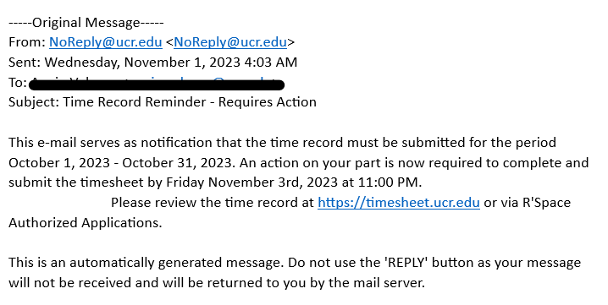
TARS Email Example
Time Record Reminder – Requires Action from Graduate Student

Slide 12
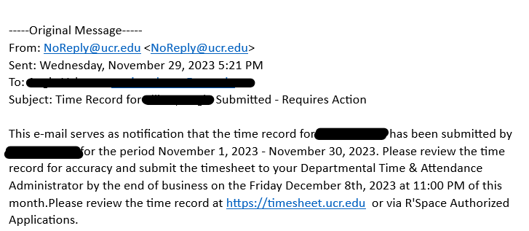
TARS Email Example
Time Record for (Employee) Submitted – Requires Action from Supervisor.

Slide 13
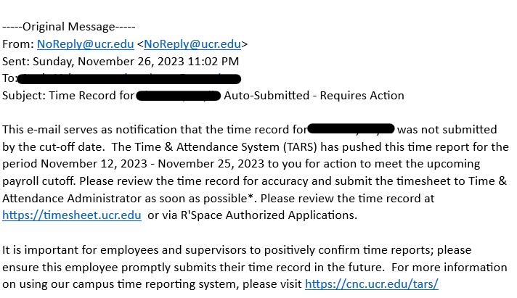
TARS Email Example
Time Record for (Student’s Name) Auto-Submitted – Requires Action from Supervisor.

Slide 14
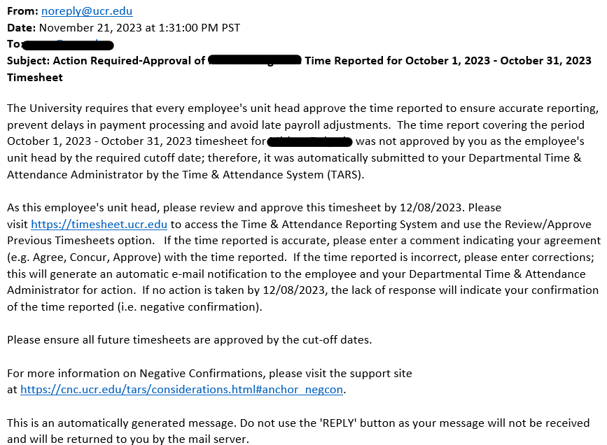
TARS Email Example
Action Required – Supervisor Approval (Timesheet was not approved on time)

Slide 15
Questions
&
Answers

