Slide 1


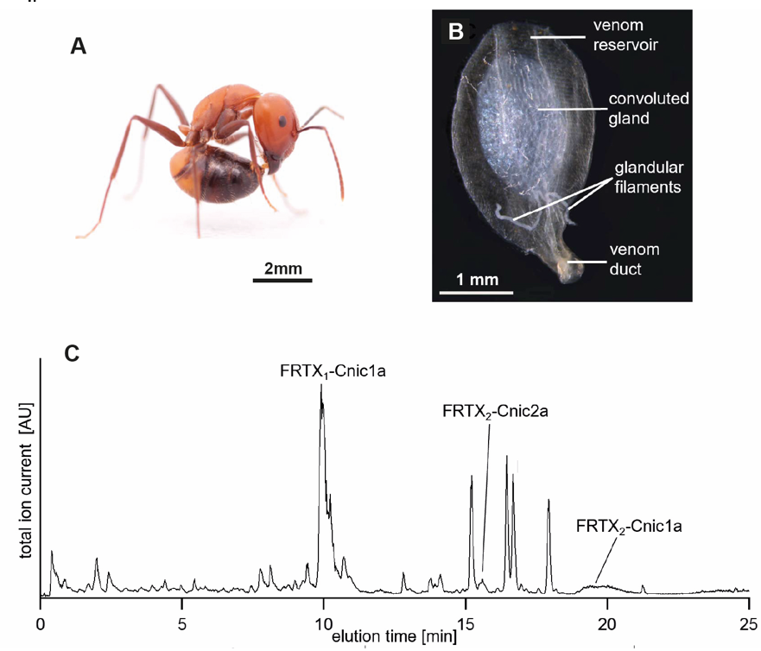
PhD position advertisement
Genomic Basis of Evolutionary Innovations (Gevol)
Interdisciplinary project:
combining organismic (Simon Tragust)
comparative genomic and transcriptomic (Barbara Feldmeyer ) as well as
analytical chemistry (Timo Niedermeyer ) know-how and methods
More info and how to apply:
https://www.zoologie.uni-halle.de/allgemeine_zoologie/staff/tragust/3077307_3467732/

