Slide 1

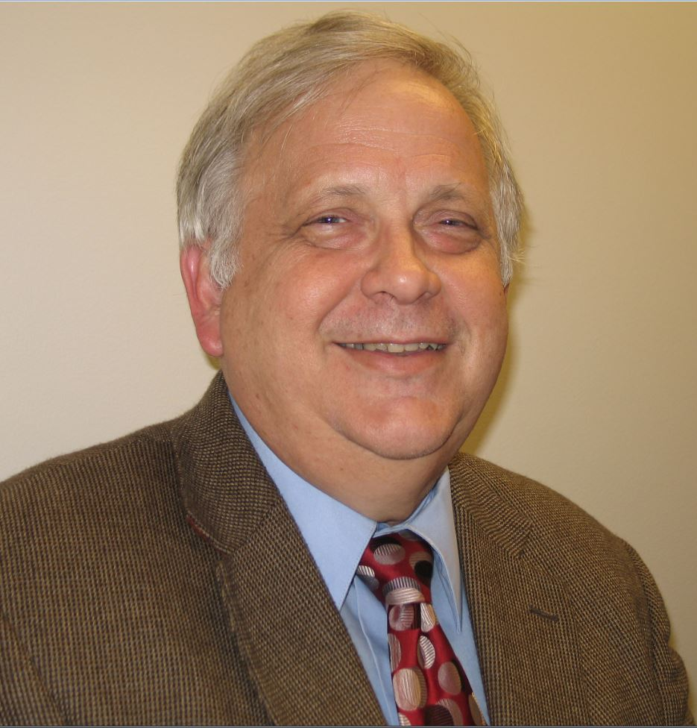




Mite-y Talks: 2023 International Webinar Series
Ticks
Mite ecology
The Acarological Society of America (ASA) is pleased to present to you our second year of international webinar series. The aim of our web series is to showcase research in acarology and make it accessible to a broader audience. We feature acarologists who have largely contributed to the study of Acari through a career of innovative research in multiple subfields of acarology. Join us to learn more about their research and ask questions!
This month, we will be hearing from Dr. Michael Roe, Professor at the North Carolina State University :
Phylogeny
Ticks
Ticks are not Insects- How do they see, smell and reproduce
Adult ticks must take a blood meal before they reproduce. For decades there has been the general trend for researchers and the public to assume that since ticks look like and develop in stages like insects, their body functions are similar to insects. My lab goal has been to test this hypothesis relative to how ticks regulate egg development with hormones, how they smell and taste, and how they see the world around them. My presentation is all about "ticks are not insects" and the "unexpected".
Dr. Michael Roe
Wednesday,
May 31, 2023
2 PM (ET)
Registration Link: https://ufl.zoom.us/meeting/register/tJUlf-mqqTkoH9IF1FxiblRZ6oPI7O5LSyMw
@AcarologicalSoc
edemard@ufl.edu
https://www.youtube.com/channel/UCHhTYCYByN0W8E9b-NiRTgA
https://acarologicalsoc.org/
Acarological Society of America

