Slide 1


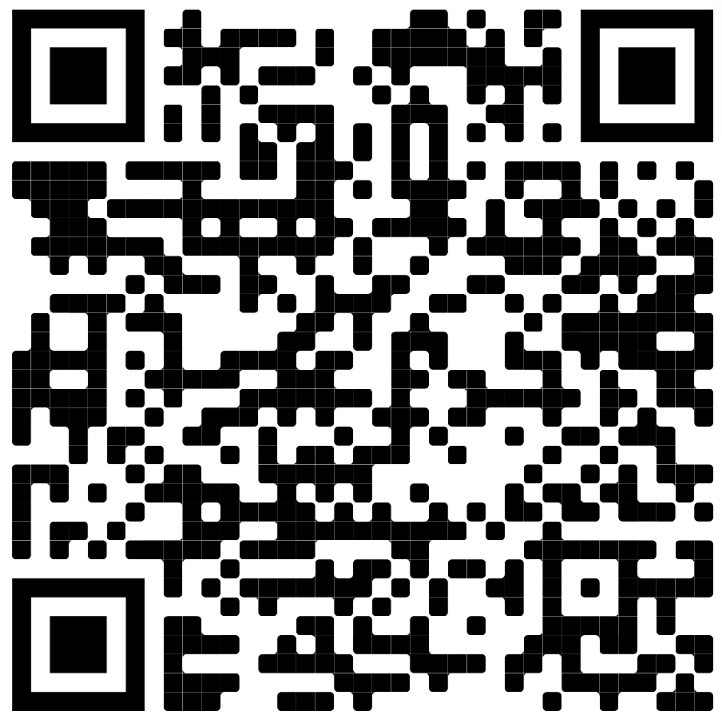

The Department of Entomology invites applications from undergraduate students for our Inclusivity
Fellowship Program to conduct laboratory research in entomology at UCR. We recognize that there
are marginalized groups that face systemic barriers throughout their academic journeys.
An award of $1000 will be provided to an undergraduate student that has faced or addressed social,
cultural, and financial barriers to participation in research. The funds are meant to support their
ability to participate in laboratory research under the guidance of a Department of Entomology
principal investigator. Faculty members at UCR may provide additional research support and will
provide mentorship. At this time, this scholarship is limited to students enrolled at colleges and
universities in Southern California.
applications must be submitted by 5:00 pm on Sunday, May 1st, 2022
https://entomology.ucr.edu/inclusivity-entomology - go to inclusivity scholarship application

