Slide 1
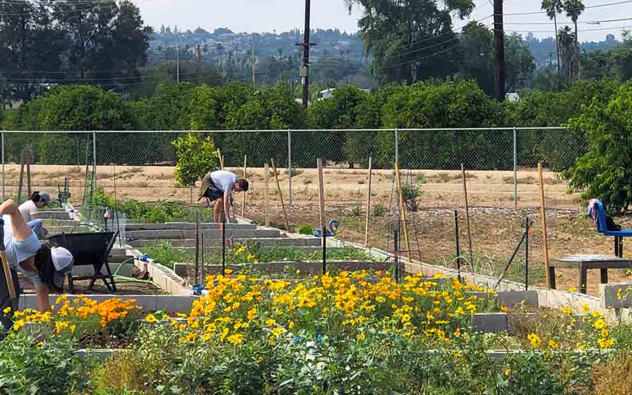
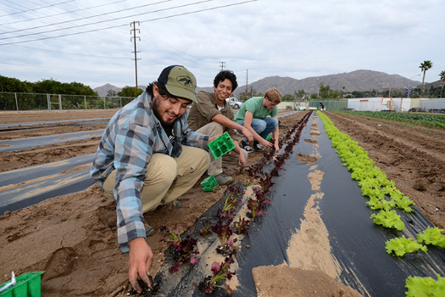
UCR R’Garden
Grow your own vegetables and flowers!
Help feed the campus community
Learn about gardening, composting, sustainability initiatives, and more
Participate in workshops and social events organized by and for students
Located adjacent to Lot 30
Volunteer and internship opportunities are available!
Contact:
  amy.litt@ucr.edu
  crystal.brachetti@ucr.edu

