Slide 1
Graduate Quantitative Methods Center (GradQuant)
GradSuccess
August 10, 2022

Slide 2
What is GradQuant?
Graduate Quantitative
Methods Center
Part of GradSuccess:
GradQuant
Graduate Writing Center
Graduate Student Resource Center
Graduate Student Mentorship Program
Teaching Assistant Development Program
Provides programming on basic and advanced statistics, data analysis, experimental design, computer programming, and digital research methods
Notes:
Graduate Quantitative Methods Center
Improves UCR graduate students’ training in quantitative methods
probability and statistical inference
statistical software and computing
math for statistics
professional ethics regarding data
Provides support for all levels

Slide 3
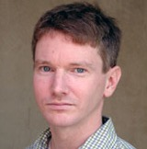
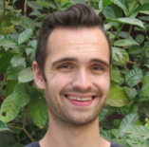
Our Staff
Dr. Kevin Esterling
Faculty Director
Jason Chou
Coordinator
Dr. Diogo Ferrari
Associate Faculty Director
Matt Arthur
Lead Consultant

Slide 4
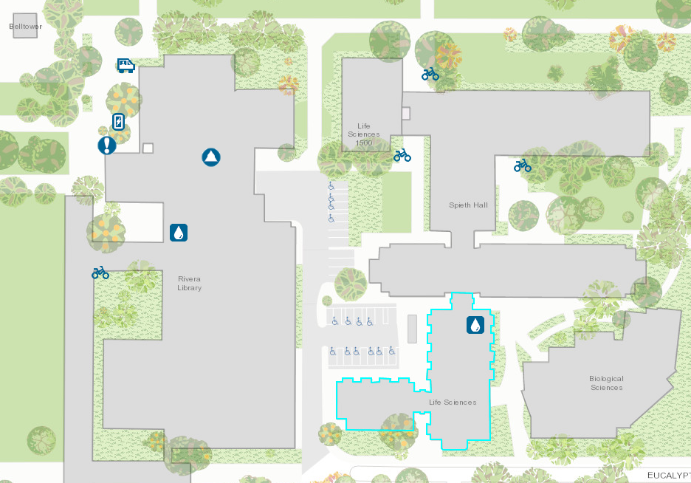
Where is GradQuant?
Belltower
When we are on campus, we are located in
Life Sciences 1425.
Rivera Library
Life Sciences

Slide 5
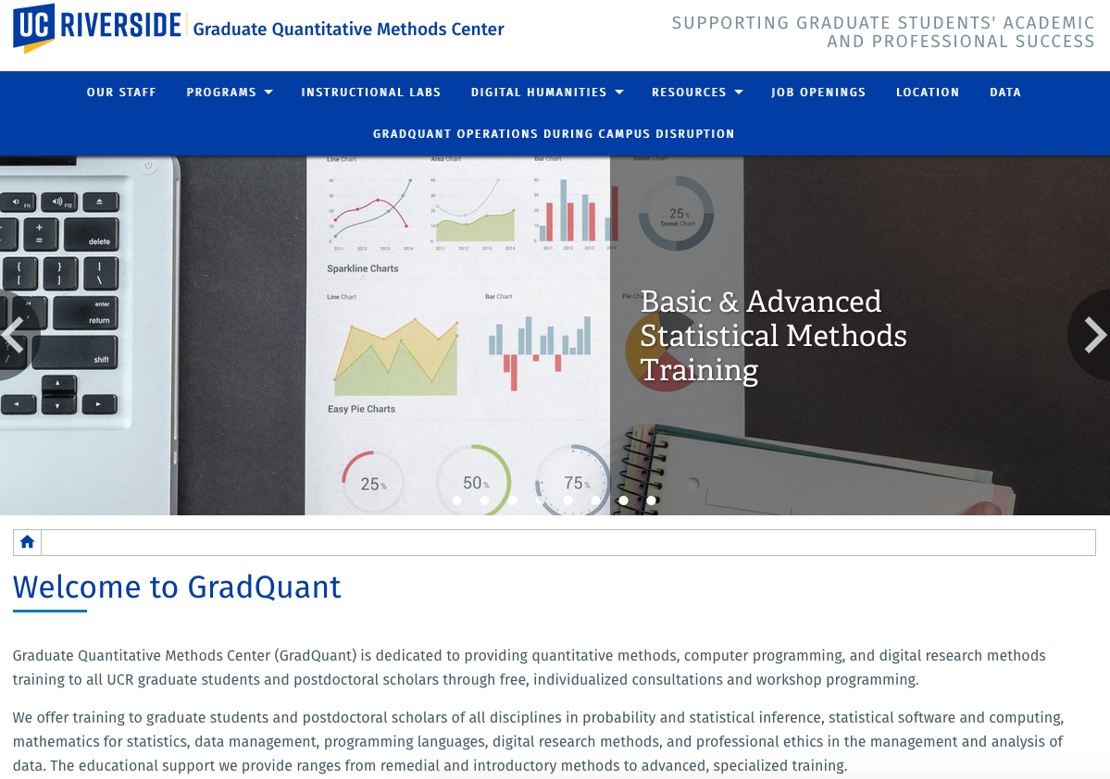
Website: https://gradquant.ucr.edu

Slide 6
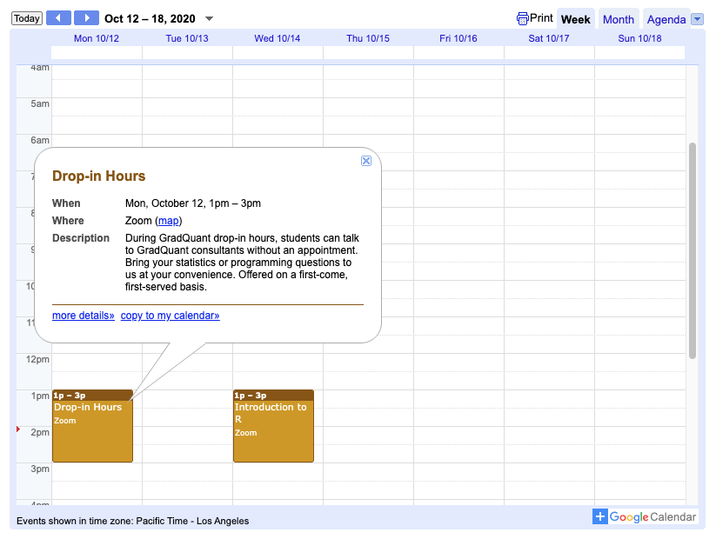
Calendar
On the GradSuccess main page
On GradQuant “Workshops” and “Drop-in hours” pages
Shows GradQuant workshops, drop-in hours, and other events
Click on a calendar item to show event details

Slide 7
GradQuant Programs
Individual consultations
Drop-in and Hacky Hours
Data Analysis Workshops
Guest speaker presentations
Summer Statistics and Programming Bootcamp
Statistics and Programming Resources
Previous Workshops Recordings
Quantitative data analysis
Digital humanities

Slide 8
Individual Consultations
https://gradquant.ucr.edu/programs/consultations
20- and 50-minute appointments.
Currently offered online in Skype.
Discuss statistical analyses for your projects.
Troubleshoot code, learn new things, and review your results.
Visit https://ucr.mywconline.com to schedule a consultation.
Notes:
Work on whatever statistical, computational, or programming questions you want answered

Slide 9
WC Online
https://ucr.mywconline.com
Create, modify, and cancel consultation appointments
Sign-up for a workshop

Slide 10
Drop-in & Hacky Hours
https://gradquant.ucr.edu/programs/dropinhours
No appointment necessary
Drop-in Hours: Open to grad students and postdocs
Meets on Zoom (check calendar for times)
Led by GradQuant Lead Consultant
Hacky Hours: A collaboration with UCR Library. Open to all UCR community (undergrad/grad students, postdocs, staff, faculty)
Meets on Zoom (check calendar for times)
Led by GradQuant Lead Consultant and UCR Library Data Librarian

Slide 11
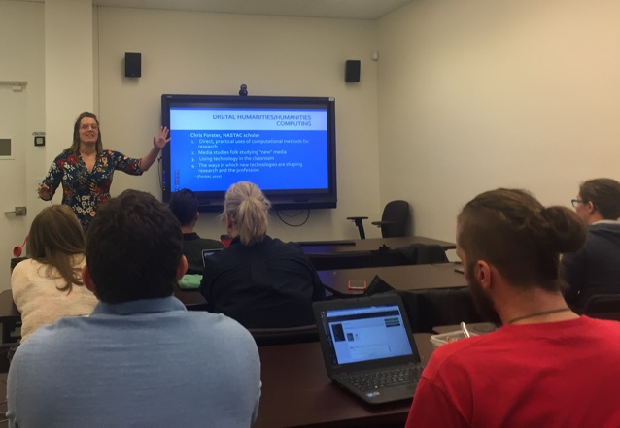
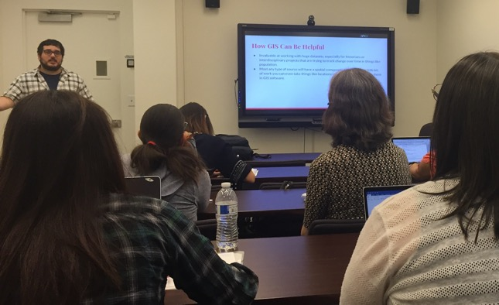
Workshops
https://gradquant.ucr.edu/programs/workshops
Two 1-hour sessions/topic
Sample of past workshops:
Introduction to R
Causal Inference
Hypothesis Testing
Correlation and Regression
ANOVA
Data Manipulation in R
Data Visualization in R
How to Use UCR LaTeX Dissertation Template
Introduction to SAS
Are we missing something? Suggest
a topic using our online form.
Notes:
Your input is stored in a human-readable plain text file. Here you write your document and give it some “instructions” on how your document should look like and how your text should be formatted.

Slide 12
Previous Workshop Recordings
https://gradquant.ucr.edu/programs/workshops/previous
Our previous workshops are available online:
Video recordings
Slides
Code and datasets
Access everything on our “Previous Workshop Resources” webpage.
UCR login is required.

Slide 13
Special Events / Guest Speakers
https://gradquant.ucr.edu/programs/special-events
Planned speakers include:
Dr. Chuck Huber, Associate Director of Statistical Outreach at StataCorp
Dr. Sara Gummert, Director of Academic Engagement at Dedoose

Slide 14
Summer Statistics and Programming Bootcamp
https://gradquant.ucr.edu/programs/statsbootcamp
8-week-long bootcamp held in July-August.
Two hours/week
Materials covered: Basics of descriptive and inferential statistics as well as some of their applications, and introduction to to Excel and R
Registration opens in the Spring Quarter.

Slide 15
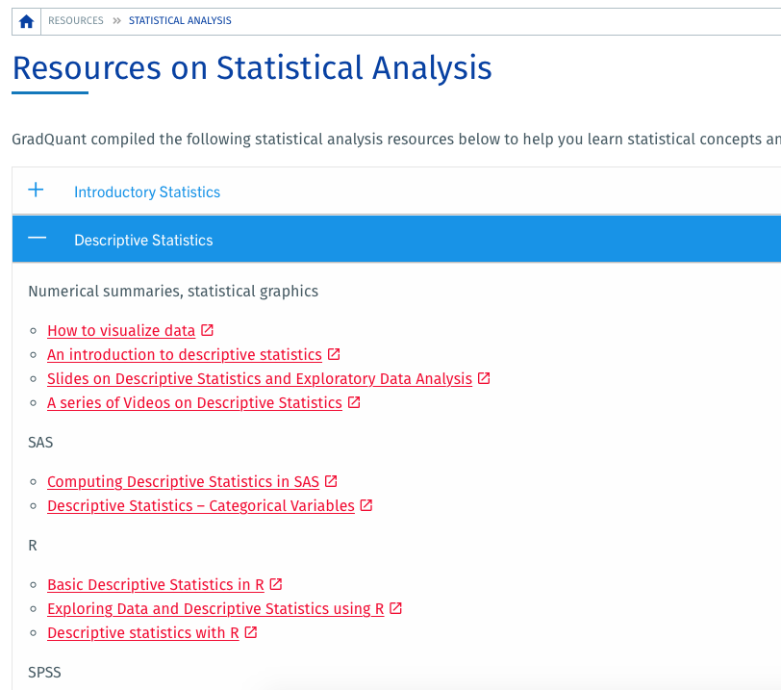
Statistics and Programming Resources
https://gradquant.ucr.edu/resources
Statistical Analysis
Statistical Software
Databases and Programming

Slide 16
Newsletters
R’Grad Weekly
GradQuant Newsletter (weekly; monthly over summer)
Read these newsletters to find out about:
Upcoming GradSuccess/GradQuant workshops and trainings
Social and wellness events
Opportunities (funding!)
GradQuant-specific workshop and event information
Info on invited speakers, trainings, and competitions
GradSuccess/GradQuant job posts
Notes:
R’Grad Weekly
Upcoming GradSuccess workshops and trainings
Social and wellness events
Opportunities (funding!)
GradQuant-specific workshop and event information
This week’s drop-in hours and consultants on duty
Info on invited speakers, trainings, and competitions
GradSuccess is hiring!

Slide 17
Social Media
Follow/Like us
@UCRGradSuccess
Tag us using #GradQuant
Notes:
Ask questions and keep track of GradSuccess events by following us on your preferred social media platform
And don’t forget to tag us using #GradQuant when you attend our events!

Slide 18
https://gradquant.ucr.edu
Contact us at gradquant@ucr.edu

