Slide 1

Graduate Student Employment
September 22, 2025
CHASS AP
Susan Brown

Slide 2
Graduate Student Employment
Academic titles in support of instruction or research are:
Research
Graduate Student Researchers (GSRs)
Instruction
Teaching Assistants
Associate Ins (Instructors)
Readers
Tutors

Slide 3
Graduate Student Employment
Students appointed to these titles will be represented by the United Auto Workers union.
Systemwide Bargaining Contracts:
https://ucnet.universityofcalifornia.edu/resources/employment-policies-contracts/bargaining-units/
An Academic Student Employee appointment is established only by the issuance of a Written Notice of Appointment and signed acceptance.
You will find eligibility requirements and workload information on the Graduate Division website: https://graduate.ucr.edu/
Graduate Student Employment Tools: https://graduate.ucr.edu/graduate-student-employment#time-and-attendance-reporting-

Slide 4
Time Reporting
Submission of monthly or biweekly timesheets is required of all Academic Student Employees through the UCR Time and Attendance Reporting System (TARS).
Employee Responsibilities
ASE/GSR Employees
Where applicable and as required by the UAW contracts, ASEs and GSRs will be required to seek prior approval for Personal Time Off and Leave of Absence.
It is the employee’s responsibility to accurately record approved leave taken and submit timesheets to their supervisor/unit head by the published deadlines.
It is the supervisor’s responsibility to accurately review and approve employee timesheets by the published payroll deadlines.
Important:
•In support of organizational excellence and to improve operational effectiveness, timely and accurate submission of time records will reduce incorrect reporting.

Slide 5
Time Reporting contd.
Monthly timesheets are required for GSRs, Teaching Assistants,and Associate Ins
Biweekly timesheets are required for Tutors and Readers
If you believe you are exceeding your appointment hours immediately inform your supervisor.
If after speaking to your supervisor you feel you are still exceeding your hours you will speak to your department administrator (Graduate coordinator, Graduate Advisor, Department Chair).

Slide 6
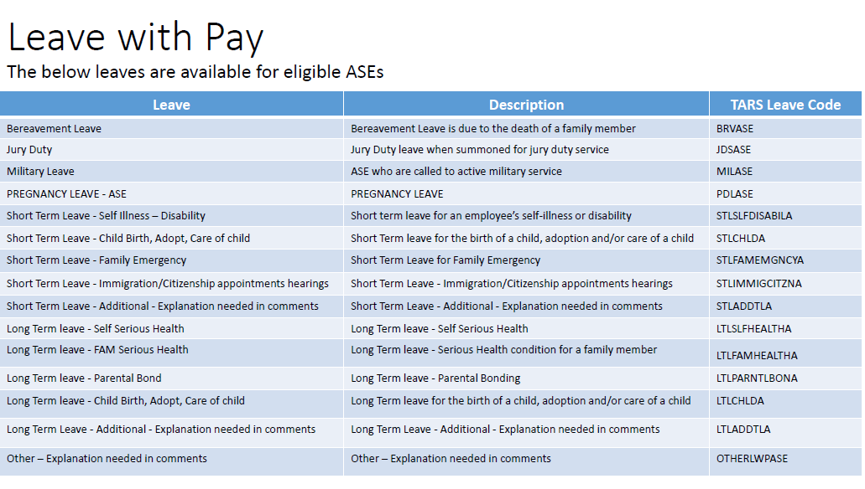
Time And Attendance (TARS)

Slide 7
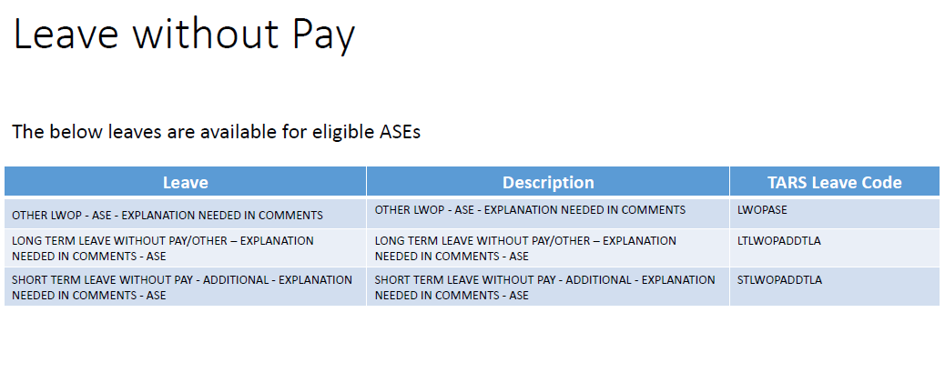
Time And Attendance (TARS) contd.

Slide 8
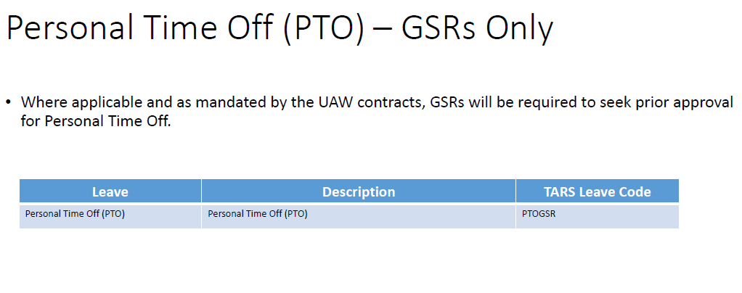
Time And Attendance (TARS) contd.

Slide 9

Short Term Leave
GSRs, Teaching Assistants and Assoc Ins with a 50% appointment who take a leave shall be eligible for up to two (2) days of paid leave for quarter Campuses. The amount of paid leave will be prorated for salaried appointments other than 50% FTE.
Upon request from an appointee, and subject to the provisions of contract, the
University will grant an appointees reasonable request for leave of absence of
appropriate duration due to:
a. personal illness and/or disability;
b. birth, adoption, or care of a child or family member as defined
below in Section H;
c. family emergencies; or
d. appointments and/or hearings scheduled by federal immigration
officials or the U.S. Department of State with respect to immigration
or citizenship status of the appointee, spouse, domestic partner, child or
parent in accordance with Article 15 - Immigration

Slide 10
Long Term Leave
Leave Eligibility
Salaried GSRs, TAs and Associate Ins who take a leave pursuant to the contract shall be eligible for up to eight (8) weeks of paid leave per academic year.
2. Upon request from appointee and subject to the provisions of this Article, the University will grant a reasonable request for long-term leave due to:
a. The appointee’s serious health condition, as defined under the Family and Medical Leave Act (FMLA), or to care for a family member of the appointee, as defined in Section H, who has a serious health condition;
b. To care for and bond with the newborn child or a child placed with the appointee for adoption or foster care, provided that the leave is taken within twelve months of the birth or placement of the child with the appointee; or
c. Pregnancy, childbirth or related medical conditions for the period prior to, during, and after childbirth.
3. Whenever possible, leave should be requested at least thirty (30) calendar days in advance of the start date of the leave. The leave will not continue beyond the end date of the appointment.
***Contact your supervisor as soon as you know of the need for a leave. ***

Slide 11
Resources
TARS: timesheet.ucr.edu
TARS User Aids: https://live-ucr-graduate.pantheonsite.io/document/asegsrjobaidpdf
Timesheet Issues Reach out to: Timesheetfeedback@ucr.edu
Bargaining contract TAs, AIs, Tutors, Readers: https://ucnet.universityofcalifornia.edu/resources/employment-policies-contracts/bargaining-units/academic-student-employees/contract/
Bargaining contract GSRs: https://ucnet.universityofcalifornia.edu/resources/employment-policies-contracts/bargaining-units/graduate-student-researchers/contract/

