Slide 1

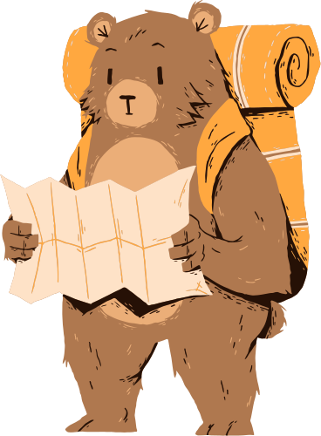
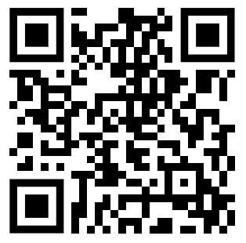
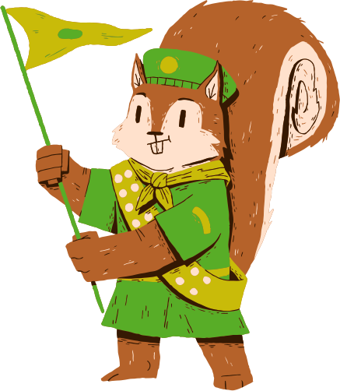


Are you lost with research, too?
Try the SEEDS-CCB mentorship program!
Get paired with a graduate student mentor!
Get advice on starting research, pursuing science careers, and more!
Scan me! Or go to
https://tinyurl.com/SEEDSCCBMenteesS25
Notes:
SHOW TO UNDERGRADS
The spiel:
If you’re interested in joining a research lab or pursuing a career in science, but don’t know where to start, you can sign up for the SEEDS-CCB mentorship program! The program pairs you with a graduate student mentor at UCR in evolution, ecology, or conservation biology for the quarter. You’ll have one-on-one meetings talking about everything from making the most of your time in undergrad to developing a professional identity. Scan this QR code to learn more!

