Slide 1
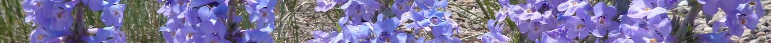
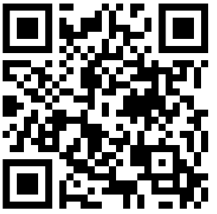
^{AMERICAN PENSTEMON SOCIETY}
APPLICATIONS SOUGHT FOR 2025 SPECIAL PROJECT GRANTS
The purpose of the APS Special Projects Program is to stimulate activities that promote knowledge and appreciation of Penstemons. The Society is particularly interested in funding projects that:
1) Promote conservation of Penstemon species in the wild, especially rare or sensitive ones, through understanding of factors that affect their survival, or
2) Promote appreciation for the diversity and beauty of Penstemons in wild and domestic landscapes, through horticultural research, dissemination of information of interest to gardeners, or the construction or enhancement of educational display gardens.
All applicants must be current members of APS, and may join APS for the purpose of submitting a proposal. Maximum award amount is $1000; in the past three years, awards have ranged from $100 to $1000. Awards are not intended to pay wages or travel to meetings. The number of successful awards in any year will be determined by the number of high-quality proposals, value of the awards, and the annual budget. Awardees are required to submit a final project report, due one year after the award is made, and provide either an article for the newsletter or the Journal, or an oral presentation at an annual meeting.
Proposal Format
Proposals should not exceed five pages, and must follow this format:
1. Project name
2. Name and contact information of submitter(s)
3. Requested funding amount
4. Objective of the project
5. Background and rationale
6. Proposed methods and timeline
7. Itemized budget
8. Description of submitters’ qualifications.
Submit proposals to Dorothy Tuthill via email (dtuthill@uwyo.edu) or mail (1487 State Highway 230, Laramie, WY, 82070) no later than March 31, 2025. Receipt of proposals will be acknowledged by email, and successful awardees will be notified no later than May 15, with disbursements made in late May.
Visit the APS website for more information.
Graduate student scholarship grant
In addition to the program described above, graduate students researching Penstemon-related topics may apply for a research grant with a maximum award of $5000. Full details of this program, including instructions for proposal submission, are available at https://penstemons.org/index.php/society/grants.
More information about the American Penstemon Society can be found at
^{https://penstemons.org.}

Slide 2
^{AMERICAN PENSTEMON SOCIETY}
APPLICATIONS SOUGHT FOR 2025 GRADUATE STUDENT SCHOLARSHIPS
The American Penstemon Society will provide one grant up to $5000 to a graduate student conducting research on the genus Penstemon. The Society is particularly interested in funding projects that promote a better understanding of Penstemon species in the wild, including biogeography, systematics, and understanding of factors that affect their survival. However, proposals need not be restricted to those areas of research; proposals will be accepted on any Penstemon-related topic.
Proposal Format
Proposals should not exceed five pages, and must follow this format:
1. Project name
2. Name and contact information of submitter
3. Requested funding amount
4. Research objective and hypotheses
5. Introduction
6. Proposed methods and timeline
7. Intellectual merit
8. Broader impacts
9. Itemized budget
10. A letter of support from a faculty advisor
Submit proposals to Dorothy Tuthill via email (dtuthill@uwyo.edu) or mail (1487 State Highway 230, Laramie, WY, 82070) no later than March 31, 2025. Receipt of proposals will be acknowledged by email, and successful awardees will be notified no later than May 15, with disbursements made in late May.
Visit the APS website for more information.
Special Projects Grants
In addition to the program described above, APS supports non-research projects that promote knowledge and appreciation of Penstemons, including public gardens and other outreach projects. Maximum award is $1000. Full details of this program, including instructions for proposal submission, are available at https://penstemons.org/index.php/society/grants.
More information about the American Penstemon Society can be found at
^{https://penstemons.org.}

