Slide 1

Fulfilling the Academic Mission: Academic Senate Survey of UC Faculty and Instructors About Their Experiences During the Pandemic, March 2020 to May 2021
Faculty Representative Mary Gauvain
Chair, UC Academic Senate
Faculty Representative Robert Horwitz
Vice Chair, UC Academic Senate
Academic and Student Affairs Committee, July 2021

Slide 2
4312 Faculty and instructors participated
Campus | Proportion of sample
Berkeley | 12%
Davis | 9%
Irvine | 6%
Los Angeles | 13%
Merced | 4%
Riverside | 8%
San Diego | 8%
San Francisco | 6%
Santa Barbara | 7%
Santa Cruz | 4%
Not identified | 24%
Academic position | Proportion of sample
Full Professor | 34%
Associate Professor | 15%
Assistant Professor | 14%
SOE/PSOE | 5%
Unit 18 Lecturer | 18%
Graduate Student Instructor of Record | 5%
Other | 9%
F
A
E
D
B
C
81% had no prior experience with online instruction
Notes:
March 2020 - Rapid switch to remote instruction
Lockdown period much longer than expected
Student enrollment and course completion held steady
Suggests remote instruction went well
How did this happen?

Slide 3
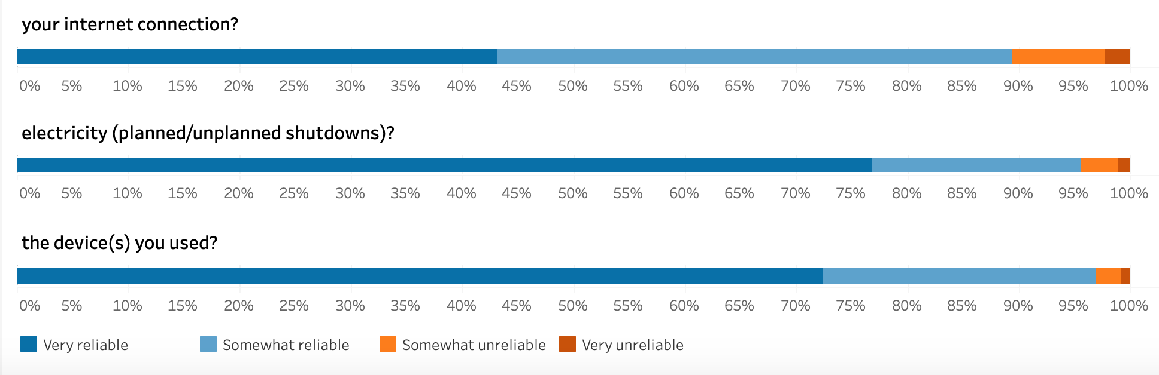
Teaching Environment During the Pandemic
Reliability of Resources and Services Used for Remote Instruction
$523.8 M
$438.5 M
05.12.2021
3

Slide 4
Teaching Environment During the Pandemic
Purchases | % reported purchase
Computer-new | 33%
Computer-upgrade | 12%
Larger monitor | 34%
Better internet | 53%
Better camera | 38%
Better lighting | 38%
Headphones | 33%
Printer | 16%
Standing desk | 17%
Ergonomic chair | 23%
Other | 45%
Who paid for it? | Average | Range
Personal funds | 50% | 39-58%
Personal + other | 38% | 33-41%
Other funds | 13% | 8-24%
Amount spent from personal funds | Proportion reporting
Over $500 | 31%
$201-500 | 21%
Less than $200 | 22%
Did not indicate | 26%

Slide 5
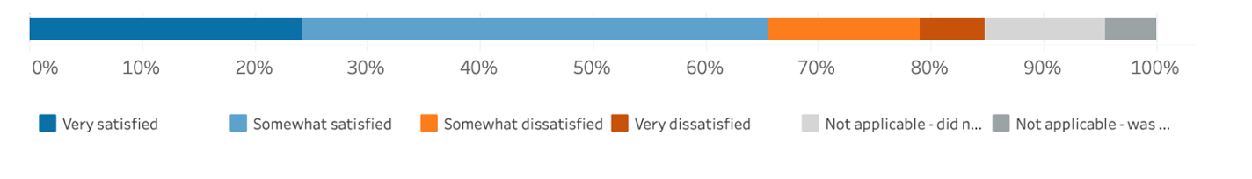
Campus resources, includes:
Learning Center
Learning Management System (LMS)
Library Services
IT Services
Satisfaction with campus resources for remote instruction

Slide 6
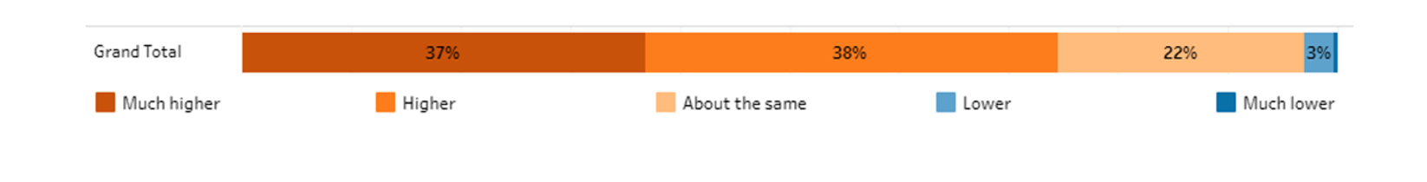
Work Conditions During the Pandemic
Faculty/instructors reported their workload was higher during
remote instruction compared to in-person classes
At-home remote instruction | Total | Men | Women
Had access to a quiet space to teach | 78% | 83% | 76%
Had obligations that affected the teaching experience | 41% | 36% | 44%
Proportion of those with obligations who identified the obligation as caregiving | 78% | 75% | 82%
Proportion of caregivers who did not have adequate assistance when teaching | 55% | 49% | 59%

Slide 7
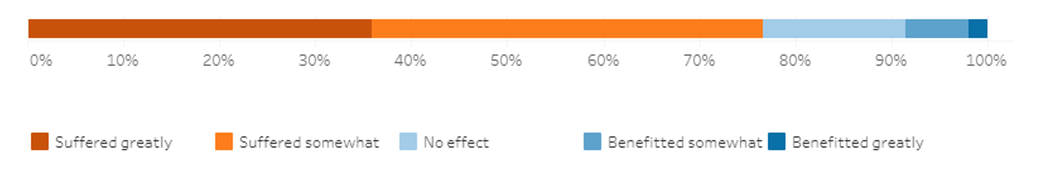
Impact on Research
Faculty reported that the last year of remote instruction had a negative impact on their research
Impact by faculty gender and rank | Suffered greatly | Suffered somewhat | No effect | Benefitted somewhat | Benefitted greatly
Men | 31% | 41% | 18% | 7% | 3%
Women | 40% | 39% | 12% | 7% | 2%
Asst. Prof. | 41% | 41% | 11% | 6% | 1%
Assoc. Prof. | 44% | 37% | 11% | 6% | 3%
Full Prof. | 31% | 40% | 19% | 8% | 3%

Slide 8
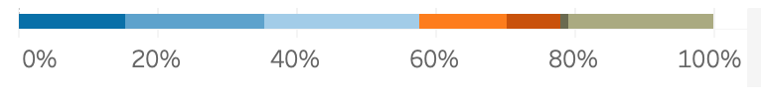

Learning Environment
On average, how would you rate synchronous class attendance in your remote courses during the pandemic?
Undergraduate students:
Graduate students:

Slide 9
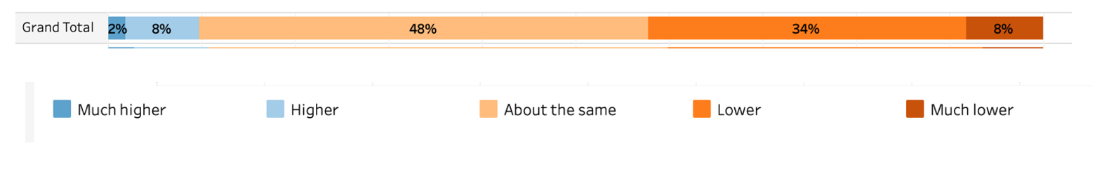
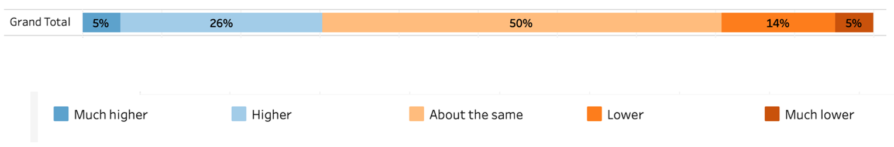
Compared to when you teach in-person, what was the learning experience like for undergraduate students during remote instruction?
Students’ understanding of course material:
Students’ perception of the academic difficulty of the course:

Slide 10
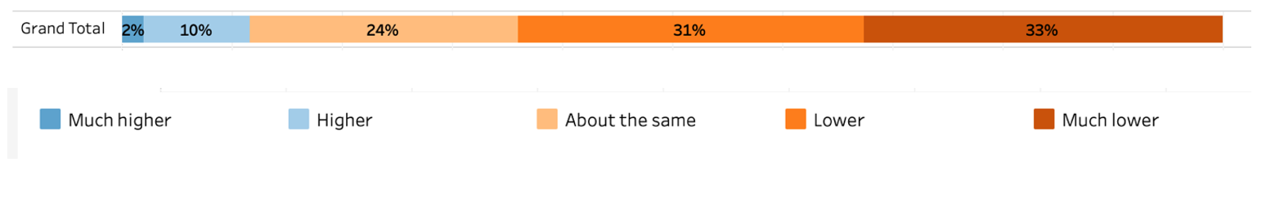
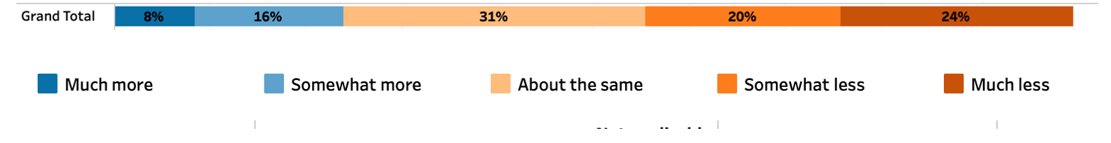
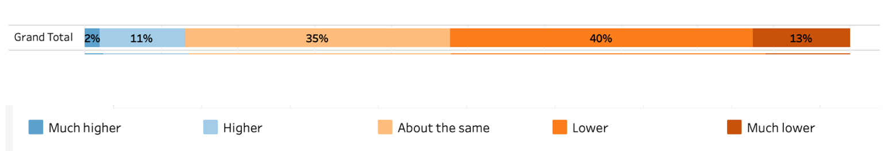
Students’ participation in synchronous lectures:
Students’ use of office hours:
Students’ satisfaction with the course:

Slide 11
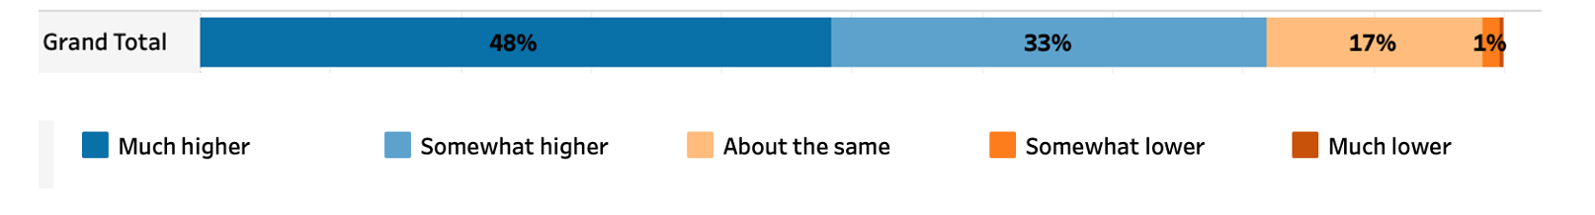
Faculty/instructors’ flexibility or willingness to make accommodations regarding class-related expectations:
Faculty/instructors’ perception of the amount of academic dishonesty (cheating) on tests and homework assignments:

Slide 12
Teaching modality preference:
Do you prefer remote or in-person instruction? | Proportion who chose this response
In-person | 70%
Remote | 16%
No preference | 14%

Slide 13
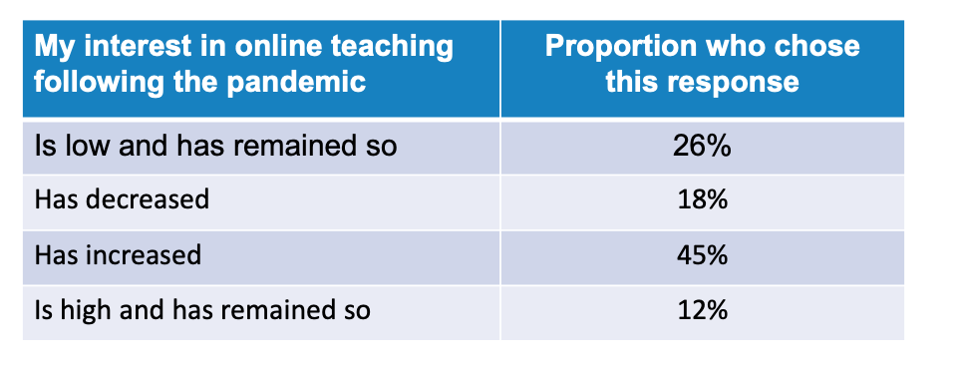
Interest in online instruction:

Slide 14
Did you notice any changes in students’ expression of hardships that prevented them from meeting deadlines or other course expectations?
Types of hardship expressed | Proportion reporting
Technical issues (e.g., computer, internet) | 85%
Scheduling issues (e.g., meeting deadlines) | 59%
Mental distress due to remote instruction | 64%
Mental distress due to pandemic/state of world | 86%
Health issues related to COVID | 65%
Family distress | 86%
Other | 21%

Slide 15
Other types of hardships expressed by students:
Stress-Related
Emotional distress
Disengagement from school
Anger over state of the world
Living Conditions
Economic difficulties
Unstable home environment
Family and friend emergencies
Schoolwork-Related
Privacy issues, esp. during exams
Too many classes/ class times conflict
Juggling work and school demands

Slide 16
Lessons Learned and Ideas for Moving Forward
Teaching
Research
Service

Slide 17
Questions and Discussion

