Slide 1

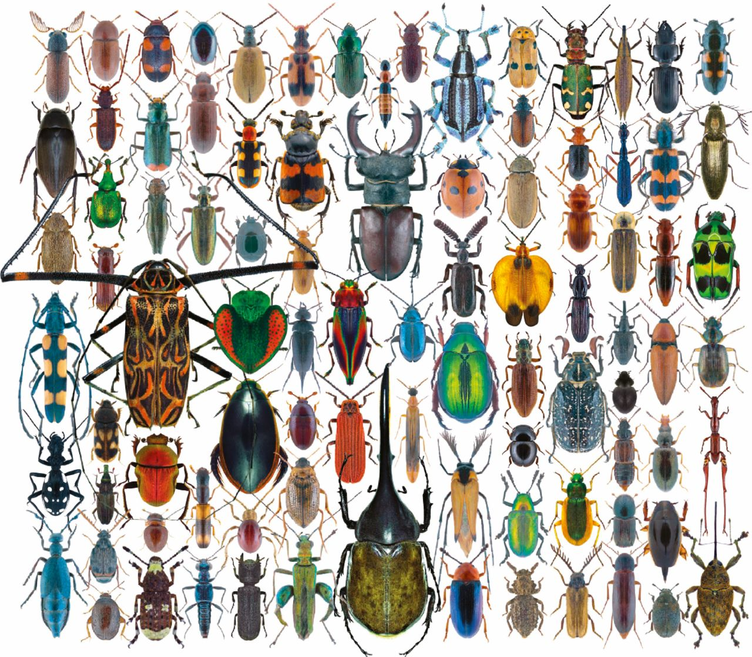
Evolution of Insect Genomes
ENTM149/249
Spring 2021
Credits: 4F
Instructor:
Dr. Allison K. Hansen
e-mail: allison.hansen@ucr.edu
-Learn genomics and bioinformatics through an evolutionary lens focusing on the most species rich group of animals, the Insects.
-Get hands on experience to explore the genomic basis of key insect innovations, such as flight, chemoreception, sociality, pesticide resistance, and host plant specialization
-No coding experience needed
Insect Image credit:
Udo Schmidt

